Slide 1
13/09/2021
LO: To use place value
C: Number line to 100

Slide 2
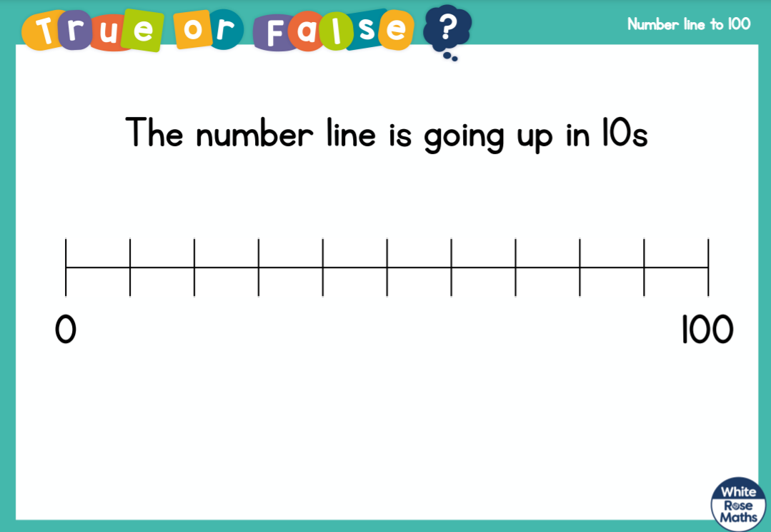

Slide 3
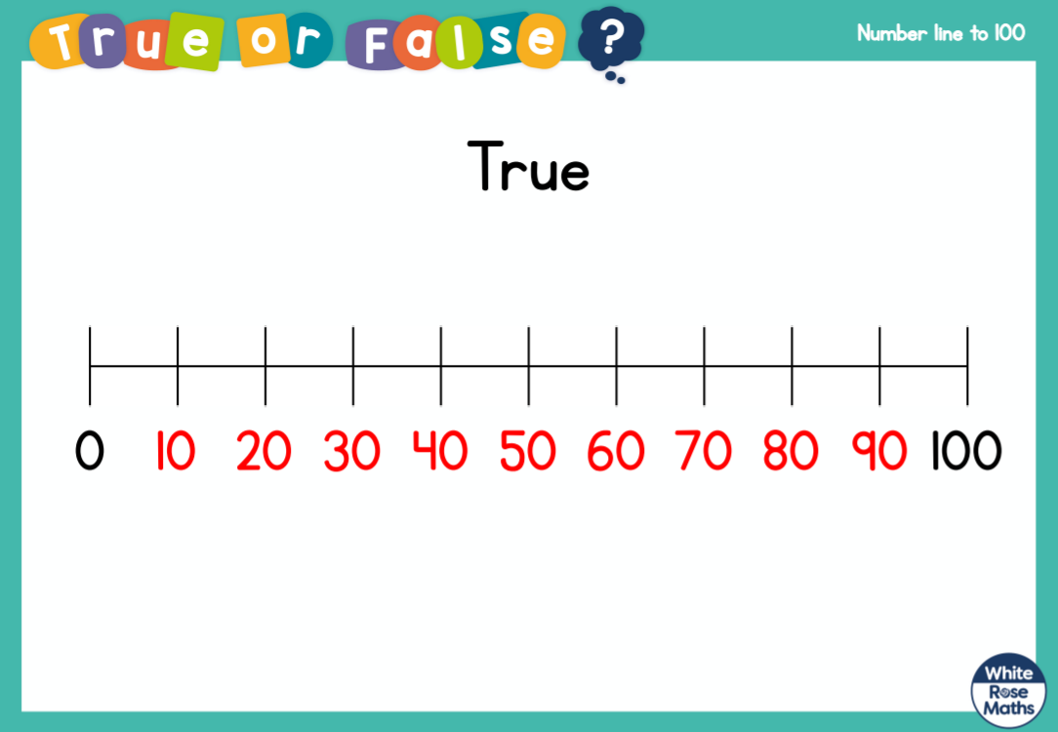

Slide 4


Slide 6
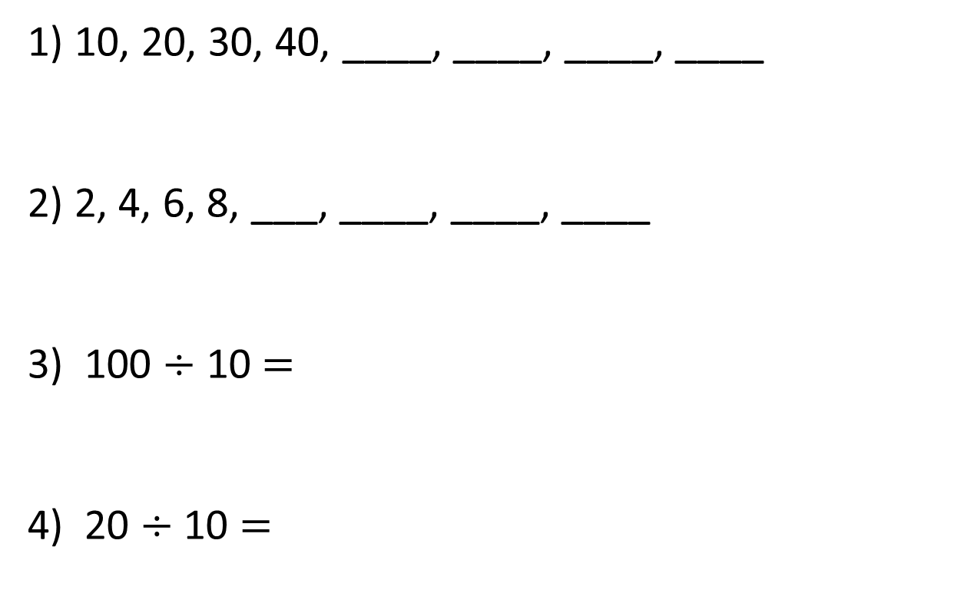
1) 10, 20, 30, 40, ____, ____, ____, ____
2) 2, 4, 6, 8, ___, ____, ____, ____
3) 100 $÷$ 10 $=$
4) 20 $÷$ 10 $=$

Slide 7
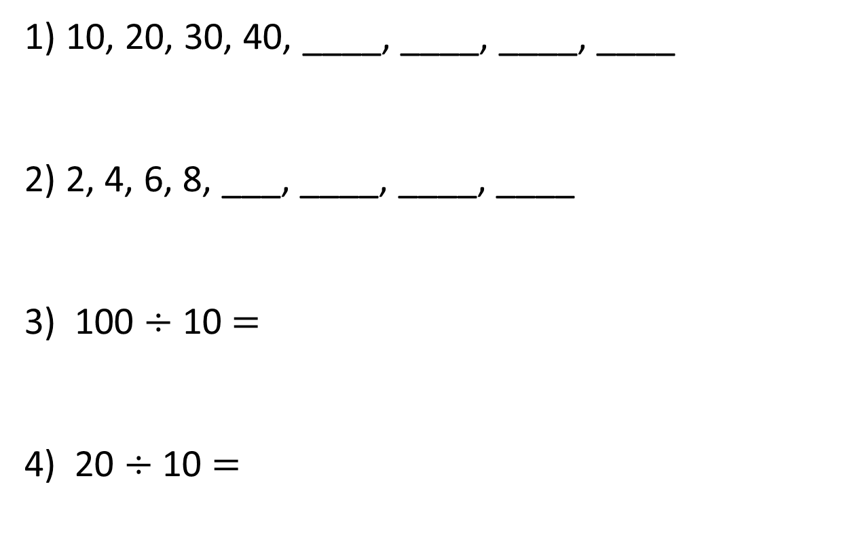
1) 10, 20, 30, 40, ____, ____, ____, ____
2) 2, 4, 6, 8, ___, ____, ____, ____
3) 100 $÷$ 10 $=$
4) 20 $÷$ 10 $=$
50
60
70
80
10
12
14
16
10
2

Slide 9








Complete the number line.
$−$ 10
$−$ 10
$+$ 10
$+$ 10
$+$ 10
$+$ 10
$+$ 10
$+$ 10
0
10
20
30
40
50
60
70
80
90
100

Slide 10








Complete the number line.
$−$ 5
$−$ 5
$+$ 5
$+$ 5
$+$ 5
$+$ 5
$+$ 5
$+$ 5
0
5
10
15
20
25
30
35
40
45
50

Slide 11
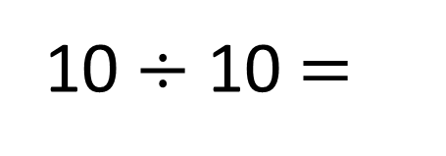
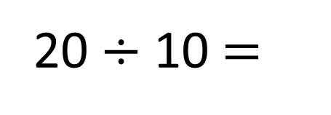
Complete the number lines.
20
0
2
4
6
8
10
12
14
16
18
20
20 $÷$ 10 $=$
2
10
10
11
12
13
14
15
16
17
18
19
20
10 $÷$ 10 $=$
1

Slide 12
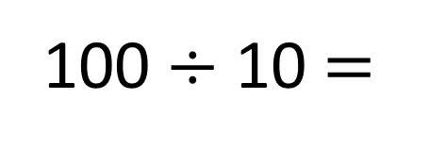
Write the missing numbers.
20
85
0
10
20
50
80
90
100
100
100 $÷$ 10 $=$
10

Slide 13
Estimate the numbers indicated by the arrows.
47
74
0
10
20
30
40
50
60
70
80
90
45
75
100

