Slide 1
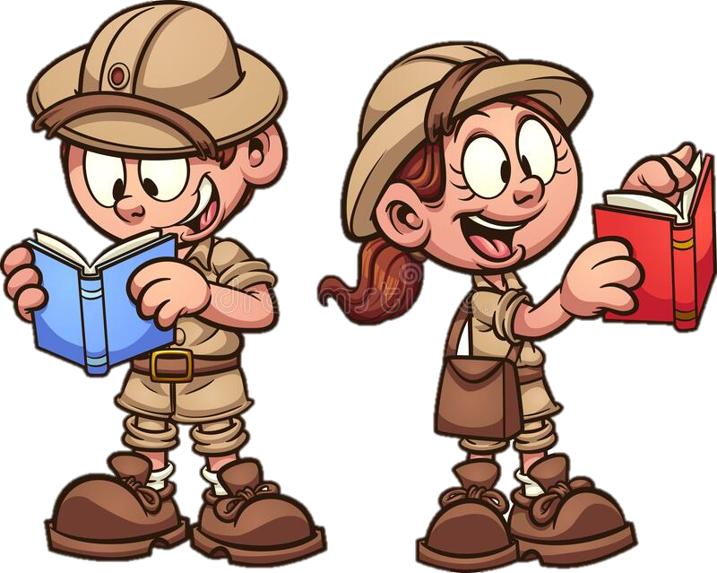
Monday 20th September 2021
LO: To practice adverbials
C: Finding Something Tale

Slide 2
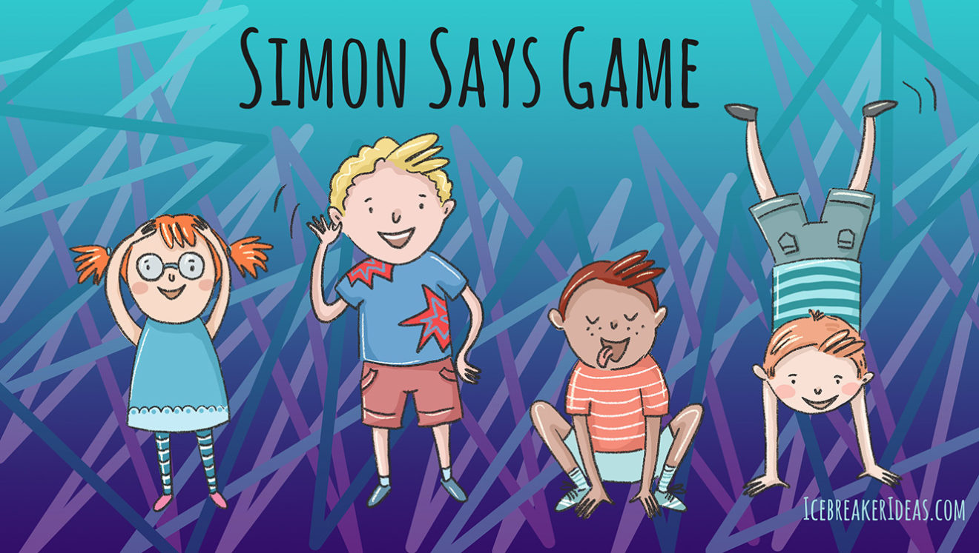
First let’s play a game!

Slide 3
Our first type of adverbial is an adverbial of manner.
This describes how you are doing something (a verb).
E.g. Jasper tentatively picked up the amulet.

Slide 4
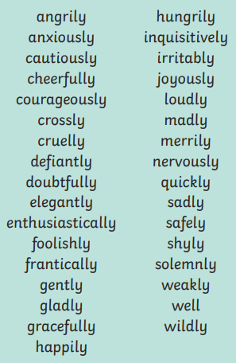
Let’s look at some examples.
Who can use one of these in a sentence?

Slide 5
Your first task is to label your pictures with 3 adverbials of manner you think are best fitting.

Slide 6
Our first type of adverbial is an adverbial of time.
This describes when something is happening.
E.g. As he reached the entrance of the tomb, Jasper started feeling anxious.

Slide 7
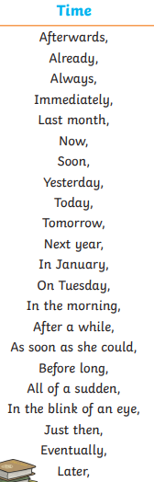
Can you spot a pattern between these adverbials?

Slide 8
Let’s see if we can make some even better adverbials which match our Egyptian Story?

Slide 9
Your next task is to label your pictures with 2 adverbials of time you think are best fitting.

