Slide 1

Wednesday 22nd September 2021
LO: To practice compound sentences.
C: Finding Something Tale

Slide 2
First, let’s watch a video!
https://www.youtube.com/watch?v=7c1Gbo-BvKo&t=131s

Slide 3

Getting Started
What is a simple sentence?
A simple sentence is a group of words that expresses one complete thought. Every simple sentence must contain a subject and a verb.
Can you spot the subjects and the verbs in this simple sentences?
Ewan likes ice cream.
subject
verb
Shamil likes yoghurt.
subject
verb

Slide 4



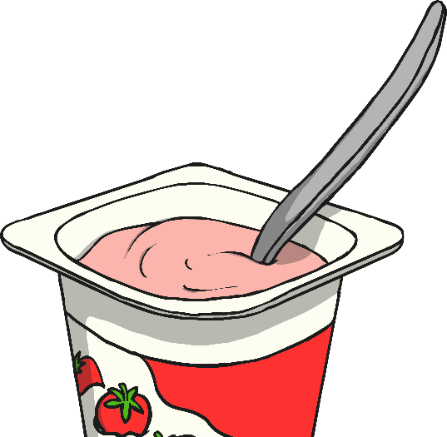
Getting Started
Both of these simple sentences make sense on their own.
Ewan likes
ice cream.
Shamil likes yoghurt.
and
When we link them together with a conjunction, they form a compound sentence.

Slide 5
Getting Started
There are seven conjunctions that we could use:
for
and
nor
but
or
yet
so
Ewan likes
ice cream.
?
Shamil likes yoghurt.
Which co-ordinating conjunctions could we use to link these two sentences?

Slide 6
Next Steps
for
and
nor
but
or
yet
so
It was time for maths.
?
My pencil broke.
Which conjunctions could be used to link these two simple sentences to create a compound sentence?

Slide 7

Next Steps
for
and
nor
but
or
yet
so
Millie had lots of friends.
?
He was a friendly boy.
Which co-ordinating conjunctions could be used to link these two sentences to create a compound sentence?

Slide 8
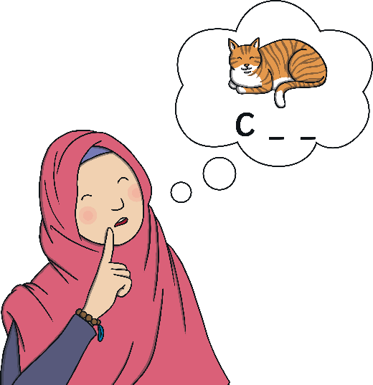
Next Steps
for
and
nor
but
or
yet
so
Sally practised her spelling words.
?
She got full marks in
the test.
Which conjunctions could we use to link these two sentences to create a compound sentence?

Slide 9
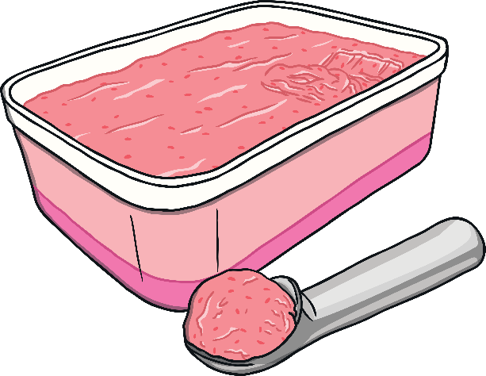
Next Steps
for
and
nor
but
or
yet
so
You can choose chocolate ice cream.
?
You can choose strawberry
ice cream.
Which conjunctions could we use to link these two sentences to create a compound sentence?

Slide 10
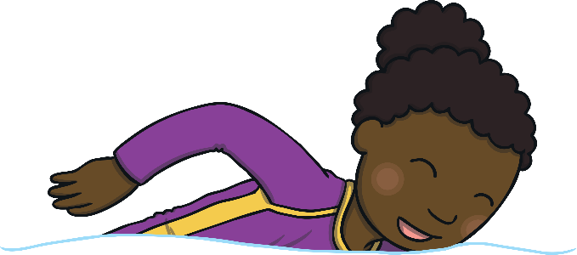
Next Steps
for
and
nor
but
or
yet
so
?
You can’t jump in the pool.
You can go swimming.
Which conjunctions could we use to link these two sentences to create a compound sentence?

Slide 11

Next Steps
for
and
nor
but
or
yet
so
Ryan didn’t want to be late.
?
He hurried
to school.
Which conjunctions could we use to link these two sentences to create a compound sentence?

Slide 12
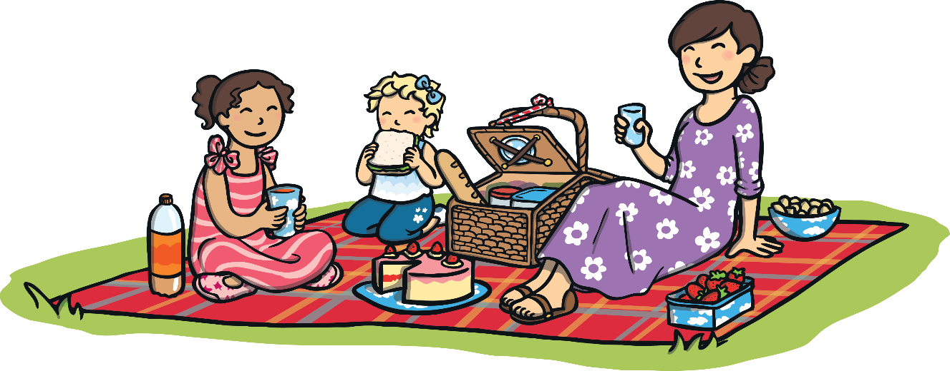
Compound Sentence Hunt
Can you spot the compound sentences in this text?
Which conjunctions have been used?
It was a hot, sunny day and the park was very busy.
Izaac played on the swings but he didn’t go on the slide. It was too scary. It was soon dinner time so Dad got out their picnic. Izaac could have ham sandwiches or he could have cheese sandwiches.

Slide 13
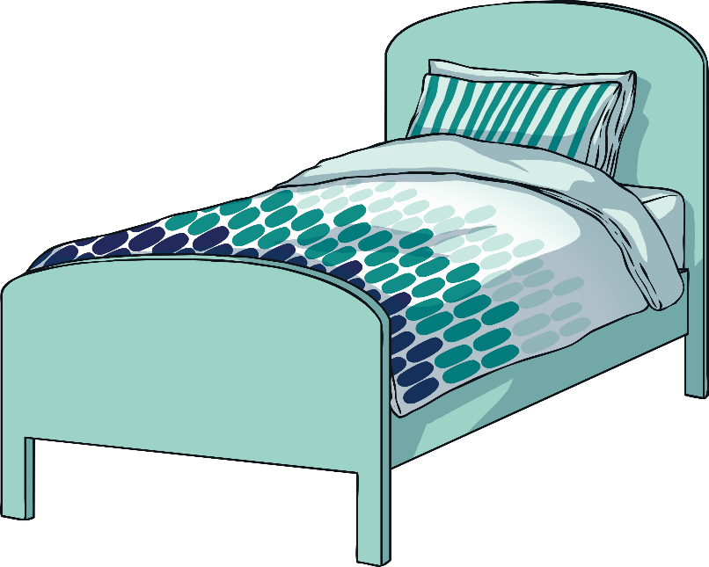
Practise Your Skills
Now, it’s your turn. How could you add a conjunction and another simple sentence to create a compound sentence?
My bed
was very comfortable.
for
and
nor
but
or
yet
so
?

Slide 14
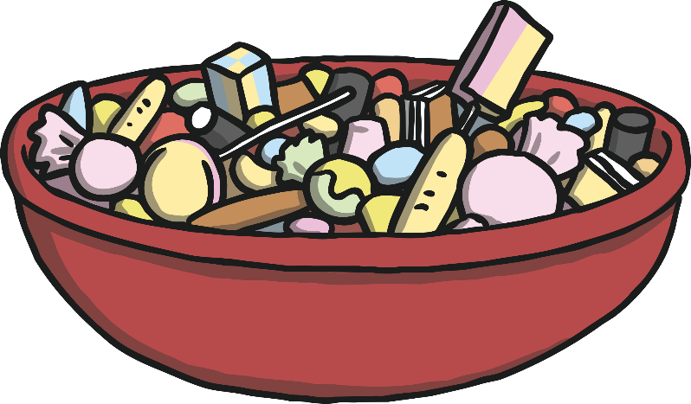
Practise Your Skills
How could you add a conjunction and another simple sentence to create a compound sentence?
for
and
nor
but
or
yet
so
I love to eat lollies.
?

Slide 15
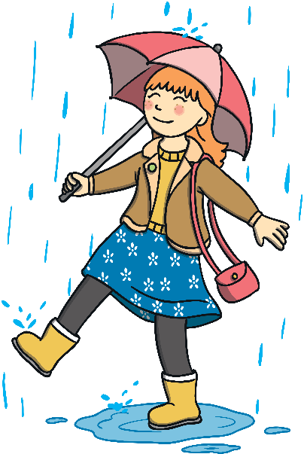
Practise Your Skills
How could you add a conjunction and another simple sentence to create a compound sentence?
for
and
nor
but
or
yet
so
?
I played in the rain.

Slide 16

Practise Your Skills
How could you add a co-ordinating conjunction and another main/independent clause to create a compound sentence?
There was a loud bang.
for
and
nor
but
or
yet
so
?

Slide 17
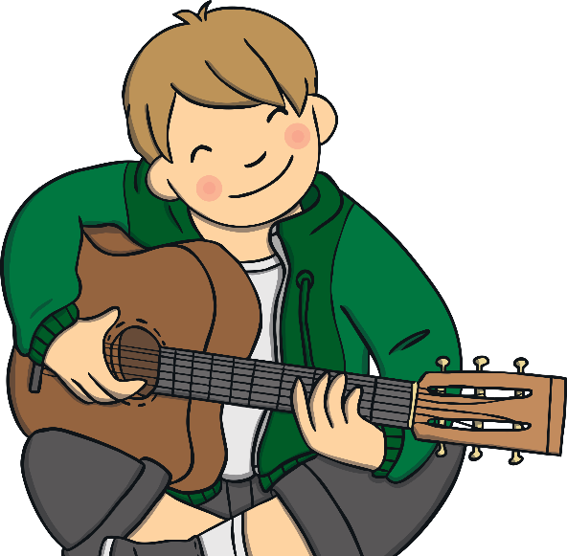
Quick Quiz: Question 1
Can you find the conjunctions in these compound sentences?
a) Freya was carrying a drink but she suddenly dropped it.
b) Omar was a fantastic chess player for he played every day.
c) Nico dreamed of being a musician so he had guitar lessons.

Slide 18
Quick Quiz: Question 2
Complete the sentences below by writing the conjunctions from the box in the correct places to form compound sentences. Use each conjunction only once.
or
but
and
You can bring a snack on the excursion but
don’t bring chips.
Would you like to sit next to Meg or would you
like you own seat on the bus?
Make sure you remember your packed lunch and try to
remember a warm coat.

Slide 19

Quick Quiz: Question 3
Can you remember all of the conjunctions that you can use to make co-ordinating conjunctions?
for
and
nor
but
or
yet
so

Slide 20
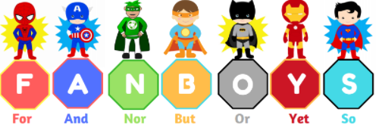
You are going to complete your own compound sentence sheet now!

