Slide 1
Computing autumn 1
Lesson 1

Slide 2
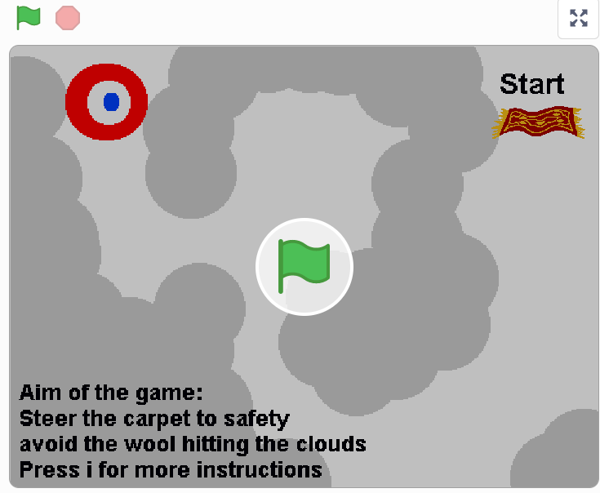
Spend some time playing this game
https://scratch.mit.edu/projects/140138686/
What does the game do? How does it work? What is the aim of the game?

Slide 3
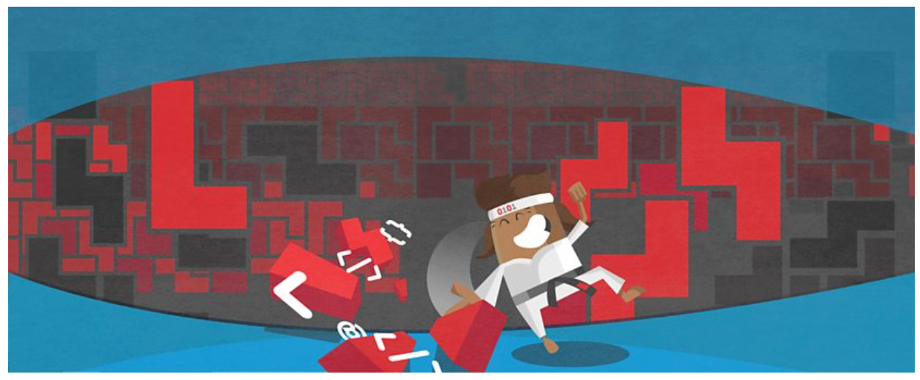
Now we are going to decompose the game.
What is decomposition?
https://www.bbc.co.uk/bitesize/topics/zs7s4wx/articles/z8ngr82

Slide 4
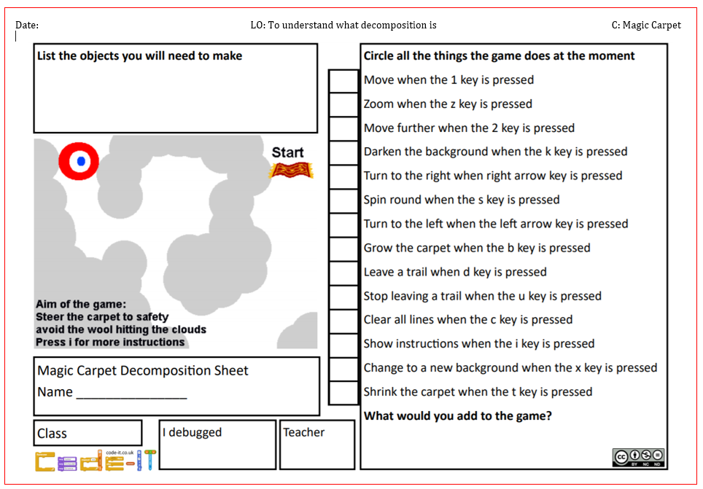
Using the decomposition sheet, can you work out what this game can and cannot do?

Slide 5
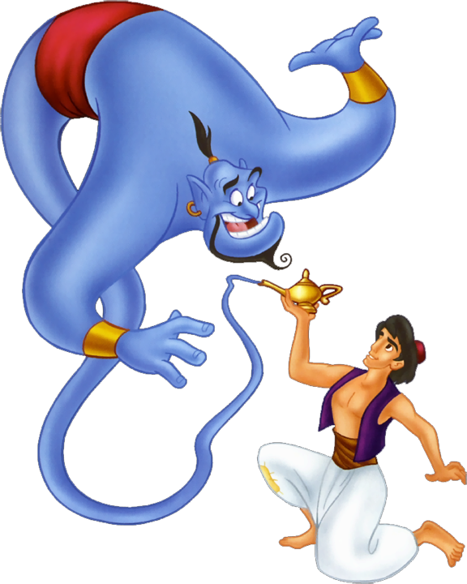
Is there anything the game cannot do but you wish it could?

