Slide 1

Friday 24th September 2021
LO: To write a problem.
C: Finding Something Tale

Slide 2

Can you edit yesterday’s work with red pen?

Slide 3
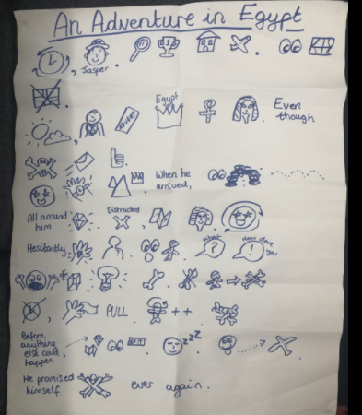
First, let’s recap the problem of our Jasper Story!

Slide 4

First you need to create some suspense to engage your reader...

Slide 5
Oh no! Now something is about to go wrong!

Slide 6
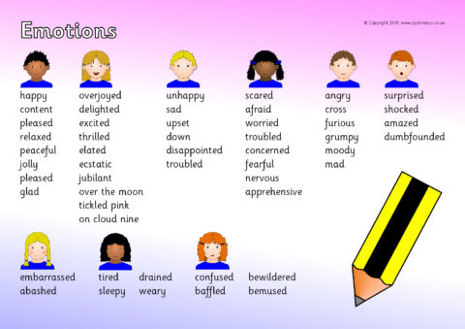
How is your character feeling?

Slide 7
Plenary: Can you read your problem section in an expressive way?

