Slide 1
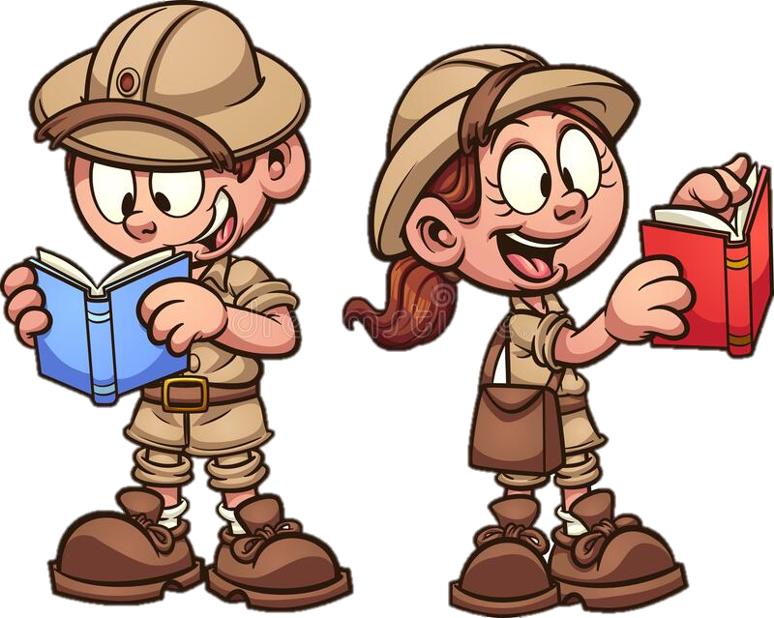
Thursday 23rd September 2021
LO: To write a build up.
C: Finding Something Tale

Slide 2
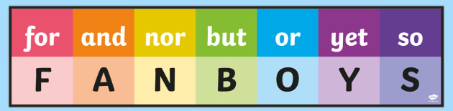
Who can use their grammar skills from yesterday to share a compound sentence?

Slide 3
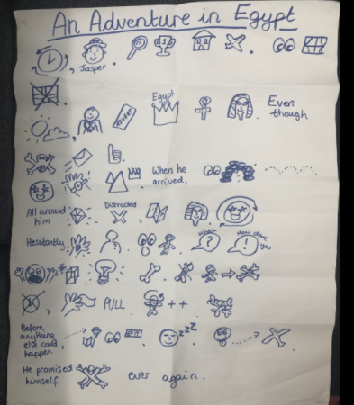
Next, let’s recap the build up of our Jasper Story!

Slide 4
Today we are going to write the build up of our story!
In the build up, our character explores the tomb and finds their treasure.

Slide 5
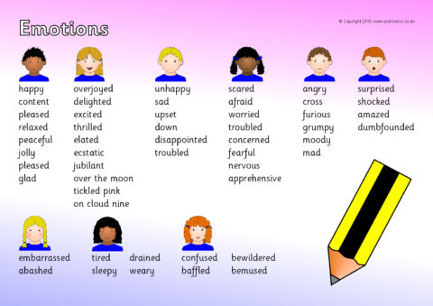
First your explorer needs to arrive at the tomb. How are they feeling?

Slide 6
Next they need to explore the tomb! Maybe they can use one of their tools.

Slide 7
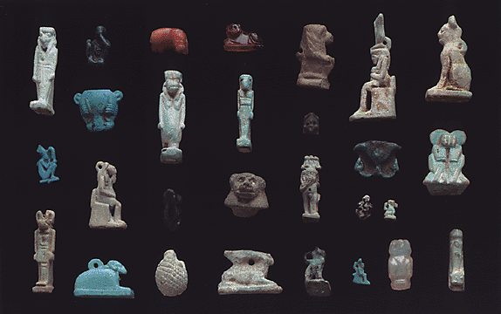
Finally they need to find their treasure! How does your character feel?

Slide 8
Plenary: Can you make sure you haven’t used any word jail emotion words?

