Slide 1

Thursday 23rd September 2021
L.O: To infer a character’s feelings.
C: Let’s do the Pharaoh!

Slide 2
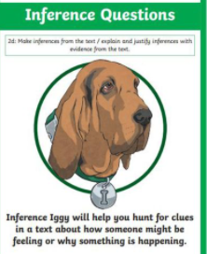
We are going to use our Inference Iggy skills today to infer a character’s thoughts and emotions!

Slide 3

Thinking question:
How does it feel to be left out or abandoned?

Slide 4
Let’s read the rest of chapter 6.
I would like you to focus on how Senny, Serraphina and Carrie might be thinking and feeling.

Slide 5

Hot-Seating!

