Slide 1
Tuesday 30th March 2021
LO: To understand beliefs and teachings.
LO: To reflect
C: Christianity –The Easter Story

Slide 2
What emotions do we associate with Palm Sunday, Good Friday and Easter Sunday?
There was hope on Palm Sunday when Jesus arrived as King - the people were expecting God to rescue them and restore their land.
There was sadness on Good Friday when their King was killed and everything seemed lost.
There was joy on Easter Sunday when Jesus was alive.

Slide 3
What do Christians believe these days brought us?
Christians believe Jesus was resurrected, brought back to new life, not to be on earth but to be with his Father, God. This gives Christians hope that when they do things wrong they can be forgiven, and that when they die they will go to heaven.

Slide 4
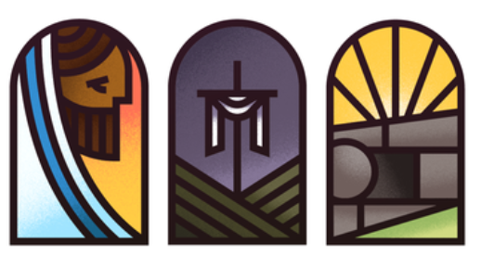
This is a triptych
(what does tri mean?)
What is this triptych representing?
What emotions is it showing?

Slide 5
What is this triptych representing?
What emotions is it showing?

Slide 6
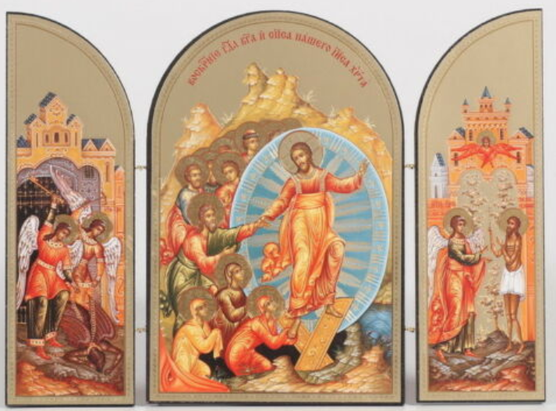
What is this triptych representing?
What emotions is it showing?

Slide 7
Task
Create a triptych for Holy Week with the the left frame showing hope, the centre frame showing sadness, and the right frame showing joy.
Underneath write what you have drawn for each emotion.
Snorkelling and Diving – as above then come and see me for the next task

