Slide 1
Friday 3rd December 2021
L.O: To write with purpose
C: Aspect 1

Slide 2
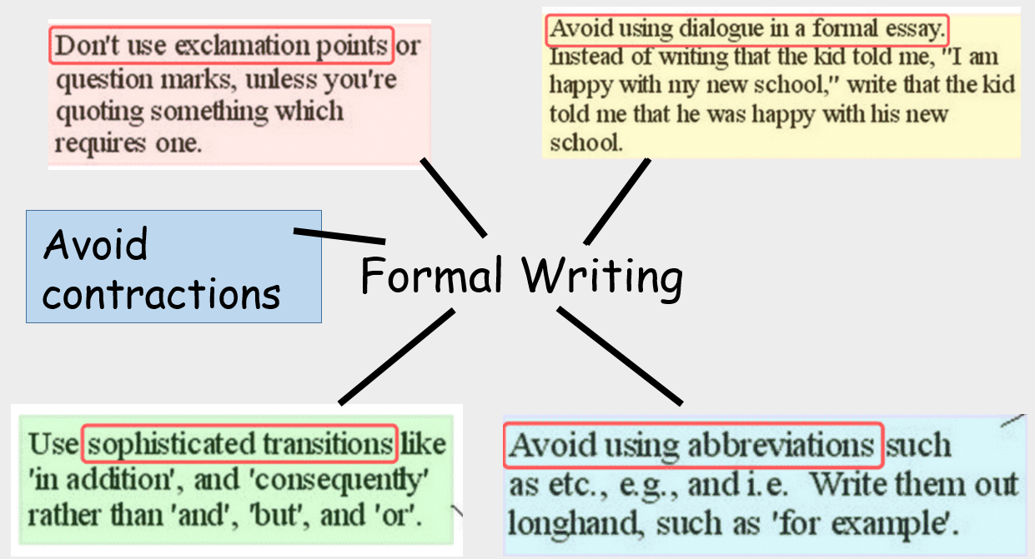

Slide 3
Let’s look at the section.
What is your subheading going to be?
This needs to be written and underlined with a ruler. It should be at the side of the page and not central like the heading is!

Slide 4
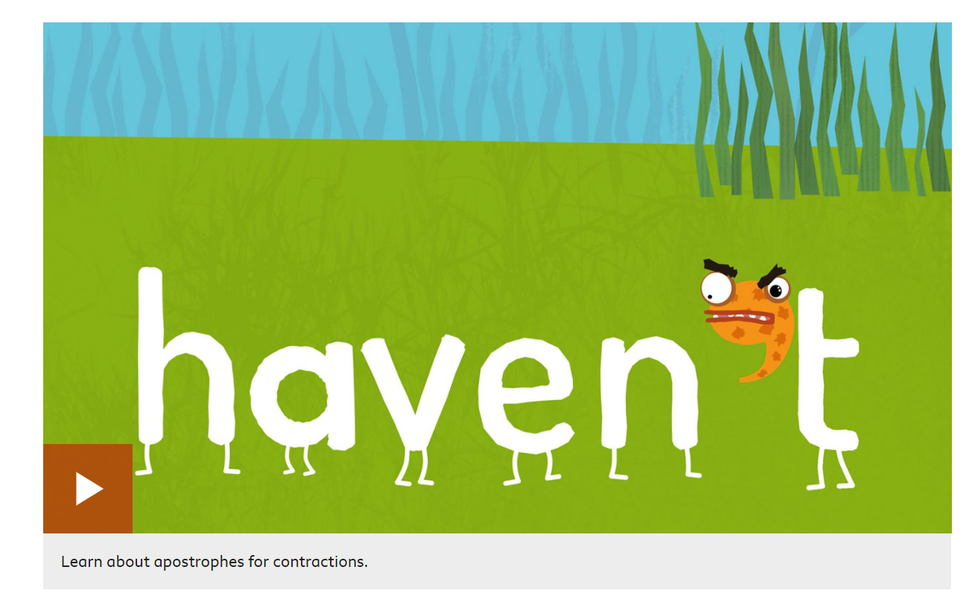
How to use apostrophes in contractions
- BBC Bitesize

Slide 5
On your sheet, expand the following contractions:
aren’t
can’t
didn’t
don’t
he’ll
I’m
what’s

Slide 6
aren’t – are not
can’t- can not
didn’t- did not
don’t- do not
he’ll- he will
I’m- I am
what’s- what is

Slide 7
It is time to write your first paragraph!
Remember you need a subheading! This could be a questions E.g How did the Ancient Egyptians build pyramids?
Remember....

