Slide 1
Thursday 2nd December 2021
L.O: To write with purpose
C: Topic sentence

Slide 2
Look carefully at your knowledge organiser, what is the first thing we need to write about?
What should we include in our topic sentence?

Slide 3
All
Most
Some
Sentence to end

Slide 4
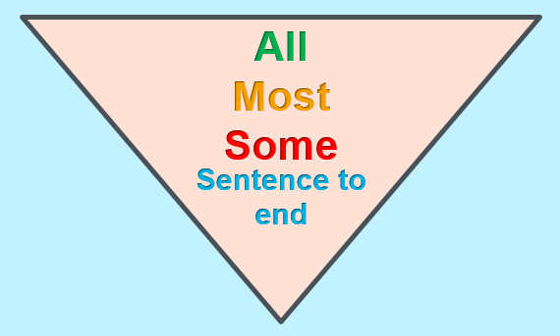
EXAMPLE
Cats can be found all across the world. Most cats are domestic creatures, residing as pets. Some cats however, such as the Borneo Bay cat, prefer to live in the wild. Little is known about this amazing creature.

Slide 5
Gods and Goddesses
Different religious beliefs can be found all across the world. Most people follow one religion or belief. Some people, like the Ancient Egyptians, believe in lots of different Gods and Goddesses. The Ancient Egyptians worshipped over two thousand Gods.

Slide 6
River Nile
All across the world are different rivers. Historically, people lived along the rivers in most countries as they were a source of water. For some people, the river is considered sacred. The longest river in Egypt is the River Nile.

Slide 7
Have a go at writing your own topic sentence.

