Slide 1
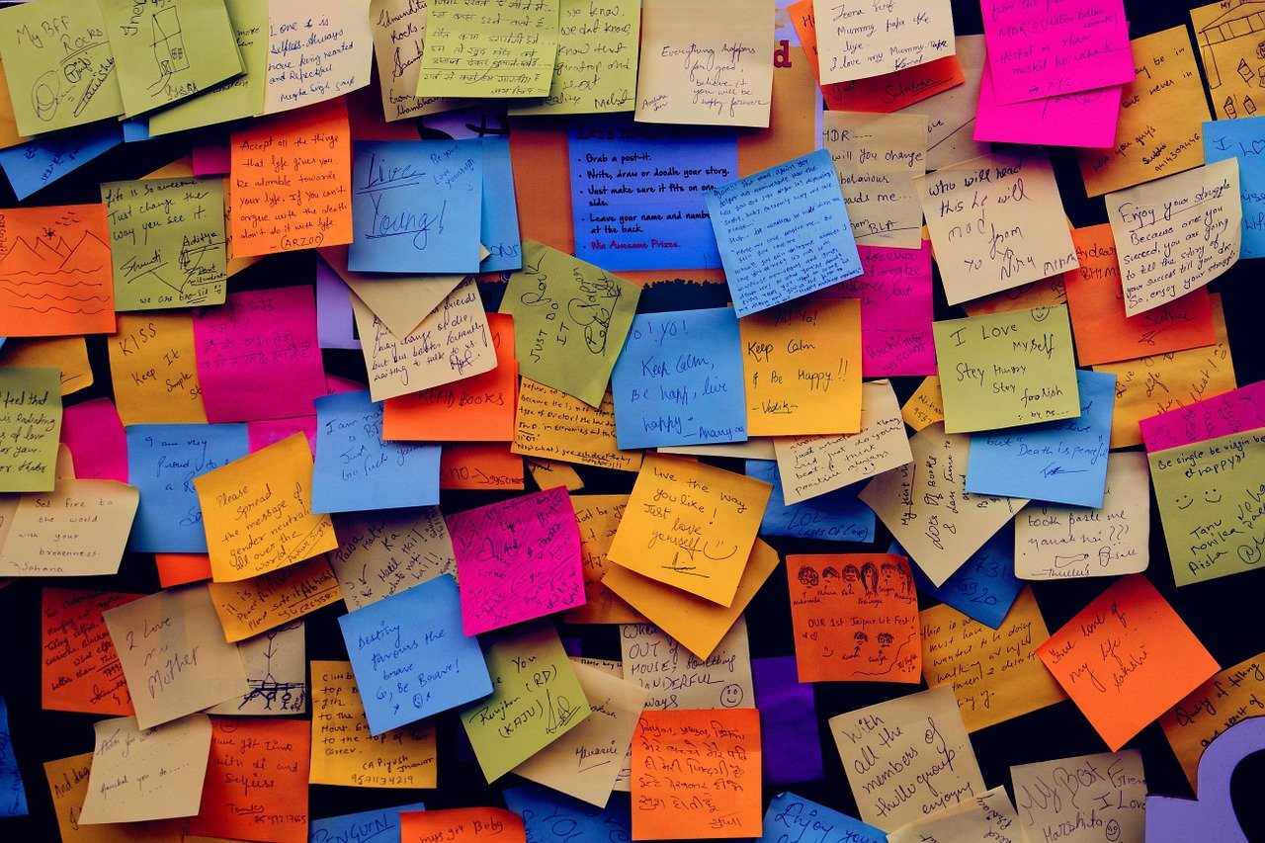
Note down everything you know about the Ancient Egyptians on your whiteboard!

Slide 2
Let’s put our notes into a bubble map!
The Afterlife
Ancient Egyptians
Mummification - prayers, amulets, natron salt, forty days
The Book of the Dead - prayers, spells and messages
Are there any areas you need to research further?

