Slide 1
Watch the video before beginning

Slide 2
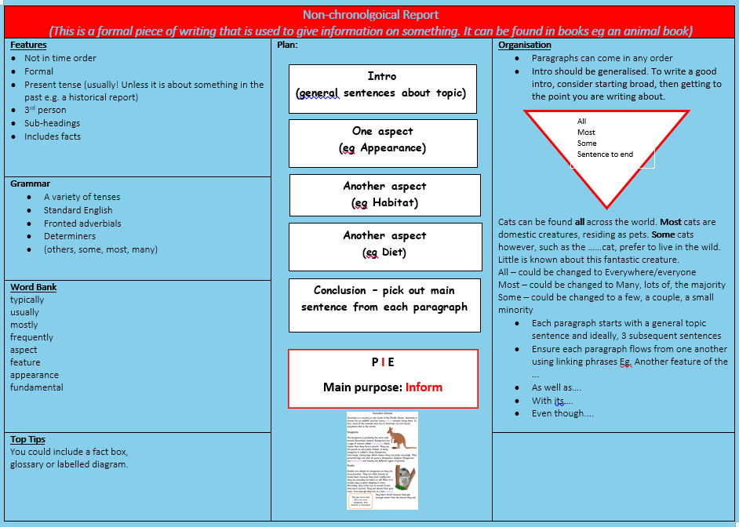

Slide 3

Non-chronological Reports
Have a think!
Are you currently reading one?

Slide 4

Here is an example
https://www.oxfordowl.co.uk/for-home/library-page/?query=Colour+Codes

Slide 5
Who thinks they might be reading one now?

Slide 6




What do all of these types of texts have
in common?

Slide 7
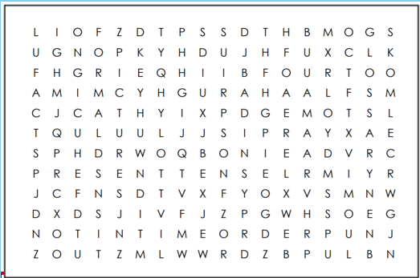
All the features of this type of text are hidden in the Word Search.
Can you find them all?

