Slide 1


Slide 2
Year 3 | Week 8 | Day 5

Slide 4


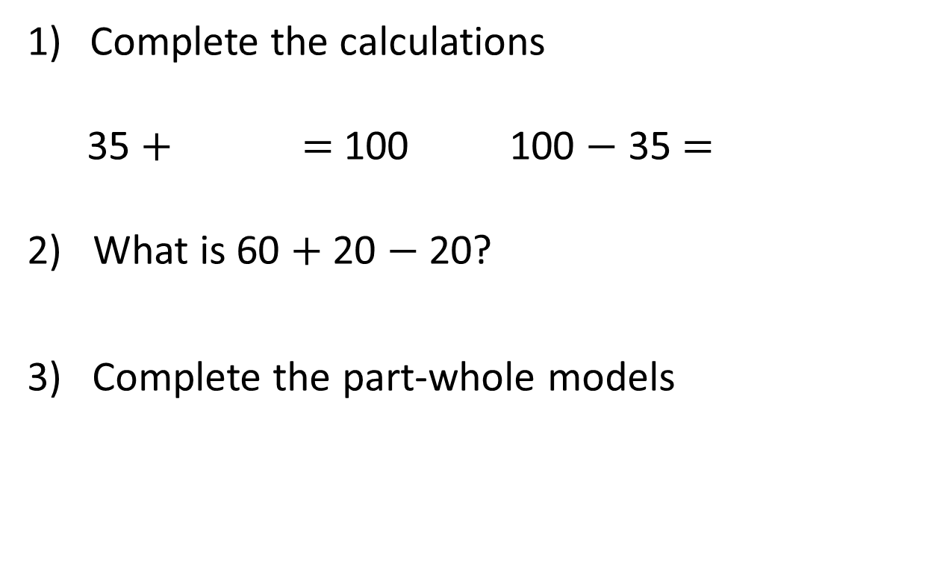
Complete the calculations
35 $+$ $=$ 100 100 $−$ 35 $=$
2) What is 60 $+$ 20 $−$ 20?
3) Complete the part-whole models
400
180
180
20
400

Slide 5
Complete the calculations
35 $+$ $=$ 100 100 $−$ 35 $=$
2) What is 60 $+$ 20 $−$ 20?
3) Complete the part-whole models
65
65
60
400
220
180
180
200
20
400

Slide 7
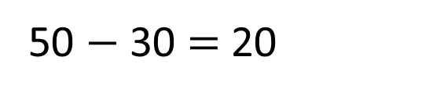
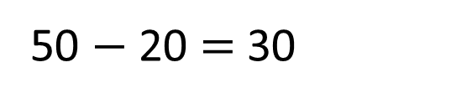
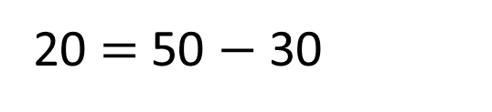
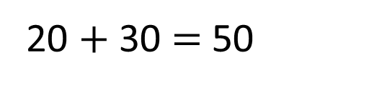
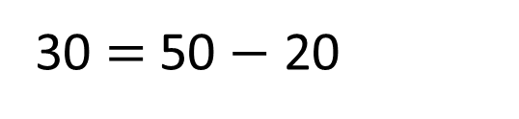
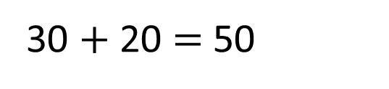
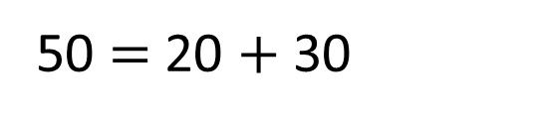
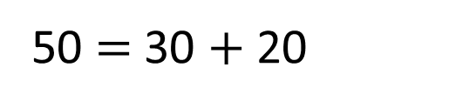
50
v
20
30
30 $+$ 20 $=$ 50
50 $=$ 30 $+$ 20
20 $+$ 30 $=$ 50
50 $=$ 20 $+$ 30
50 $−$ 20 $=$ 30
30 $=$50 $−$ 20
50 $−$ 30 $=$ 20
20 $=$ 50 $−$ 30

Slide 8




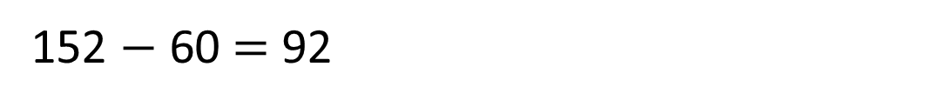
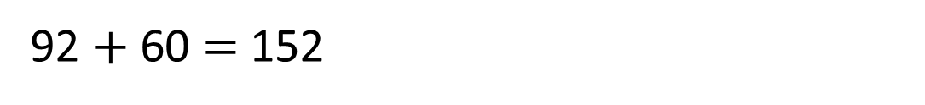
Complete the bar model.
152
v
60
92
152 $−$ 92 $=$ 60
I think that’s correct.
I will add 92 and 60 to check.
92 $+$ 60 $=$ 152
I will subtract 60 from 152 to check.
152 $−$ 60 $=$ 92

Slide 9



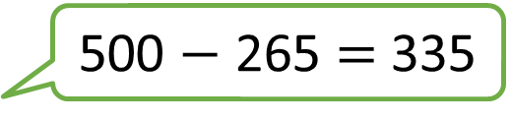
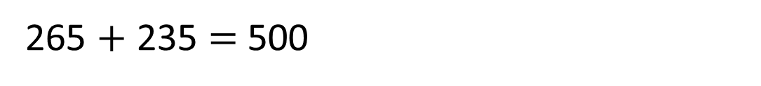

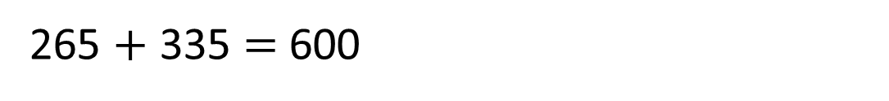
500 $−$ 265 $=$ 335
Have a think
265 $+$ 335 $=$ 600
265
500 $−$ 265 $=$ 235
500
265 $+$ 235 $=$ 500
235
Rosie is correct
Who is correct?
Use an addition to check each answer.

Slide 10
Have a go at questions
1 and 2 on the worksheet

Slide 11
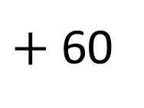
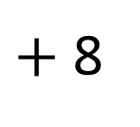
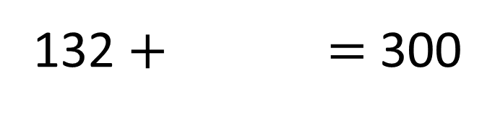
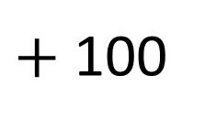
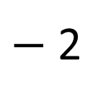
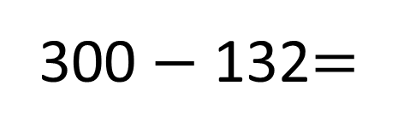
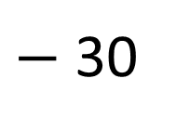
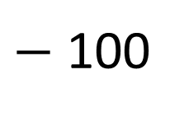
300 $−$ 132=
168
$−$ 2
$−$ 30
$−$ 100
168
170
200
300
168
132 $+$ $=$ 300
$+$ 8
$+$ 60
$+$ 100
132
140
200
300

Slide 12
Have a go at questions
3 and 4 on the worksheet

Slide 13

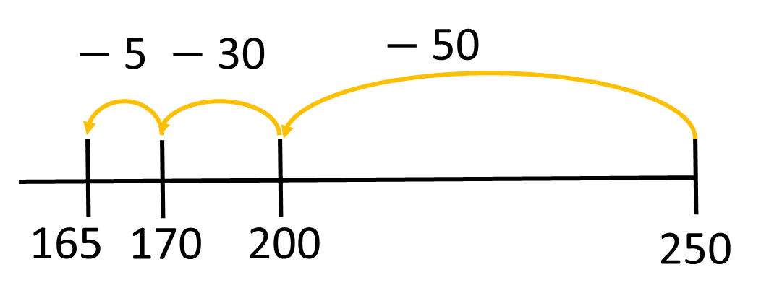
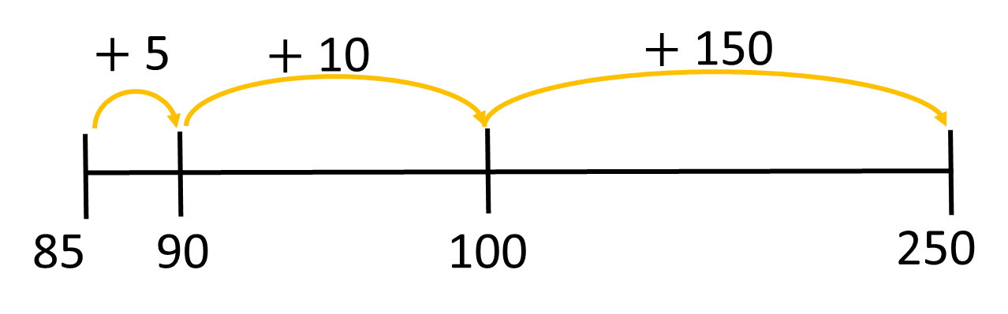
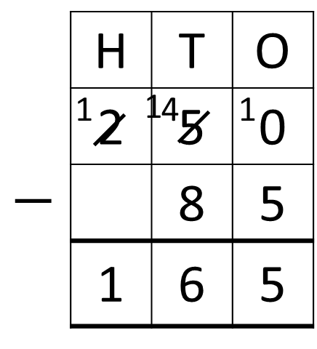
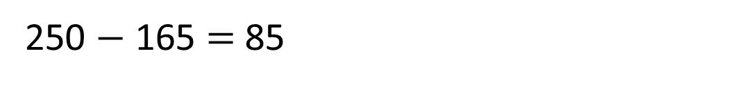
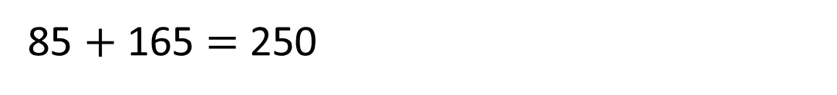
Eva plans to cycle 250 km for charity this year.
So far she has cycled 85 km.
How much further does she need to cycle?
How many different ways can you find
to calculate and check your answer?
165 km
Have a think
85 $+$ 165 $=$ 250
250 $−$ 165 $=$ 85

Slide 14
Have a go at the rest of the questions on the worksheet

