Slide 1


Slide 2

Year 3 | Week 8 | Day 3

Slide 4
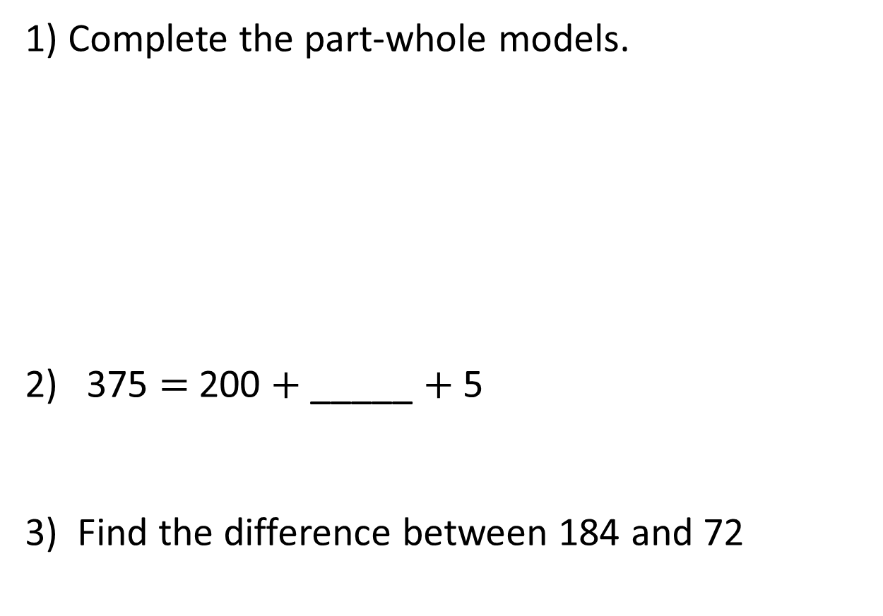
1) Complete the part-whole models.
2) 375 $=$ 200 $+$ _____ $+$ 5
3) Find the difference between 184 and 72
562
562
500
2
500
12

Slide 5
1) Complete the part-whole models.
2) 375 $=$ 200 $+$ _____ $+$ 5
3) Find the difference between 184 and 72
562
562
500
2
500
12
60
50
170
112

Slide 7

Tommy has £451
He spends £325 on a holiday.
How much money does he have left?
H | T | O
4 | 5 | 1
3 | 2 | 5
$$−$$
1 – 5 =

Slide 8







Hundreds | Tens | Ones
451
£126 left
H | T | O
4 | 5 | 1
3 | 2 | 5
4
1
451
400
1
$$−$$
50
$−$300
$−$5
$−$20
1
2
6
400
40
11
$−$300
$−$5
$−$20

Slide 9



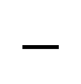
Hundreds | Tens | Ones
H | T | O
4 | 0 | 1
2 | 3 | 9
401
3
9
1
1
$$−$$
300
11
90
1
6
2
Notes:
Can we simplify?
Discuss reduction structure – take away

Slide 10
Have a go at question
1 – 5 on the worksheet

Slide 11
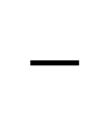

H | T | O
4 |  | 7
 | 3 | 4
2 | 9
? $−$ 3 tens = 9 tens
3
1
?
2
12 tens
$$−$$
1
9 tens
3 tens
3
Hundreds | Tens | Ones

Slide 12
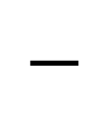
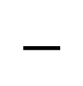
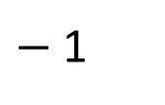
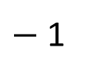
547
548
899
900
$−$ 1
$−$ 1
What is the difference between the two numbers?
H | T | O
9 | 0 | 0
5 | 4 | 8
H | T | O
8 | 9 | 9
5 | 4 | 7
9
8
1
1
$$−$$
$$−$$
3
5
2
3
5
2
3

Slide 13
Have a go at questions 6 and 7 on the worksheet

Slide 14
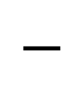
287
194 + ____ = 481
481
H | T | O
4 | 8 | 1
1 | 9 | 4
3
1
7
1
$$−$$
287
2
8
7
194
?

Slide 15
Have a go at the rest of the worksheet

