Slide 1

Wednesday 9th June 2021
LO: To write with purpose
C: Warning Story Plan
MY
STORY

Slide 2
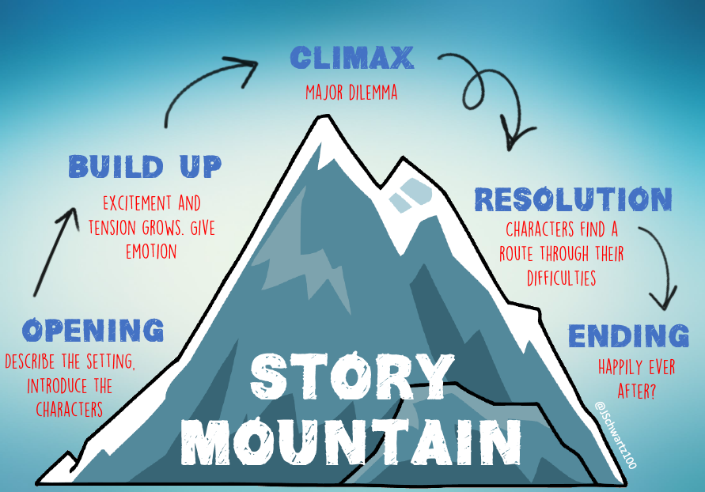
Story Structure

Slide 3
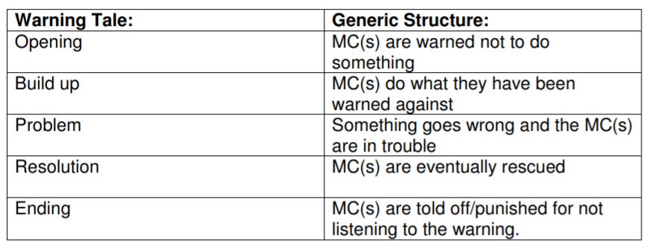
Warning Tale Structure

Slide 4
Task
Complete the table with your own story idea

Slide 5


