Slide 1
Tuesday 29th March 2022
L.O: Understand movement, forces and magnets.
C: Working Scientifically

Slide 2
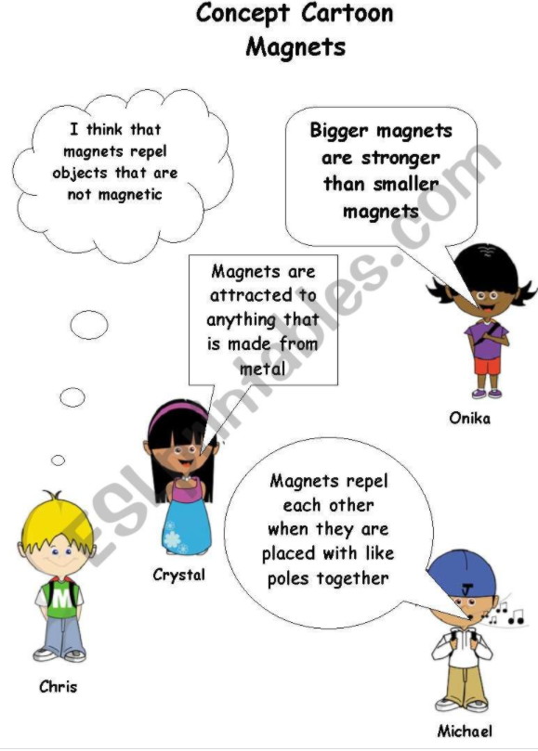
Starter

Slide 3
Our investigation
- Today we are going to investigate which materials are magnetic.
First lets think about our variables. What are we going to keep the same and what are we going to change?

Slide 4
Our investigation
Let’s look at our materials. Can you fill in your table to show your prediction?

Slide 5
Next, can you number the sections of our method to put them in chronological order?

Slide 6
Let’s do our experiment!
Remember to record your findings in your table.

Slide 7
Finally, let’s write our conclusion!

