Slide 1
1.4.2022
L.O: To use measures.
C: Add lengths

Slide 2

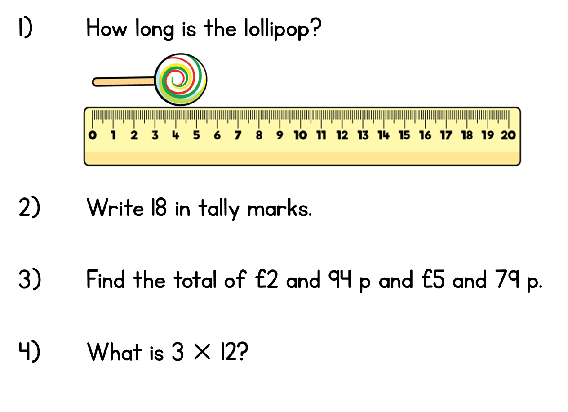
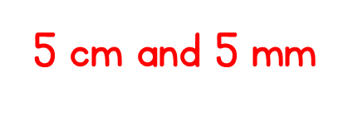
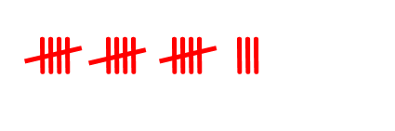


Year 3 | Week 7 | Day 4

Slide 4
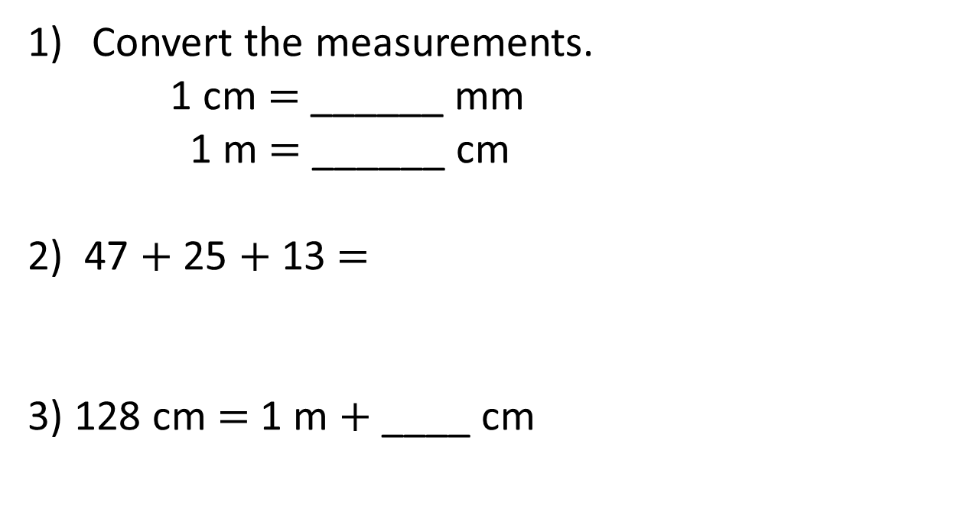
Convert the measurements.
1 cm $=$ ______ mm
1 m $=$ ______ cm
2) 47 $+$ 25 $+$ 13 $=$
3) 128 cm $=$ 1 m $+$ ____ cm

Slide 5
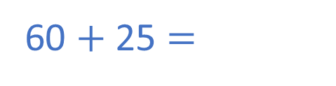
Convert the measurements.
1 cm $=$ ______ mm
1 m $=$ ______ cm
2) 47 $+$ 25 $+$ 13 $=$
3) 128 cm $=$ 1 m $+$ ____ cm
10
100
60 $+$ 25 $=$
85
28

Slide 7
Tommy uses toy bricks to make a tower.
What is the height of the tower?
53 cm
18 cm
23 cm
12 cm
12 cm
17 cm

Slide 8
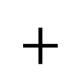
 | T | O
 | 5 | 3
 | 1 | 8
$$+$$
53 cm
7
1
1
18 cm
23 cm
12 cm
12 cm
17 cm
The height of the tower is 71 cm.

Slide 9

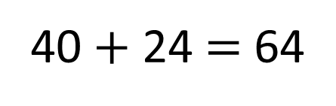
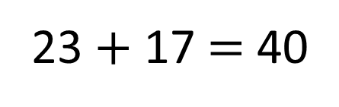
What is the length of the tower?
Have a think
23 $+$ 17 $=$ 40
40 $+$ 24 $=$ 64
53 cm
64 cm
18 cm
23 cm
12 cm
12 cm
17 cm
24 cm

Slide 10
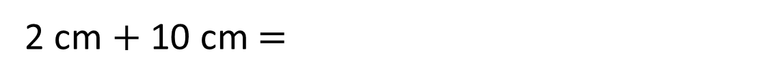
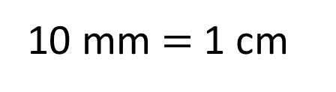
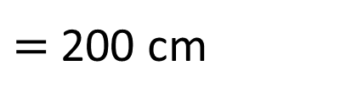

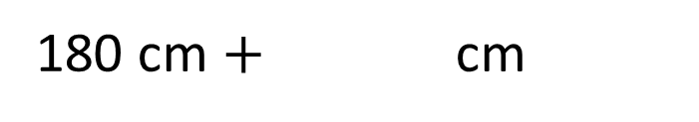
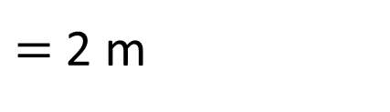
cm
20 mm $+$ 10 cm $=$
12
30
10 mm $=$ 1 cm
12 cm
2 cm $+$ 10 cm $=$
180 cm
1 m 80 cm $+$ cm
20
$=$ 2 m
180 cm $+$ cm
$=$ 200 cm
20
1 m
100 cm
80 cm

Slide 11
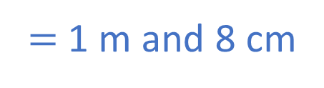

H | T | O
 | 6 | 3
 | 4 | 5
A mat is 45 cm long.
A rug is 63 cm long.
How long are they altogether?
108 cm
$$+$$
1
0
8
108 cm
$=$ 1 m and 8 cm
1 m
8 cm
1
108 cm
?
Mat
Rug
45 cm
63 cm

Slide 12


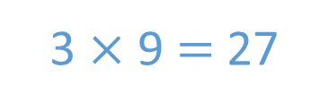
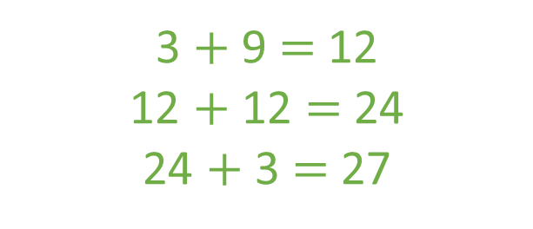
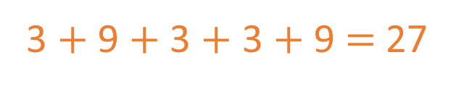
A paperclip is 30 mm long.
A crayon is 9 cm long.
Dexter arranges some paperclips
and crayons like this:
Does his pattern fit onto a 30 cm long piece of paper?
Have a think
Yes
3 cm
30 mm
3 cm
9 cm
30 mm
3 cm
30 mm
9 cm
3 $+$ 9 $+$ 3 $+$ 3 $+$9 $=$ 27
3 $+$ 9 $=$ 12
12 $+$ 12 $=$ 24
24 $+$ 3 $=$ 27
3 $×$ 9 $=$ 27

Slide 13
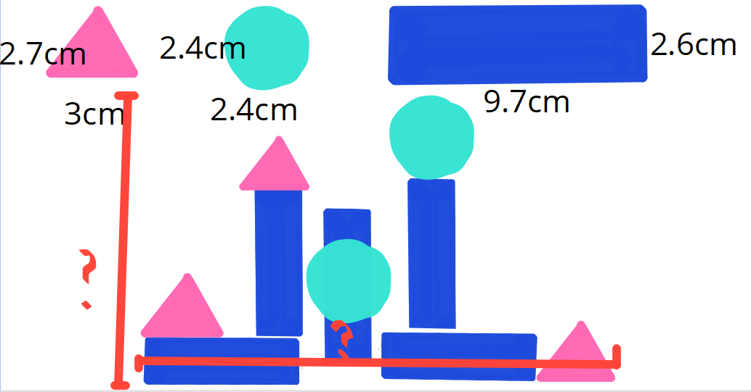
Have a go at the shape picture task!

