Slide 1
30.3.2022
L.O: To use measures.
C: Equivalent lengths m and cm
C: Equivalent lengths cm and mm.

Slide 2

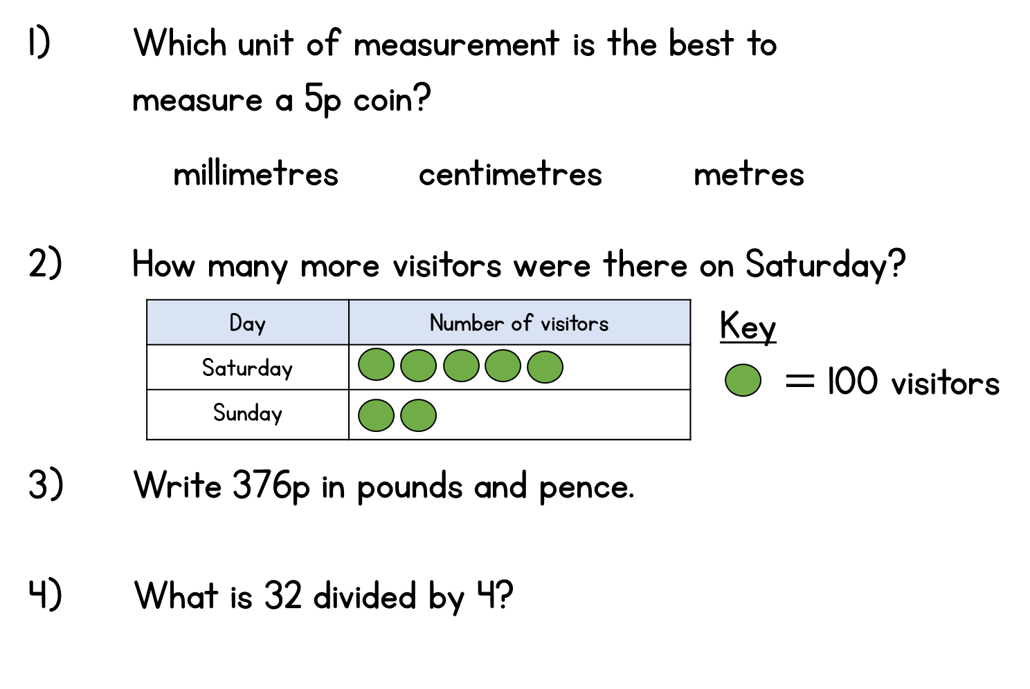
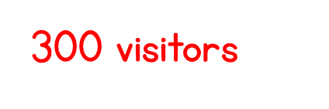
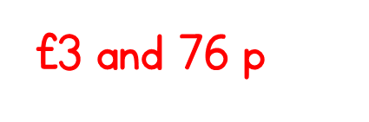
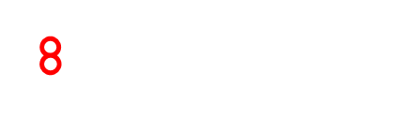
Year 3 | Week 7 | Day 2

Slide 3



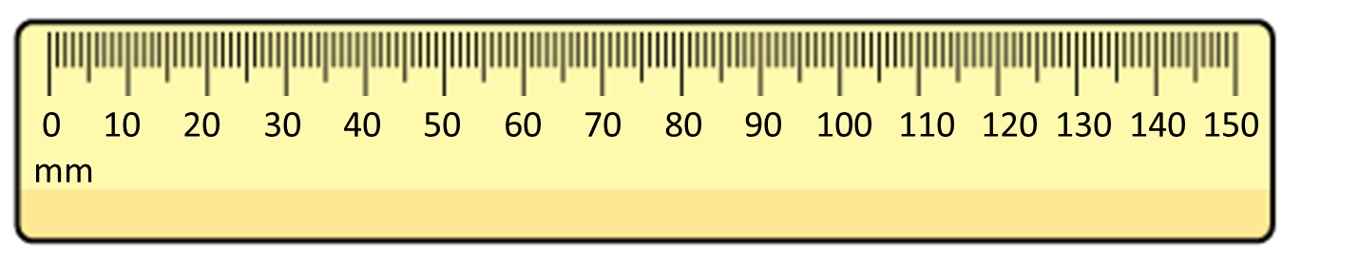
What is the length of the bar?
The bar is 8 cm long.
The bar is 80 mm long.
8 cm = 80 mm

Slide 4
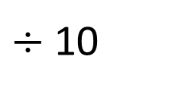
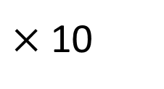
centimetres
0
1
2
3
4
5
6
7
8
9
10
0
10
20
30
40
50
60
70
80
90
100
millimetres
$×$10
$÷$10
1 cm = 10 mm
70
7 cm = mm
30 mm = cm
3

Slide 5
4 cm =
1 cm = 10 mm
40 mm
1 cm | 1 cm | 1 cm | 1 cm
1 cm
10 mm
10 mm
10 mm
10 mm
10 mm
20 mm =
2 cm
1 cm
1 cm
10 mm
10 mm

Slide 6
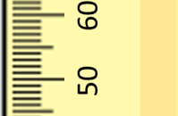
60
59
58
57
56
55
54
53
52
51
mm
50

Slide 7


Have a think
60
6 cm
59
5 cm 9 mm
58
5 cm 8 mm
57
5 cm 7 mm
56
5 cm 6 mm
51 mm
5 cm 5 mm
52 mm
55
54
5 cm 4 mm
53
5 cm 3 mm
5 cm
1 mm
52
5 cm 2 mm
50 mm
2 mm
51
5 cm 1 mm
mm
50
5 cm
cm and mm

Slide 8

20 mm
45 mm
Have a think
82 mm
2 cm
4 cm 5 mm
8 cm 2 mm
cm
40 mm
45 mm
48 mm
50 mm
41
42
43
44
46
47
4 cm
4 cm
5 mm
4 cm
8 mm
5 cm

Slide 9
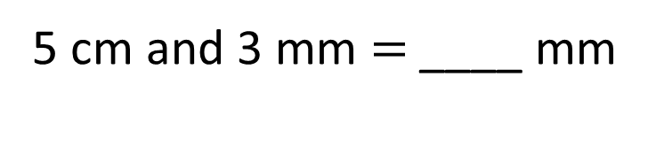
53
5 cm and 3 mm $=$ ____ mm
53 mm
53 mm
5 cm | 3 mm
50 mm
3 mm
5 cm
50 mm + 3 mm =
53 mm

Slide 10
Complete the sequence.
100, 200, 300, 400, _____, _____
500
600
2) How many hundreds are in 870?
8 hundreds
3) Complete the part-whole model.
490
4
hundreds
9 tens

Slide 11
Equivalent lengths
Equal lengths
metres
0
1
2
3
4
5
6
7
8
9
10
0
100
200
300
400
500
600
700
800
900
1,000
centimetres
1,000 cm = 10 m
500 cm = 5 m
600 cm = 6 m
700 cm = 7 m
8 m = 800 cm
9 m = 900 cm
1 m = 100 cm
2 m = 200 cm
3 m = 300 cm
4 m = 400 cm
0 m = 0 cm

Slide 12
4 m =
400 cm
1 m = 100 cm
1 m
100 cm
1 m | 1 m | 1 m | 1 m
100 cm
100 cm
100 cm
100 cm
200 cm =
2 m
1 m
1 m
100 cm
100 cm

Slide 13
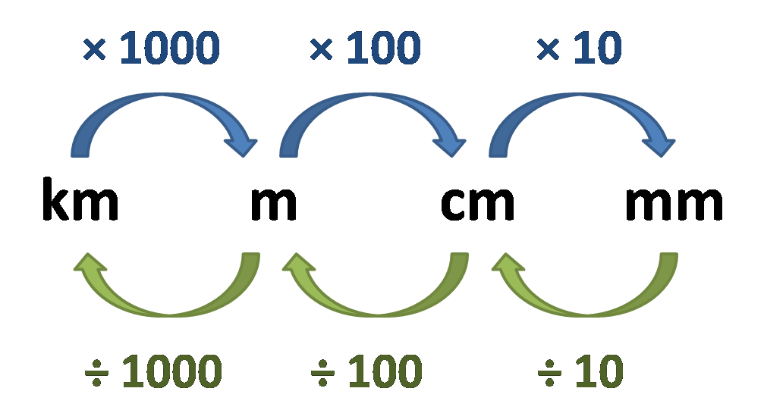

Slide 14
Have a think
600
6 m
590
5 m 90 cm
580
5 m 80 cm
570
5 m 70 cm
510 cm
520 cm
560
5 m 60 cm
550
5 m 50 cm
540
5 m 40 cm
5 m
500 cm
10 cm
20 cm
530
5 m 30 cm
520
5 m 20 cm
510
5 m 10 cm
cm
500
5 m
m and cm

Slide 15
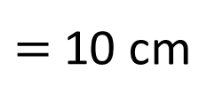
Have a think
10 cm
1 m and 35 cm
= 135 cm
100 cm
0 m
1 m
2 m
70 cm
130 cm
1 m and 30 cm
100 cm ÷ 10
$=$ 10 cm

Slide 16
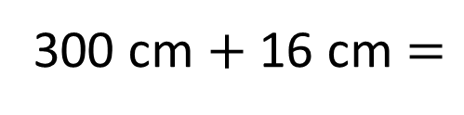
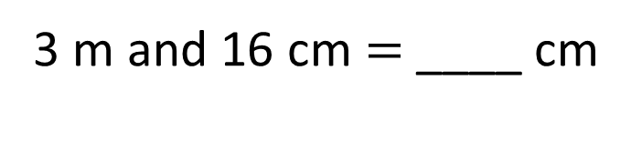
316
3 m and 16 cm $=$ ____ cm
316 cm
316 cm
3 m | 16 cm
300 cm
16 cm
3 m
300 cm $+$ 16 cm $=$
316 cm

