Slide 1
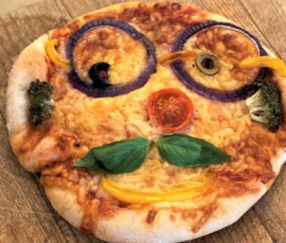
Paddlers:
Sienna has 12 slices of pizza. She eats 1/3 of them. How many slices does she eat?

Slide 2
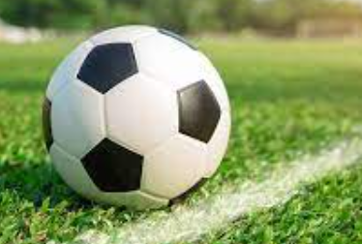
Paddlers:
Leo scored 20 goals. 1/5 of them were at away games. How many were scored at away games?

Slide 3

Paddlers:
Isla collects stickers. She has eighty in total, but decides to donate 1/8 of her collection. How many does she donate?

Slide 4

Snorkelers:
Sofia earnt 90 minutes reward time last week. She decided to spend one third of it on Roblox. How many minutes did she spend on Roblox?

Slide 5
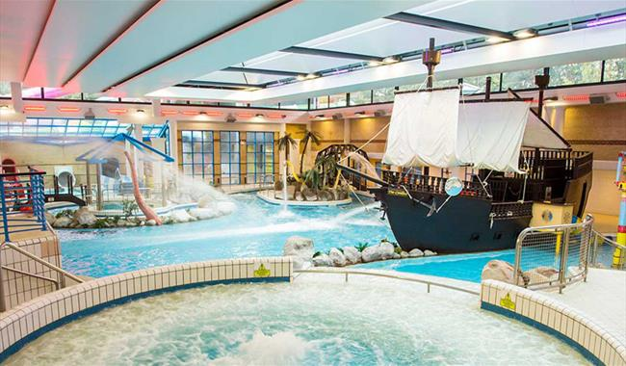
Snorkelers:
Boris spent 90 minutes at Coral Reef World. He spent half of his time going down the slides. How long did he spend on the slides?

Slide 6
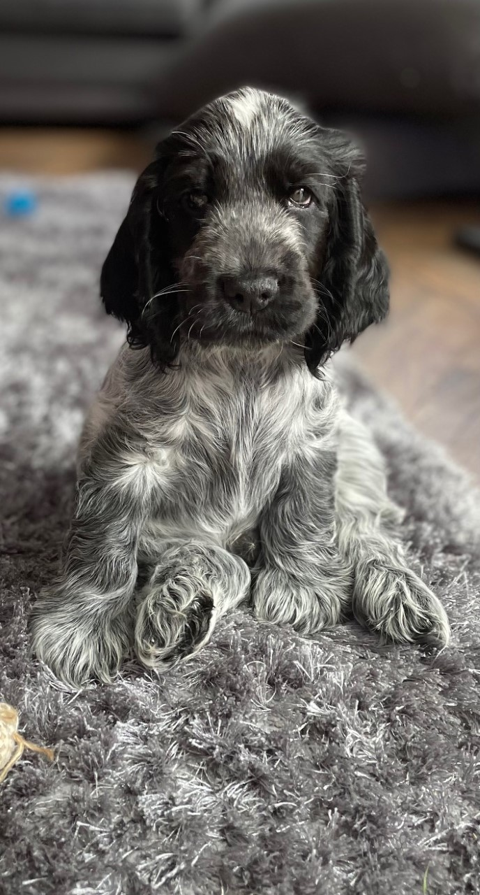
Snorkelers:
Elsie’s puppy Jerry is awake for 12 hours a day. He plays outside for 1/3 of the time. He snuggles on the sofa for ¼ of the time. How long does he spend on each thing?

Slide 7
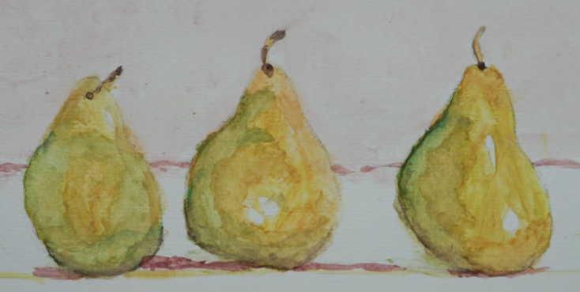
Divers:
Edie spent 75 minutes on her amazing picture. 1/5 of the time was spent on sketching. How long did it take to sketch her picture?

Slide 8

Divers:
Jessica has read 24 books this year. ½ of them were animal stories. 1/8 of them were adventure stories. How many were each genre?

Slide 9
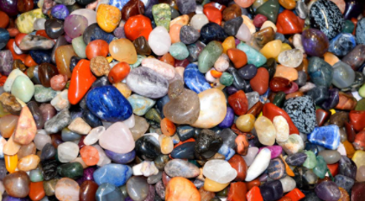
Divers:
Lottie collects beautiful stones. She has 95 in her collection. She donates 1/5 of her collection to Milo. How many does she have left?

