Slide 1
28.3.2022
L.O: To use measures.
C: Measure Lengths

Slide 3



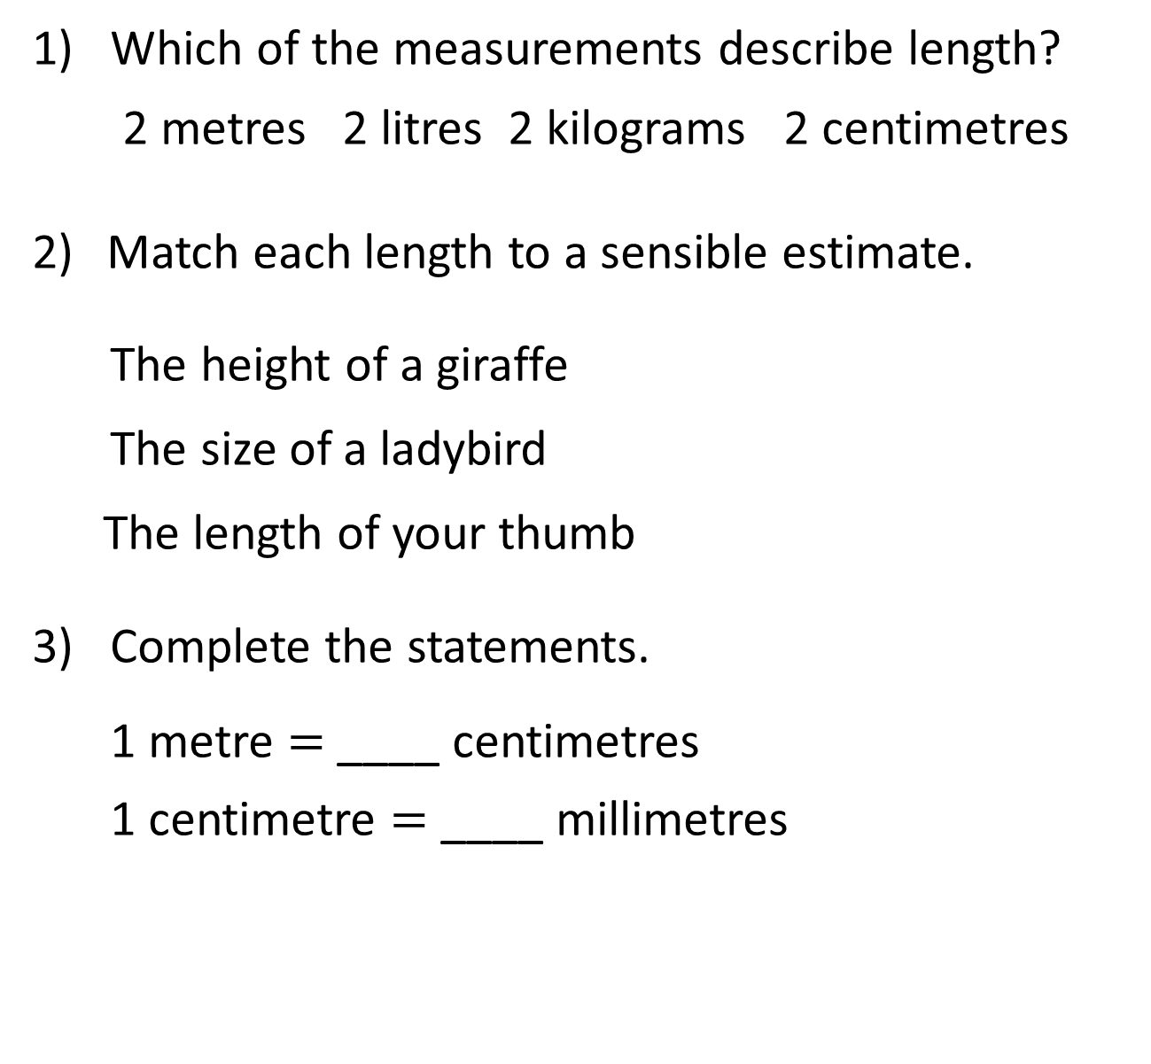
1) Which of the measurements describe length?
2 metres 2 litres 2 kilograms 2 centimetres
Match each length to a sensible estimate.
The height of a giraffe
The size of a ladybird
The length of your thumb
3) Complete the statements.
1 metre $=$ ____ centimetres
1 centimetre $=$ ____ millimetres
5 cm
5 m
5 mm

Slide 4
1) Which of the measurements describe length?
2 metres 2 litres 2 kilograms 2 centimetres
Match each length to a sensible estimate.
The height of a giraffe
The size of a ladybird
The length of your thumb
3) Complete the statements.
1 metre $=$ ____ centimetres
1 centimetre $=$ ____ millimetres
5 cm
5 m
5 mm
100
10

Slide 6

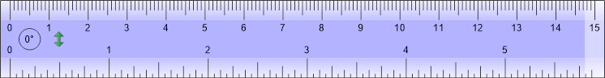
Tommy is trying to measure the brick.
He is struggling.

Slide 7
Our Top Tips for Tommy
1. Make sure you’re using the cm side of the ruler
2. Line up the edge of your item with 0 on the ruler
3. Look to see where the other edge of your item lines up with the ruler.
The brick is 5 cm long.

Slide 8
Tommy wants to measure the height of the brick too.
The brick is 2 cm tall.

Slide 9
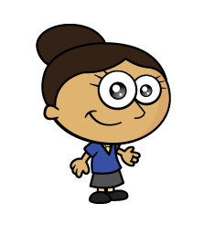


Dora is drawing a line 7 cm long.

Slide 10
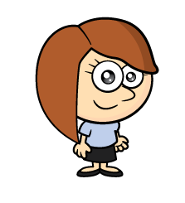

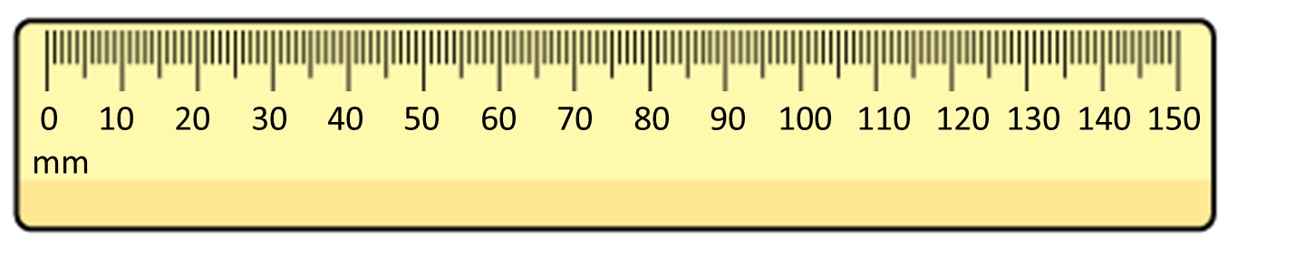

Rosie is measuring the packet of crayons.
The pack of crayons is 90 cm long.

Slide 11


Rosie is measuring one of the crayons.
The pencil is 45 mm long.

Slide 12
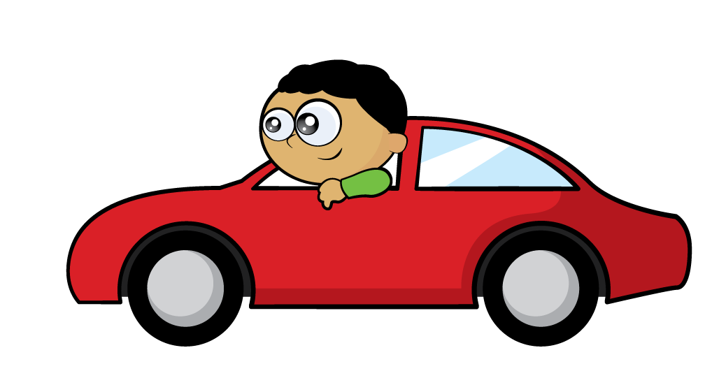

True or false?
The toy car is 125 mm long.
Have a think

Slide 13
What do you notice?
Have a think
The green bar is 5 cm long.
The orange bar is 6 cm long.
The orange bar is 1 cm longer than the green bar.
There is a gap of 3 cm between the bars.
The total length of the bars is 11 cm

Slide 14
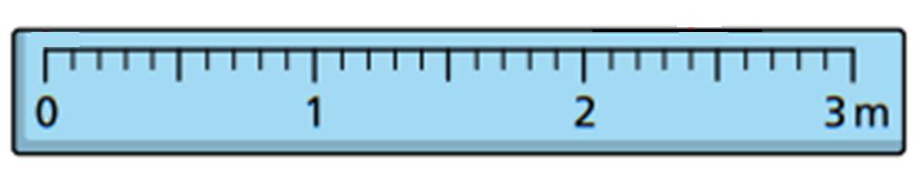
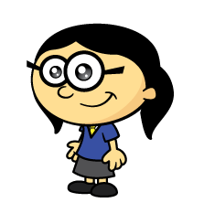
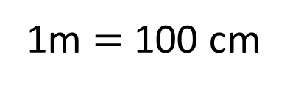
How tall is Annie?
1m $=$ 100 cm
Annie is 1 metre and 30 cm tall.

Slide 15
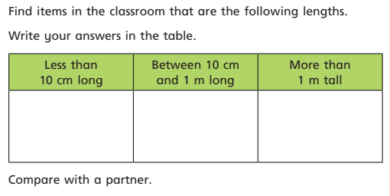
Let’s go on a hunt around our classroom!

Slide 16
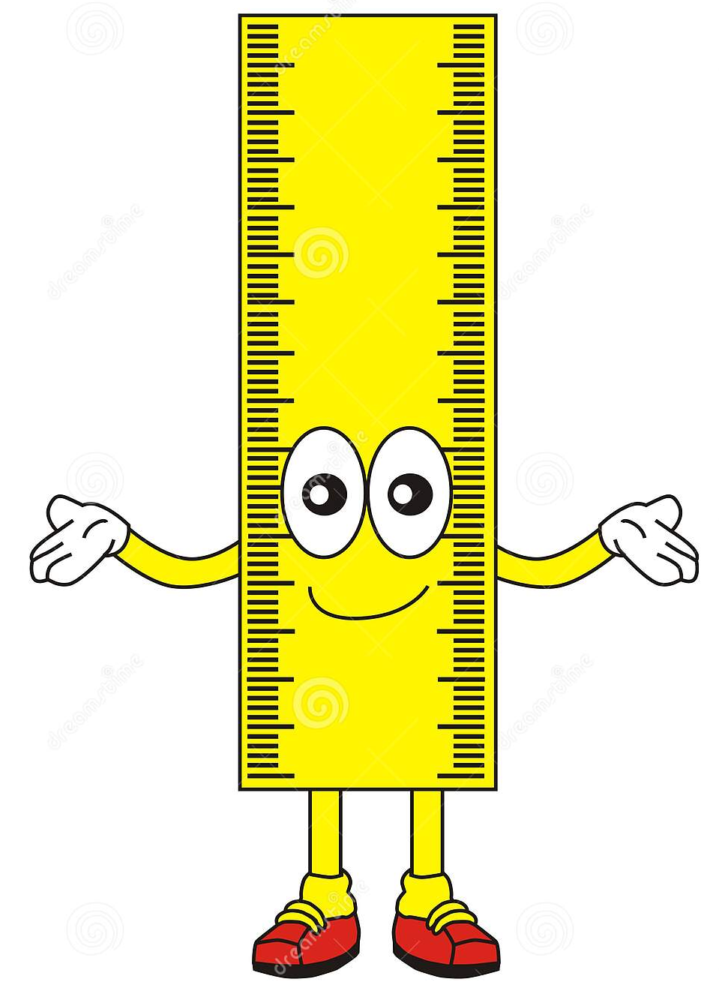
Now let’s try and draw some lines in our books!
Do you have any
top tips?

