Slide 1

Thursday 14th October 2021
L.O: To understand texts.
C: Let’s do the Pharaoh!
(Inference)

Slide 2
Starter: Thinking Question
What do we already know about Serraphina’s character?

Slide 3
Let’s read page 119-122

Slide 4
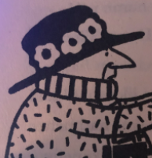
Our task today is to think about how Serraphina is feeling and what she is going to say.

