Slide 1

Thursday 14th October 2021
L.O: To write with purpose.
C: Howard Carter Informal Recount.

Slide 2
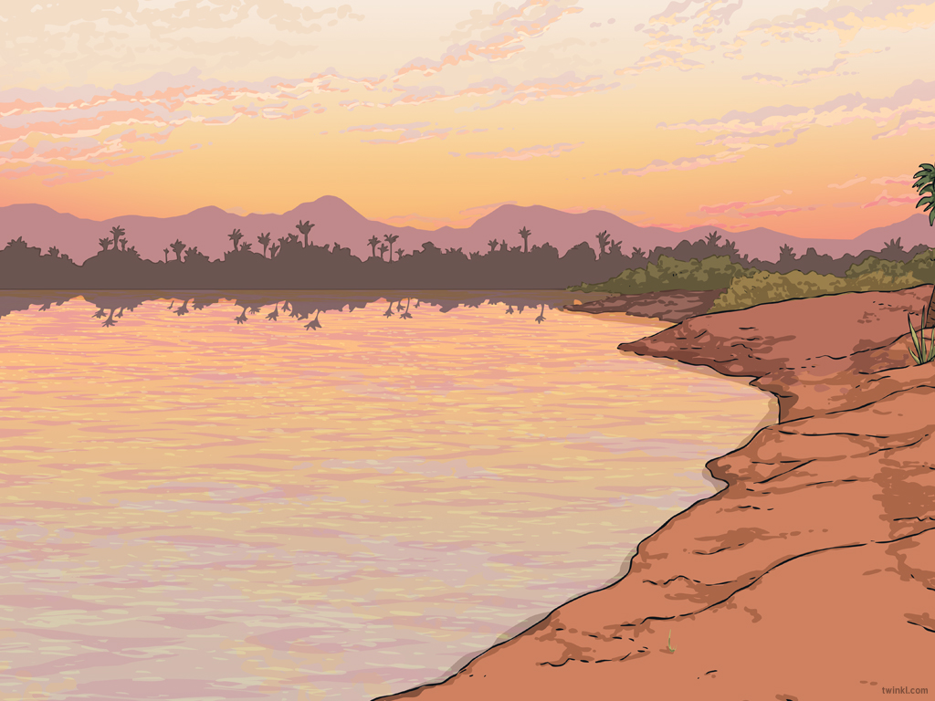

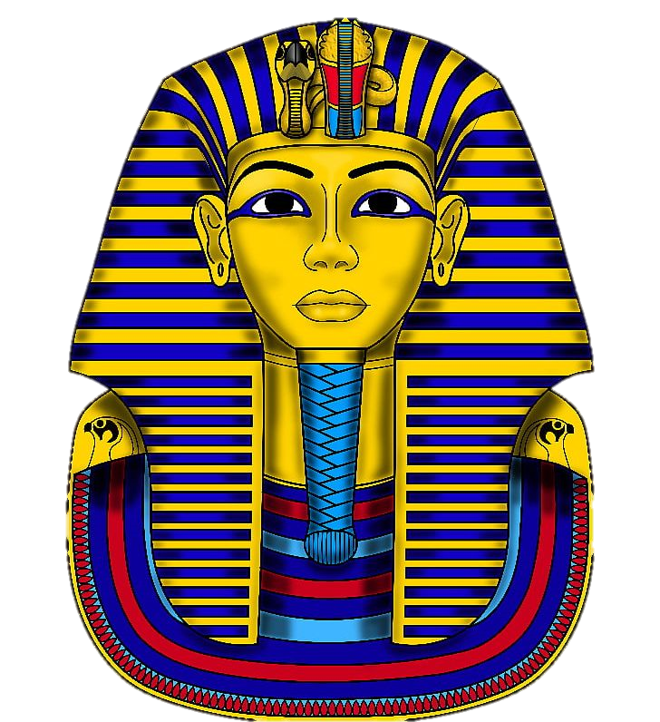
RED PEN TIME
Can you use your red pen to edit your work from yesterday?

Slide 3
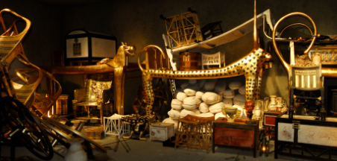
Starter
Let’s recap the part of the event when they discover the treasure chamber.

Slide 4
Today we are going to write the next paragraph of our recount.
I would like you to work with your partner to write ideas on the whiteboards, then we will write our own paragraph independently.

Slide 5
First, let’s start with a short sharp sentence. What was the treasure like? How did you feel?

Slide 6
Describe more of what you see?
What was your favourite thing?

Slide 7
Now you need to notice the mysterious statues...

Slide 8
Plenary:
Let’s practice reading with expression!
If you make an edit use the code CI in your book.

