Slide 1
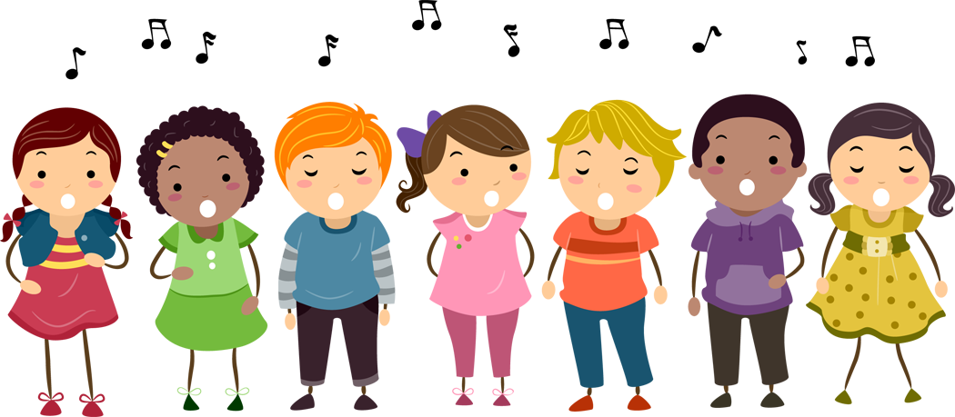
Good Afternoon Key Stage 2!
Our music term of the day is “melody”!
A melody is a string of notes which forms a clear tune.
Can you pick out the melody from this piece? Which instrument is playing the melody?

Slide 2

Our Harvest Service is next week!
Today we are going to practice the 3 songs we are going to do!

Slide 3
Let’s start with a tongue twister!
He threw three free throws.
Who threw three free throws?
He threw free throws.
Three free throws?
Three free throws.
He threw three free throws.
Three free throws through the hoop.
Children
Teachers
Together

Slide 4
Let’s practice Lord of the Harvest!
Come and Praise CD2 Track 112
https://www.youtube.com/watch?v=Njkm9jEW7cc

Slide 5
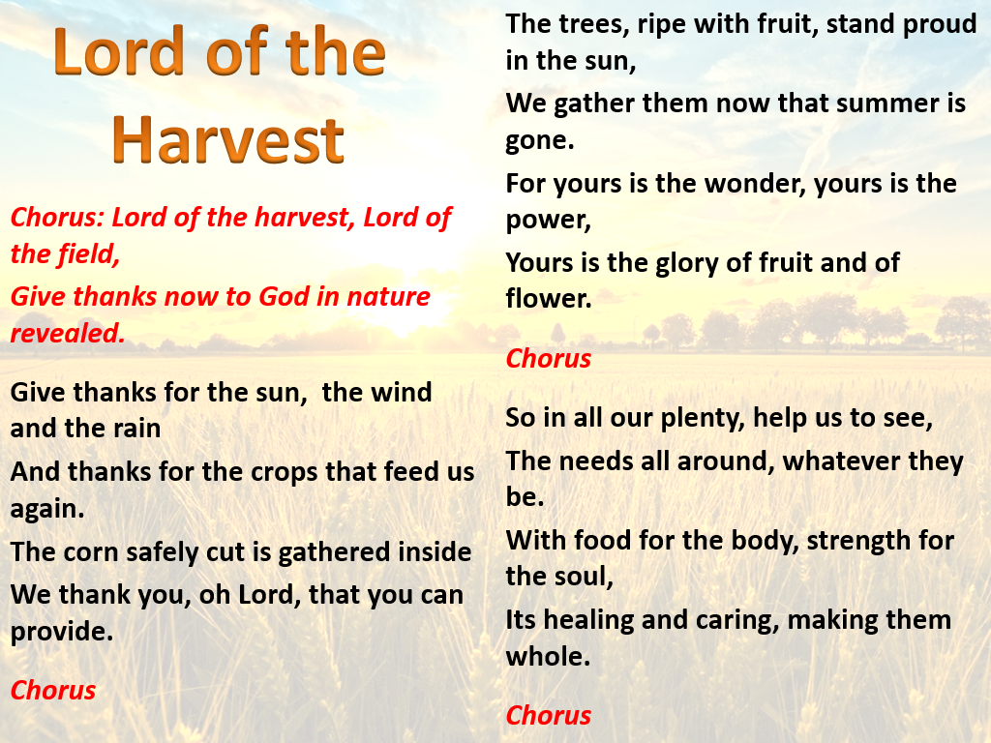
Come and Praise CD2 Track 112

Slide 6

Let’s learn I planted a seed!
Come and Praise CD2 Track 113
https://www.youtube.com/watch?v=ckwpn-fOZ4U
(Backing track)
Please singing along if you know it- a backing track with singing is coming soon!

Slide 7
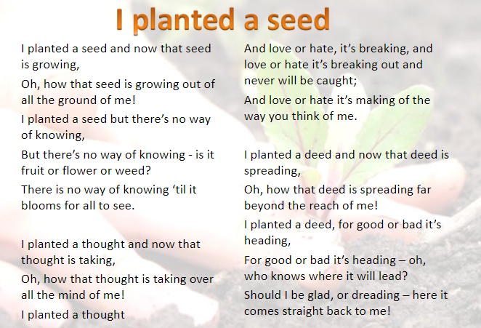
Come and Praise CD2 Track 112

Slide 8
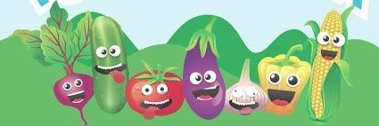
Let’s finish with one you know!
https://www.youtube.com/watch?v=PukdaXUzgOU

Slide 9


