Slide 1

Monday 11th October 2021
L.O: To write with purpose.
C: Fronted Adverbials.

Slide 2
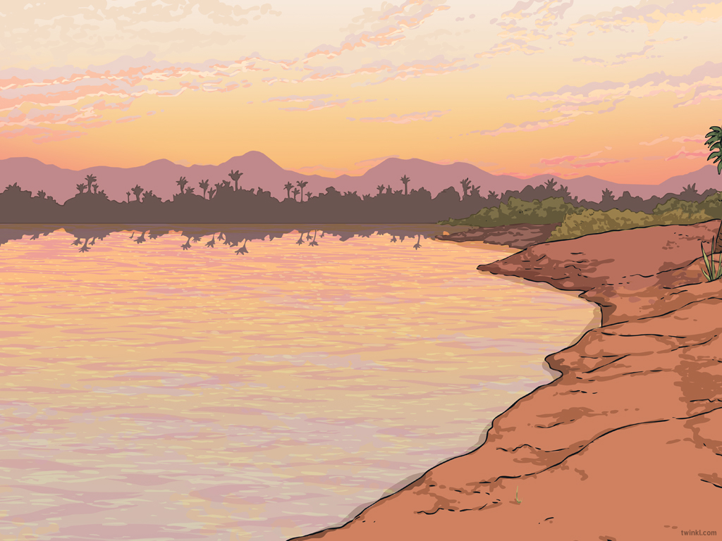

Starter
Today we are going to use fronted adverbials to make our writing more exciting.
Can you spot any in your amazing Egyptian Story?

Slide 3

We are going to work together to add some engaging fronted adverbials into my model today.
You can write ideas on your whiteboard that you would like to share!
Remember we need to use our commas!

