Slide 1
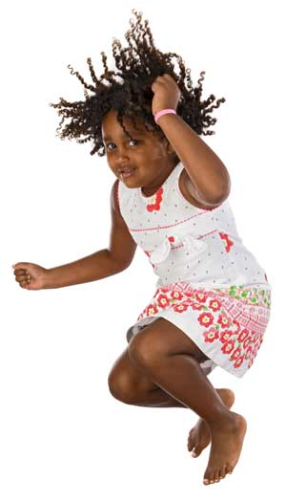
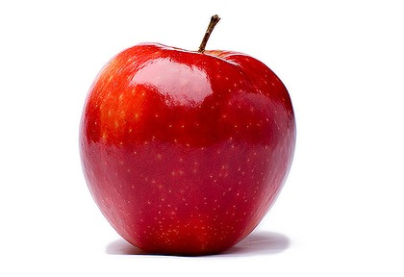
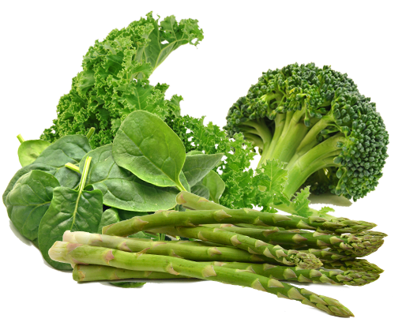
Science, Health and Fitness Quiz

Slide 2
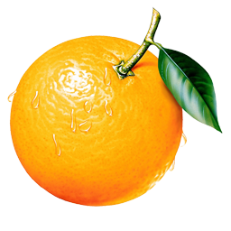
There are some missing words on each slide. Each word or group of words has a number. Read the text and guess the missing word. Write the word on your sheet.
Some are quite easy, others are a bit harder and on some you get the first letter to give you a clue! If you’re not sure of a word, give it your best guess. Have a go at spelling it correctly but don’t worry if you are not exactly right.
Good Luck!

Slide 3
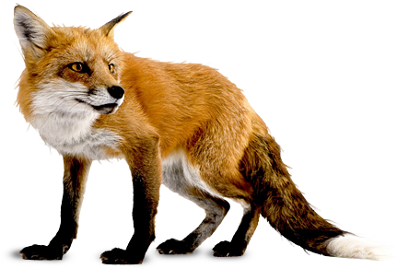
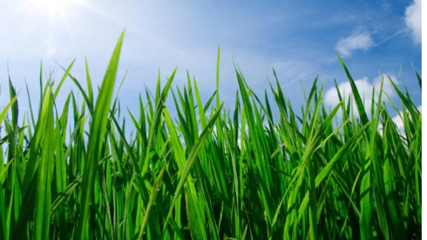
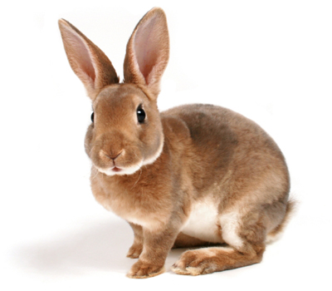
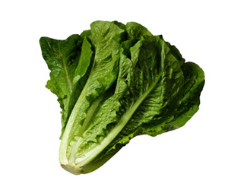
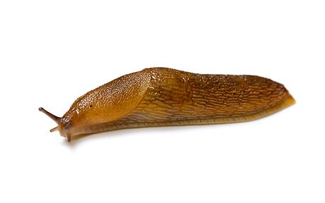
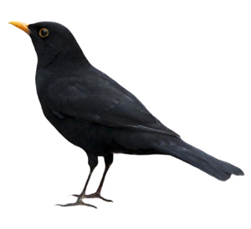
1.
Only can make their own food. They do this using sunlight and water. Animals must get their food by eating plants or other animals.
Is eaten by
Is eaten by
Is eaten by
Is eaten by
These are both examples of a
2.

Slide 4
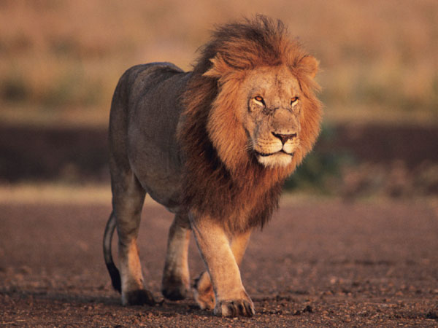
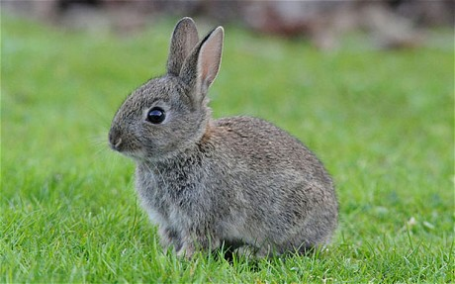
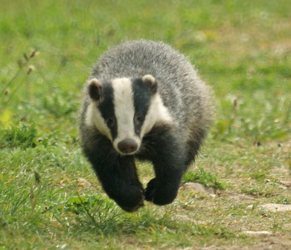
Animals can be classified into 3 groups according to how they feed
Carnivores
3.
Omnivores
Eat other animals
Eat plants
4.

Slide 5
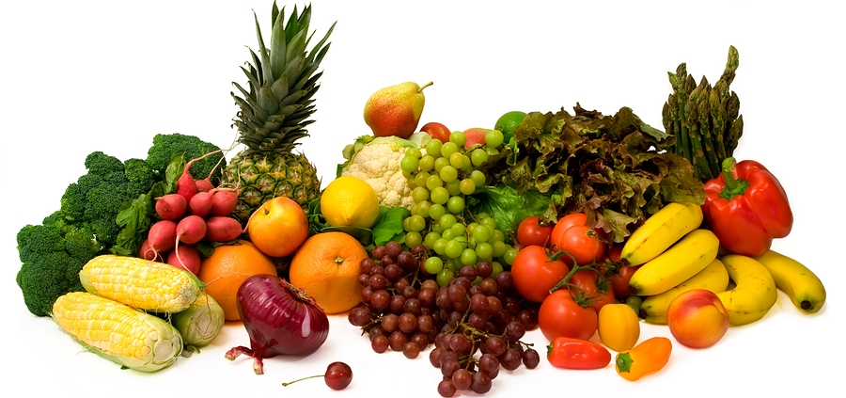
A healthy for a human should include at least 5 portions of fruit and vegetables every day.
5.
But it should not include too much
6.

Slide 6
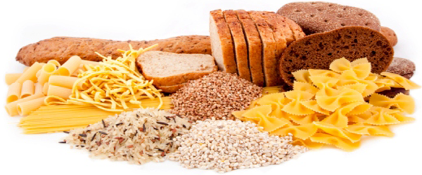
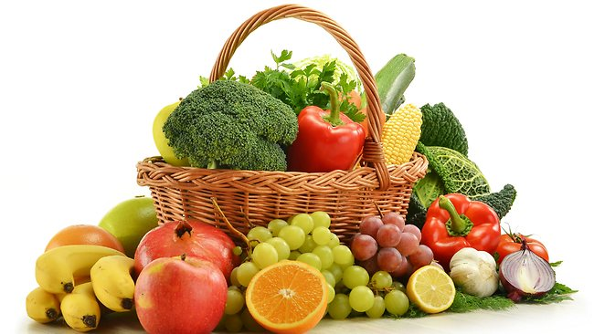
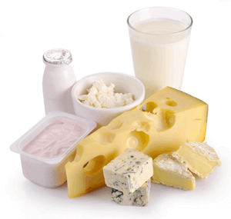
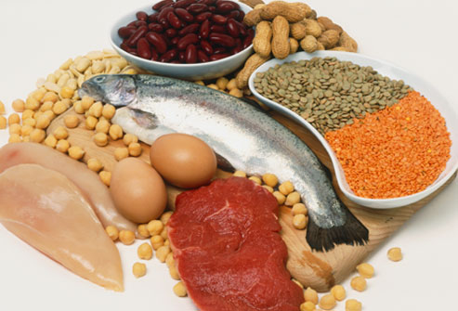
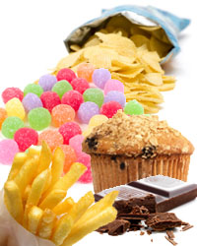
Humans eat five main types of food
7. C
Fruit and Vegetables
Fats and Sugars
8. D
Proteins

Slide 7

Each group does something different in the body
Fruit and vegetables contain vitamins and fibre to keep you healthy
This food group contains calcium which is a mineral needed by the body for strong
and
9. b
10. t
Sugars and fats should be eaten only in small amounts. They give you energy.
This food group gives you energy that releases slowly to help keep you going a long time without feeling hungry
Protein foods are needed by the body for
and
11. g
12. r

Slide 8
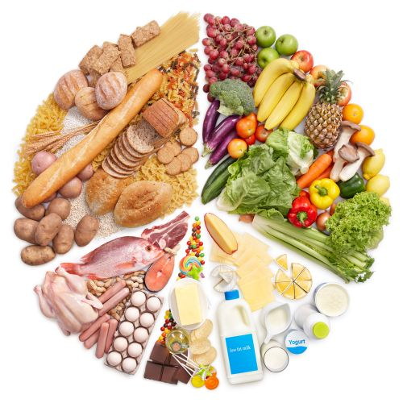
This diagram is called the
Plate. It helps to show us how much of each type of food we should eat to have a healthy diet.
13. E
14.
For good , we should try to eat foods in these proportions.
15. n

Slide 9
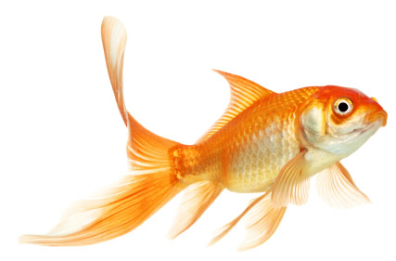
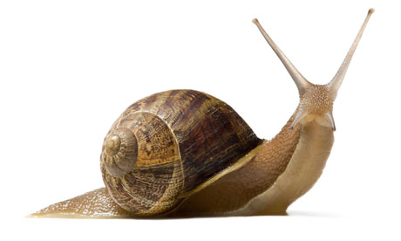
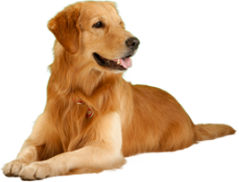
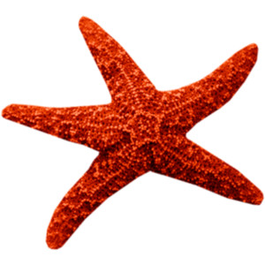
Many animals have a skeleton with a backbone that is inside their body but lots do not. Animals that have a backbone are called Vertebrates and animals that do not are called
16.
Two of these animals are vertebrates. They are the and the
17.
18.

Slide 10
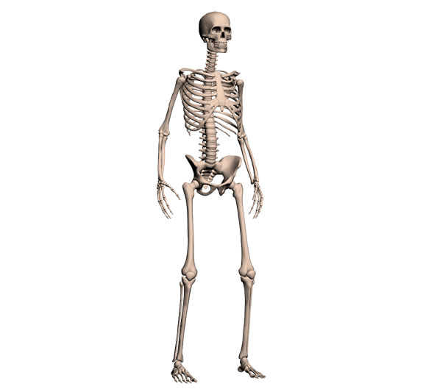
An adult human skeleton has
bones.
19.
Choose one
120
206
260
The longest bone is called the
20. f

Slide 11
The skeleton gives the body .
It also protects delicate organs, for example the protects the brain.
21. s
22.
This bone is called the
23.

Slide 12
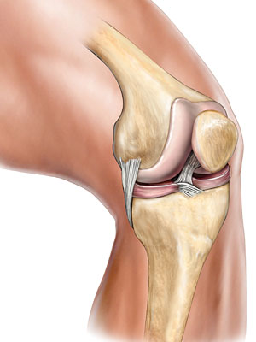
This is a knee . It is the place where the leg bones meet.
24. J

Slide 13
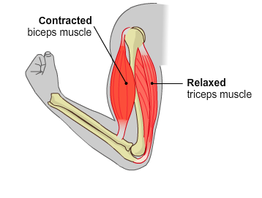
Your bones cannot move on their own, they need
These are responsible for every movement your body makes.
25.
The biceps contracts
They work in pairs to make a joint bend.
26. r
The triceps
They are attached to the bone by a
27. t

Slide 14
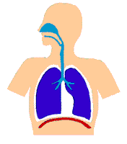
Our muscles need to work. We breathe it in from the air around us.
28.
29.
You breathe using a very powerful muscle called the
30. d

