Slide 1

Wednesday 13th October 2021
L.O: To write with purpose.
C: Howard Carter Informal Recount.

Slide 2
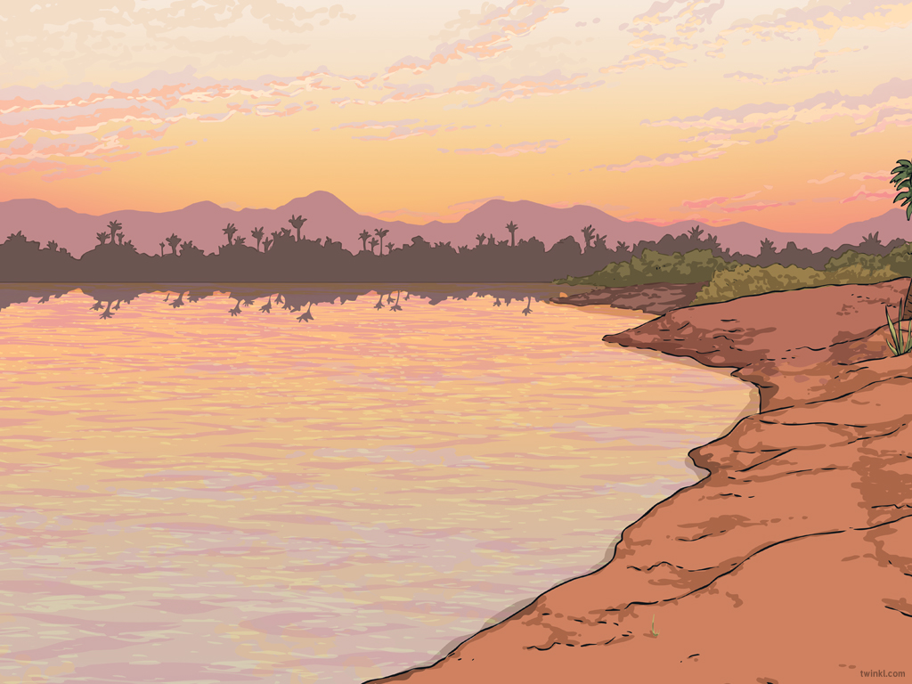


RED PEN TIME
Can you use your red pen to edit your work from yesterday?

Slide 3
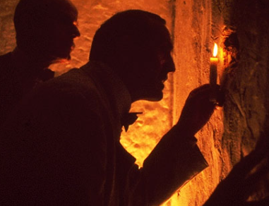
Starter
Let’s recap the part of the event when they test the safety of the tomb.

Slide 4

Today’s Team Point Challenge!
Try to include some adverbials of manner in your writing:
-tentatively, cautiously, hesitantly, apprehensively

Slide 5
Today we are going to write the next paragraph of our recount.
I would like you to work with your partner to write ideas on the whiteboards, then we will write our own paragraph independently.

Slide 6
First, let’s start with one of our amazing time adverbials...

Slide 7
Next, we need to talk about the moment Lord Carnarvon arrived.
How did you feel?

Slide 8
How did you test for booby traps?

Slide 9
Let’s use our integrated speech:

Slide 10
Plenary:
BOOK ON BOOK
Can you ensure your integrated speech is punctuated correctly.
If you make an edit use the code CI in your book.

