Slide 1
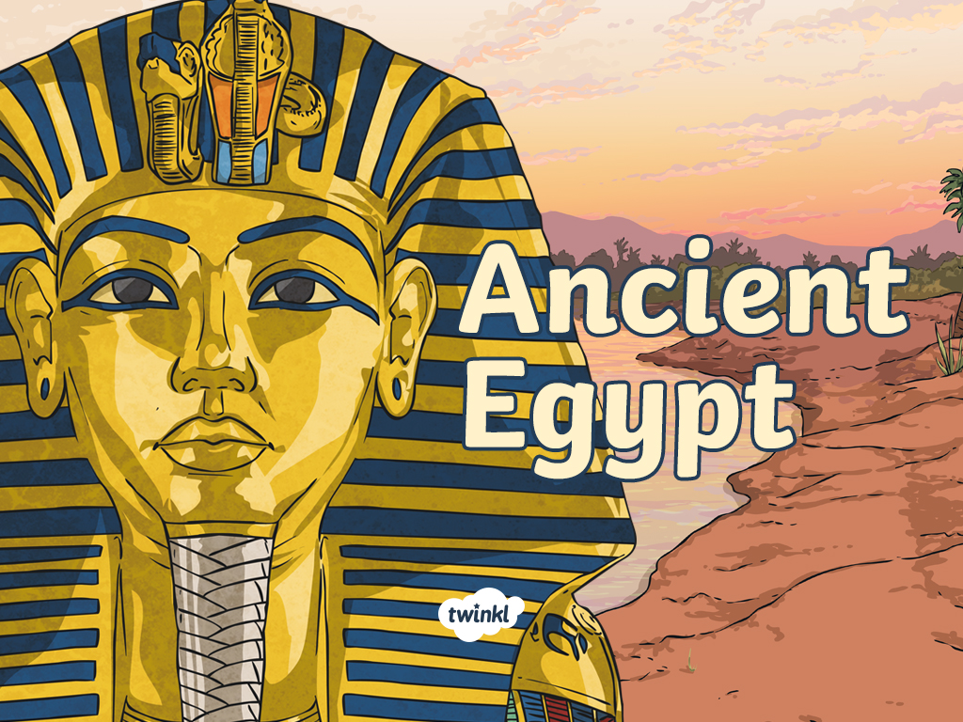
Friday 15th October 2021
L.O: To write with purpose.
C: Howard Carter Informal Recount.

Slide 2
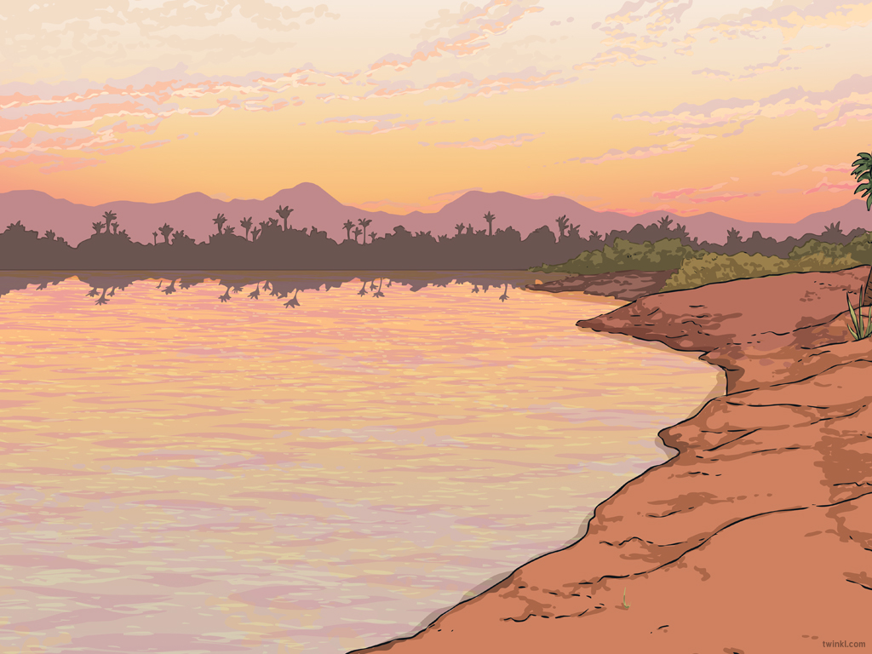

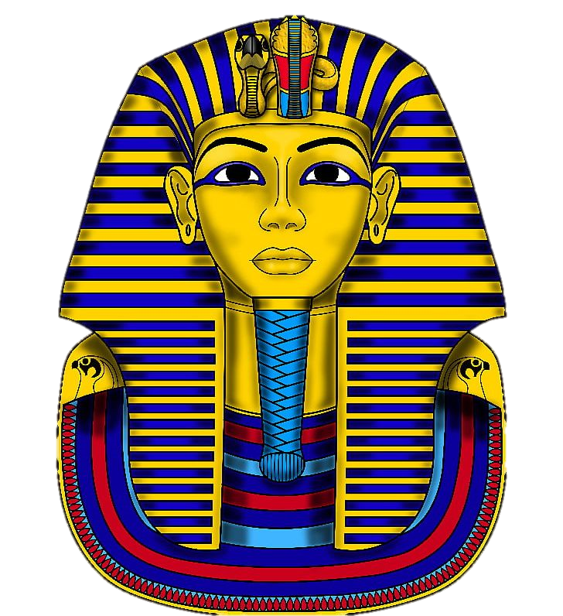
RED PEN TIME
Can you use your red pen to edit your work from yesterday?

Slide 3
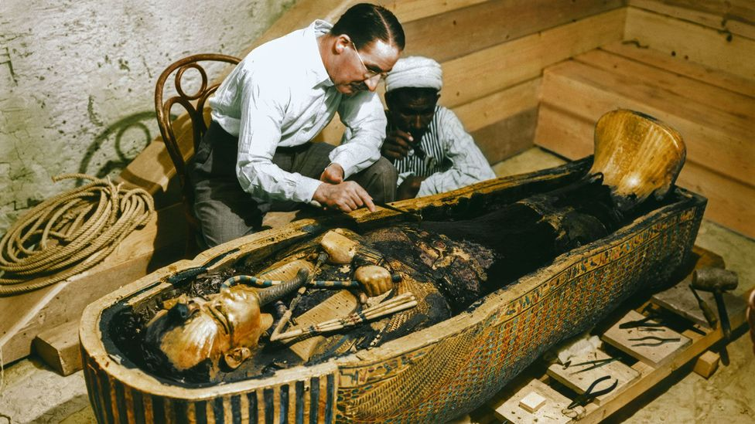
Starter
Let’s recap the part of the event when they finally found Tutankhamun’s magnificent coffin.

Slide 4
Today we are going to write the next paragraph of our recount.
I would like you to work with your partner to write ideas on the whiteboards, then we will write our own paragraph independently.

Slide 5
First, let’s start with a time adverbial.

Slide 6
Describe what you could see?
How did you uncover the sarcophagus?
How did you feel?

Slide 7
Finally, we need a conclusion paragraph.

Slide 8
Plenary:
Let’s share our recounts!
If you make an edit use the code CI in your book.

