Slide 1

Tuesday 12th October 2021
L.O: To write with purpose.
C: Howard Carter Informal Recount.

Slide 2
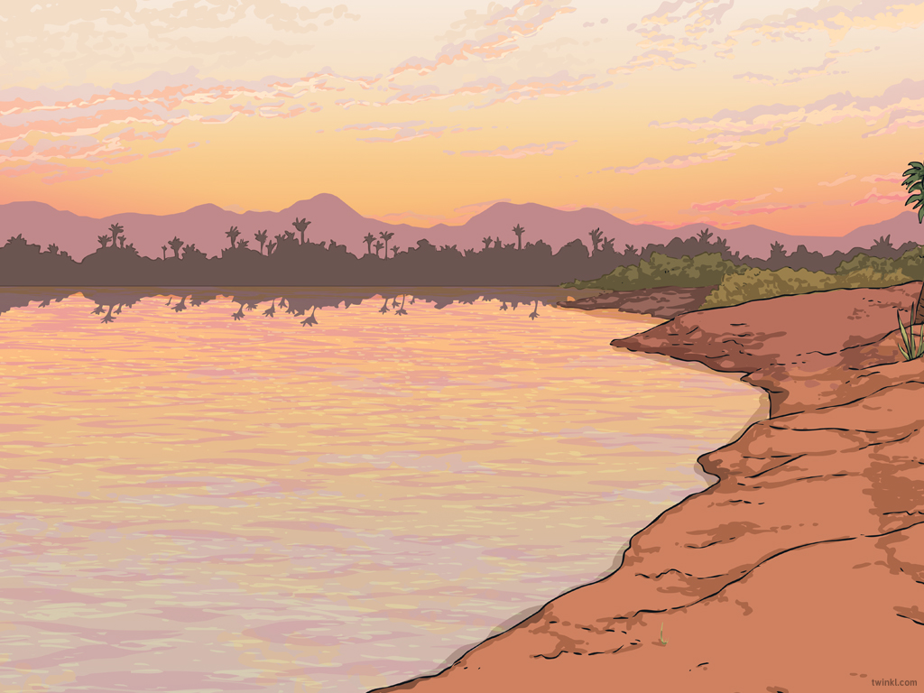
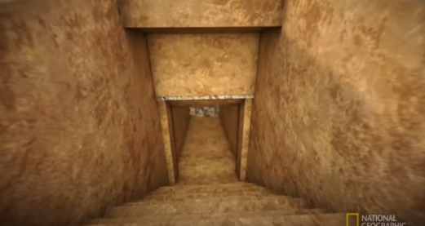
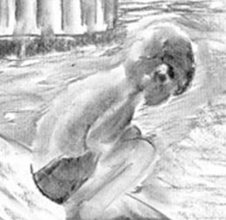
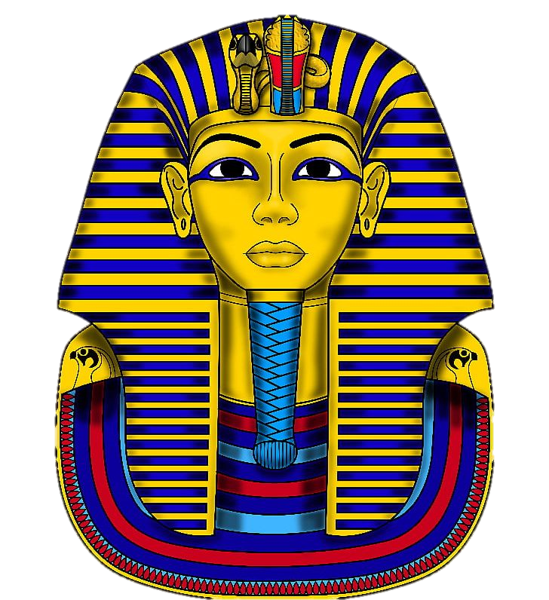
Starter
Let’s recap the part of the event when they first discover the steps...

Slide 3

Today’s Team Point Challenge!
Try to include these words/phrases in your writing and ensure they are spelt correctly.
-sensational break-through
my pulse was racing

Slide 4
Today we are going to write the next paragraph of our recount.
I would like you to work with your partner to write ideas on the whiteboards, then we will write our own paragraph independently.

Slide 5
First, let’s start with one of our amazing time adverbials...

Slide 6
Next, we need to talk about the moment the young boy found something hard.
How did you feel?

Slide 7
Now you have uncovered the rest of the steps!
How did you feel?

Slide 8
Remember: You had to cover them back up and wait for Lord Carnarvon.

Slide 9
Plenary:
Let’s share our work and see if we can edit anything together.
If you make an edit use the code CI in your book.

