Slide 1


Slide 3
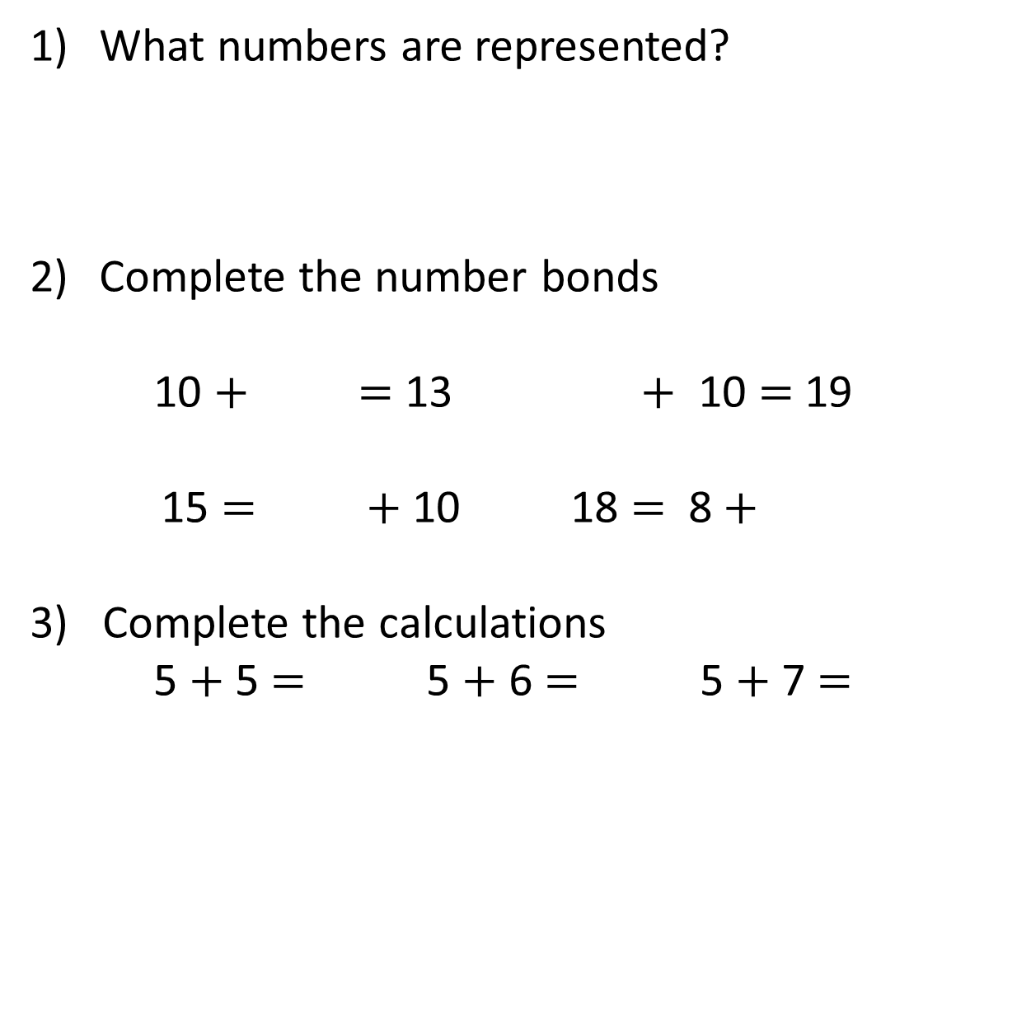
What numbers are represented?
Complete the number bonds
10 $+$ $=$ 13 $+$ 10 $=$ 19
15 $=$ $+$ 10 18 $=$ 8 $+$
3) Complete the calculations
5 $+$ 5 $=$ 5 $+$ 6 $=$ 5 $+$ 7 $=$
c
c
c
c

Slide 4
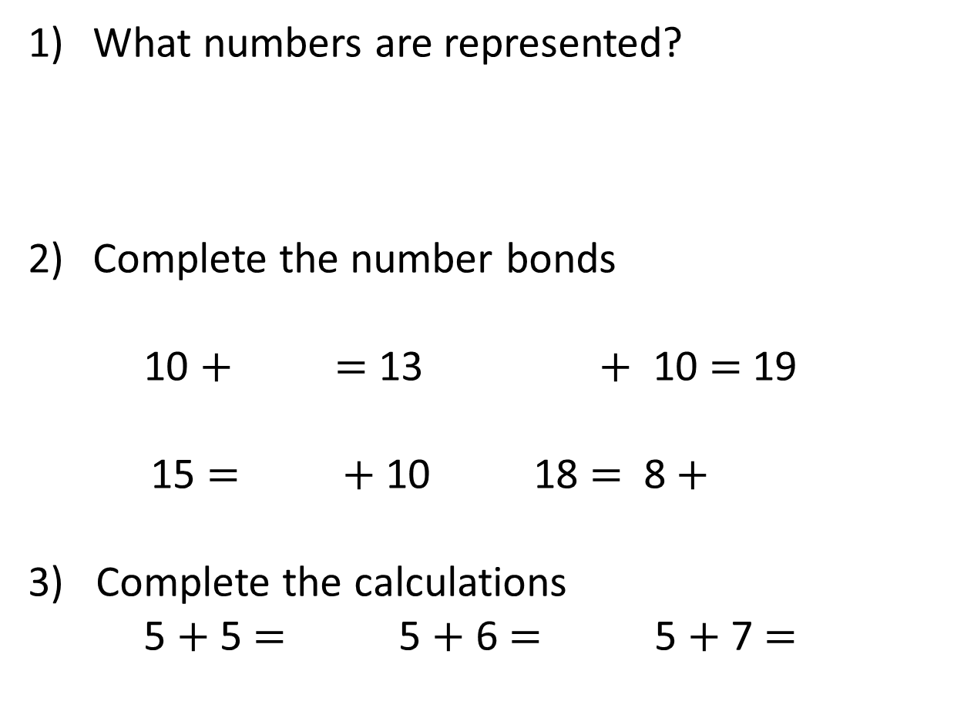
What numbers are represented?
Complete the number bonds
10 $+$ $=$ 13 $+$ 10 $=$ 19
15 $=$ $+$ 10 18 $=$ 8 $+$
3) Complete the calculations
5 $+$ 5 $=$ 5 $+$ 6 $=$ 5 $+$ 7 $=$
15
18
20
3
c
9
c
c
c
5
10
10
11
12

Slide 6
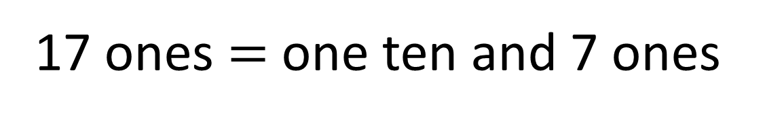
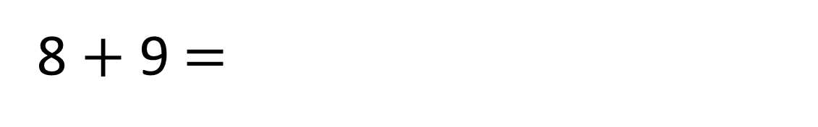
8 $+$ 9 $=$
17
17 ones $=$ one ten and 7 ones

Slide 7
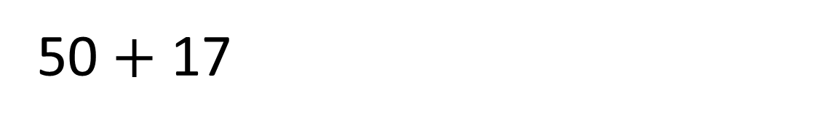
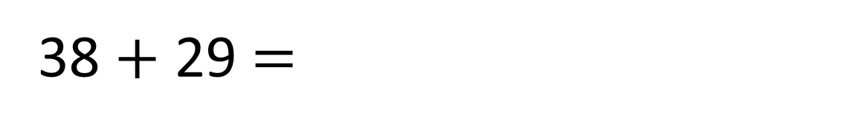
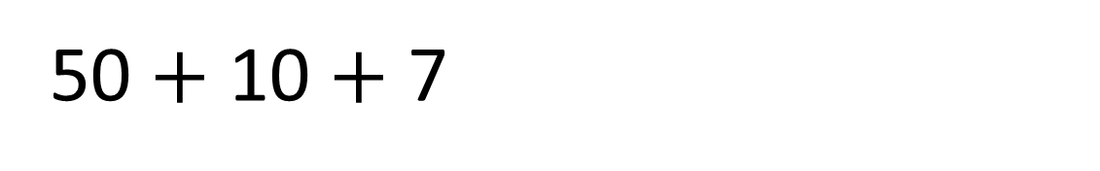
38 $+$ 29 $=$
67
50 $+$ 17
50 $+$ 10 $+$ 7

Slide 8
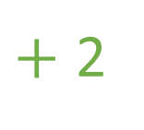
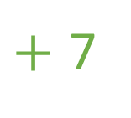
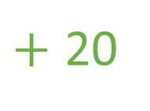
38 $+$ 29 $=$
67
$+$ 20
$+$ 2
$+$ 7
38
58
60
67

Slide 9


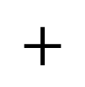
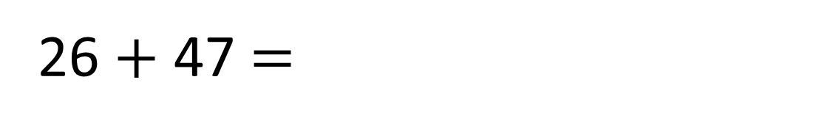
26 $+$ 47 $=$
73
Tens | Ones
 | T | O
 | 2 | 6
 | 4 | 7
$$+$$
3
7
7
3
1

Slide 10

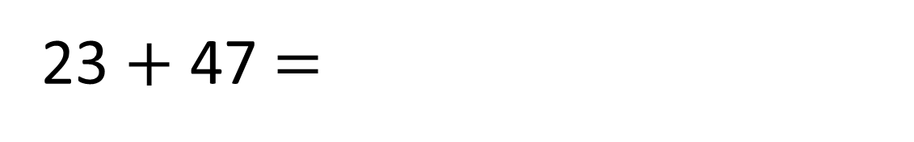
23 $+$ 47 $=$
70
Have a think
Tens | Ones
 | T | O
 | 2 | 3
 | 4 | 7
$$+$$
7
0
7
0
1

