Slide 1
Monday 1st November 2021
LO: To organise writing appropriately
C: Explanation Text Features

Slide 2
How do you solve 4 + 5 =

Slide 3
How did you, or your parents,
make breakfast?
Think about the answers you gave.
What were you doing?

Slide 4
EXPLANATION
Can you define what this work means?

Slide 5
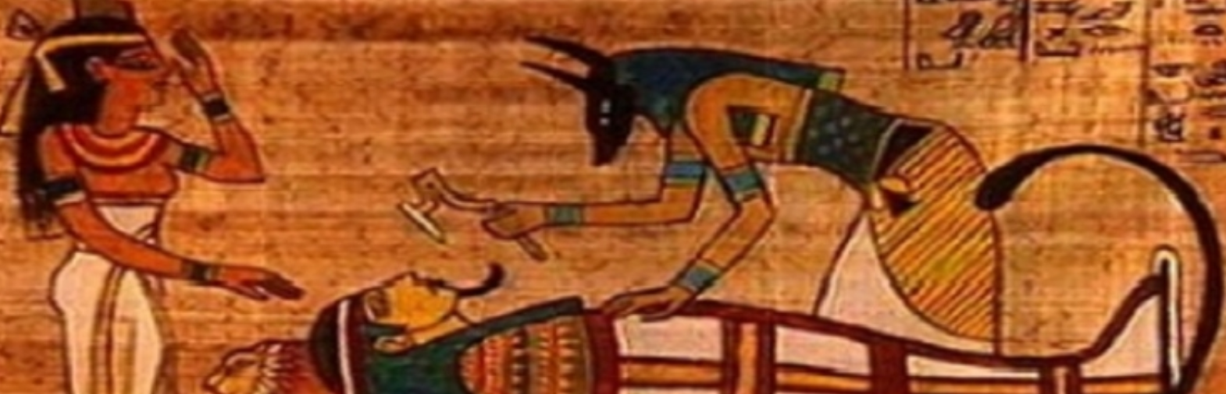
We are going to be writing an explanation text on the mummification process!
So we really need to understand how to write one properly!

Slide 6
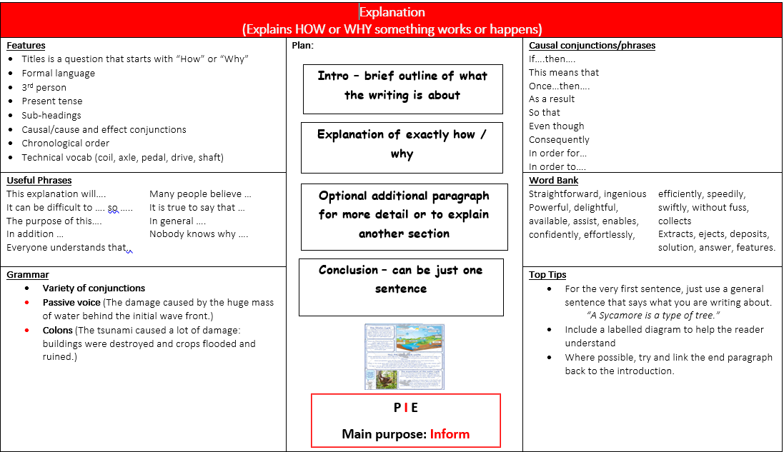

Slide 7
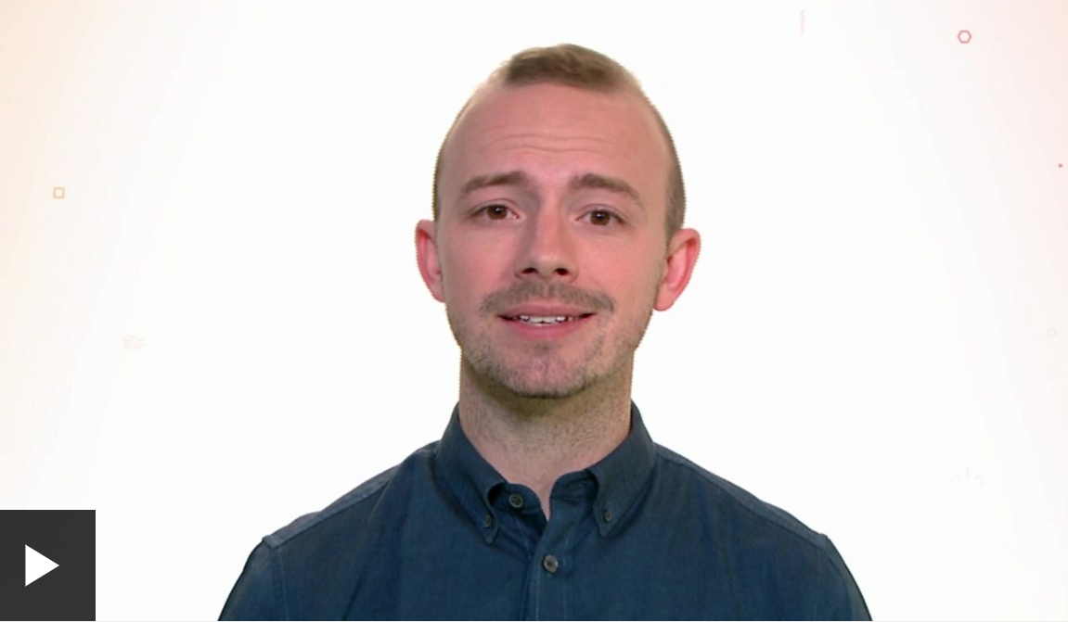
EXPLANATION
Can you define what this work means?
https://www.bbc.co.uk/bitesize/articles/zk69g7h

Slide 8
Talk To Your Partner
What are the key features of an explanation text?

Slide 9
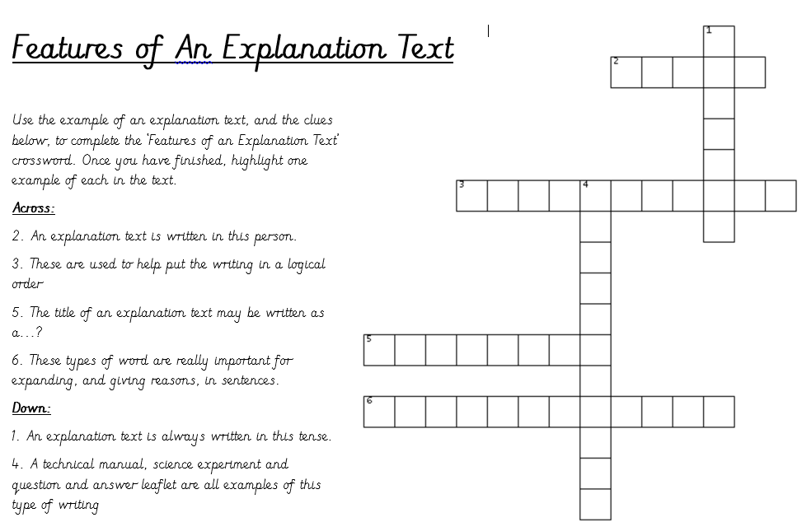
Using what you know, can you complete the crossword
and highlight the text in order to show all the key features.

