Slide 1
Tuesday 2nd November 2021
LO: To write with purpose
C: Mummification Process Plan

Slide 2
Talk to Your Partner
What can you remember about
explanation texts?

Slide 3
The question we are going to be answering:
What happened during the Mummification Process in Ancient Egyptian times?

Slide 4
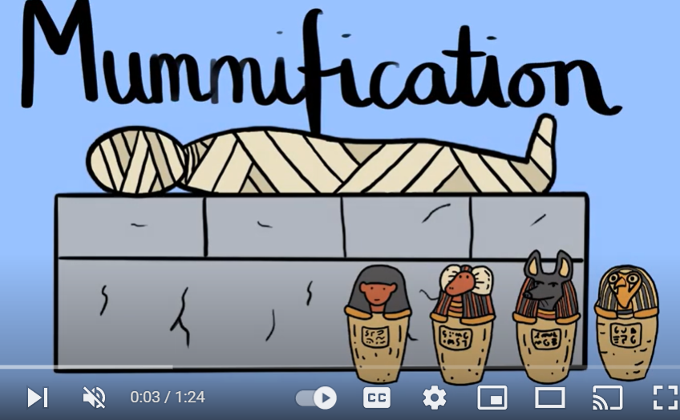
The process simplified!
(Remember to take notes)
https://www.youtube.com/watch?v=_gggNY6DR4k

Slide 5
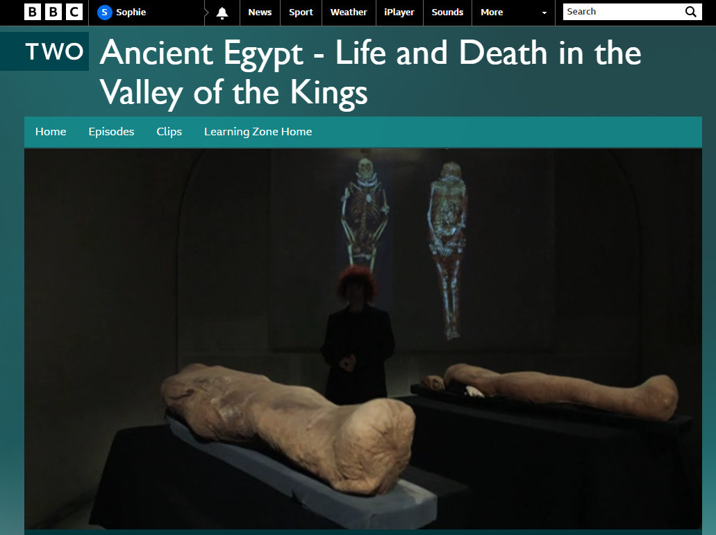
Now let’s add more detail…
https://www.bbc.co.uk/programmes/p018c9dy

Slide 6
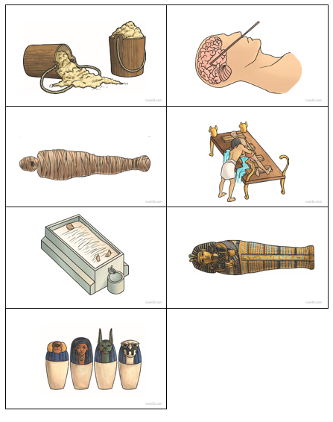
Task
Put the pictures in order and write a sentence to go with each one.

