Slide 1


Slide 3
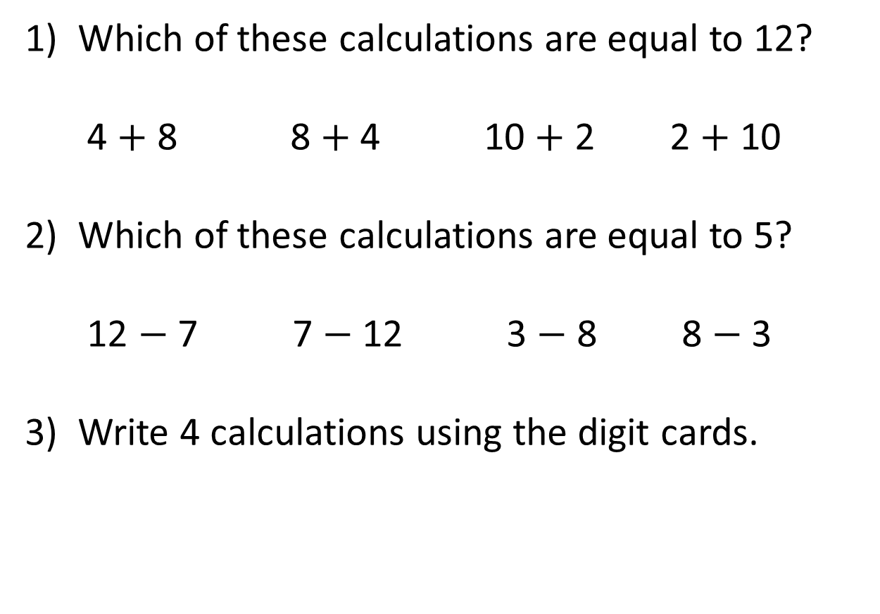
1) Which of these calculations are equal to 12?
4 $+$ 8 8 $+$ 4 10 $+$ 2 2 $+$ 10
2) Which of these calculations are equal to 5?
12 $−$ 7 7 $−$ 12 3 $−$ 8 8 $−$ 3
3) Write 4 calculations using the digit cards.
3
4
7

Slide 4
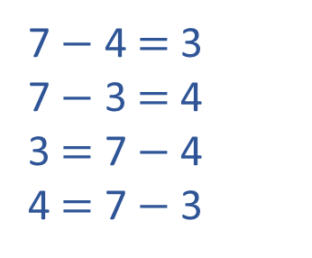
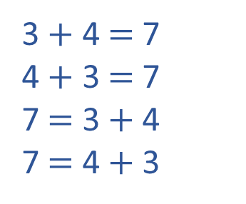
1) Which of these calculations are equal to 12?
4 $+$ 8 8 $+$ 4 10 $+$ 2 2 $+$ 10
2) Which of these calculations are equal to 5?
12 $−$ 7 7 $−$ 12 3 $−$ 8 8 $−$ 3
3) Write 4 calculations using the digit cards.
3 $+$ 4 $=$ 7
4 $+$ 3 $=$ 7
7 $=$ 3 $+$ 4
7 $=$ 4 $+$ 3
7 $−$ 4 $=$ 3
7 $−$ 3 $=$ 4
3 $=$ 7 $−$ 4
4 $=$ 7 $−$ 3
3
4
7

Slide 6
Hundreds | Tens | Ones
H | T | O
2 | 5 | 2
 | 2 | 3
+
2
7
5

Slide 7



Hundreds | Tens | Ones
H | T | O
2 |  | 4
 | 3
0
+
2
2
3
6

Slide 8
H | T | O
3 |  | 4
4 | 2
H | T | O
3 |  | 4
 | 4
1
1
+
+
2
7
3
4
3
5
6

Slide 9
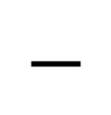
Hundreds | Tens | Ones
H | T | O
3 | 8 | 7
 | 2 | 3
$$−$$
3
6
4

Slide 10

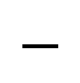
Have a think
Hundreds | Tens | Ones
H | T | O
4 | 3 | 7
 | 1 | 7
$$−$$
4
2
0

Slide 11
Have a go at question
1 - 3 on the worksheet

Slide 12
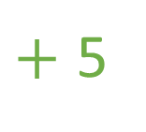
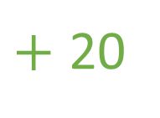
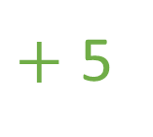
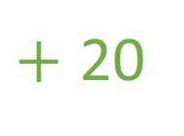
264 + 25 =
289
25
20
5
$+$ 20
$+$ 5
264
284
289
$+$ 5
$+$ 20
264
269
289

Slide 13
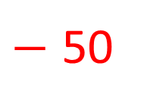
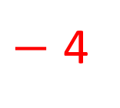
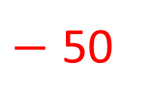
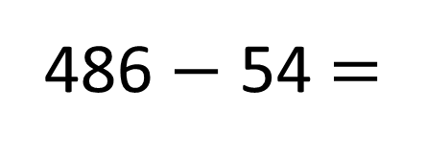
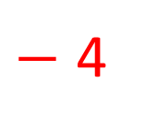
486 $−$ 54 =
432
54
$−$ 4
$−$ 50
50
4
432
436
486
$−$ 50
$−$ 4
432
482
486

Slide 14
Have a go at question
4 – 6 on the worksheet

Slide 15
0 1 3 4 6
H | T | O
4 | 7 | 3
1
4
6
3
+
1
0

Slide 16
Have a go at the rest of the questions on the worksheet

