Slide 2
Thursday 21st October 2021
L.O: To write with purpose.
C: Biography

Slide 3


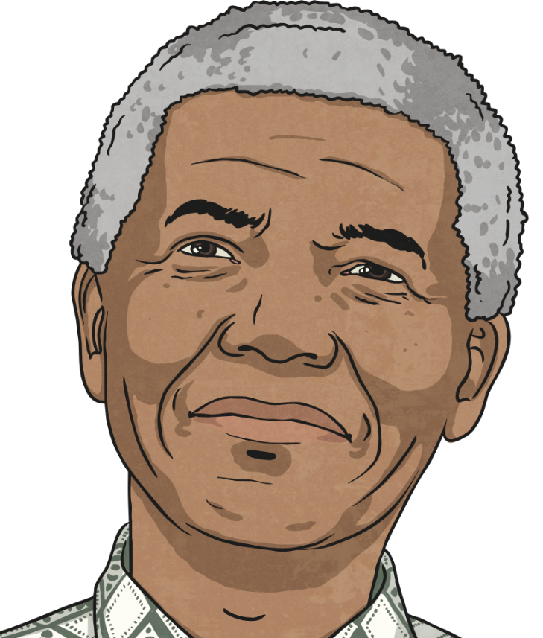
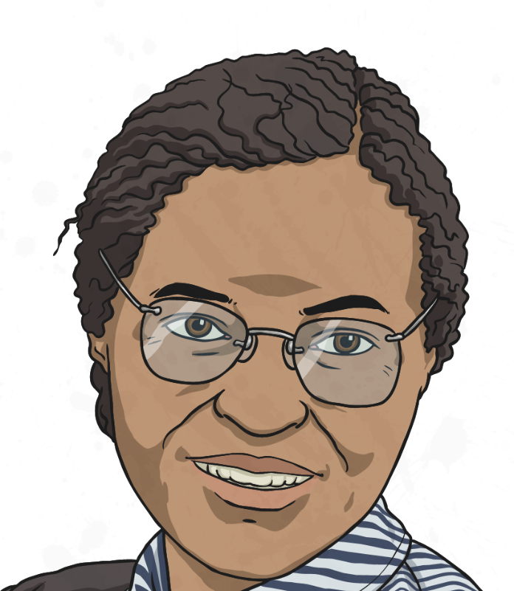
Today is editing
and
assessment time!

Slide 4
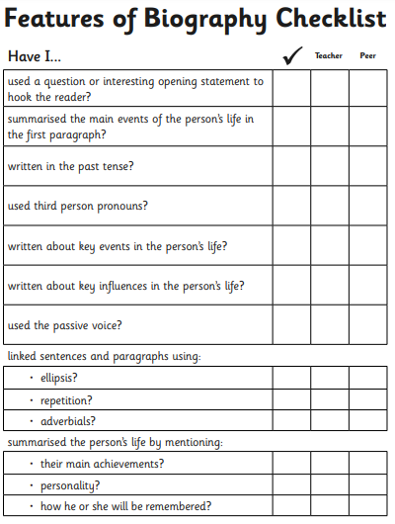
We are going to use a book-on-book approach to work through this checklist ☺

