Slide 2
Tuesday 19th October 2021
L.O: To write with purpose.
C: Biography

Slide 3

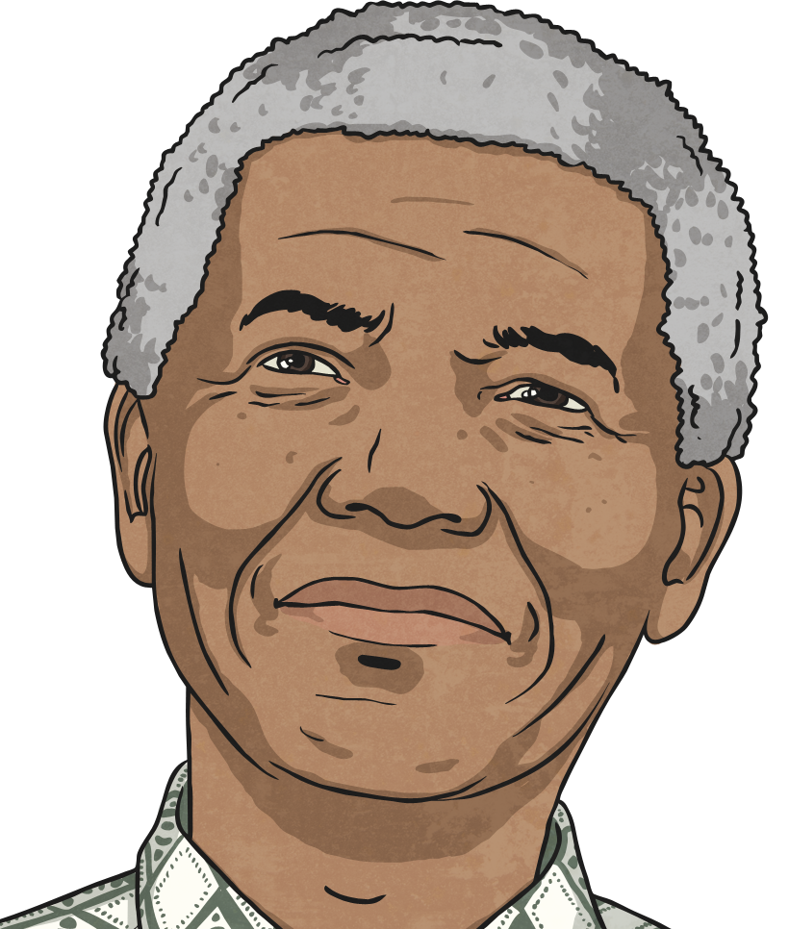
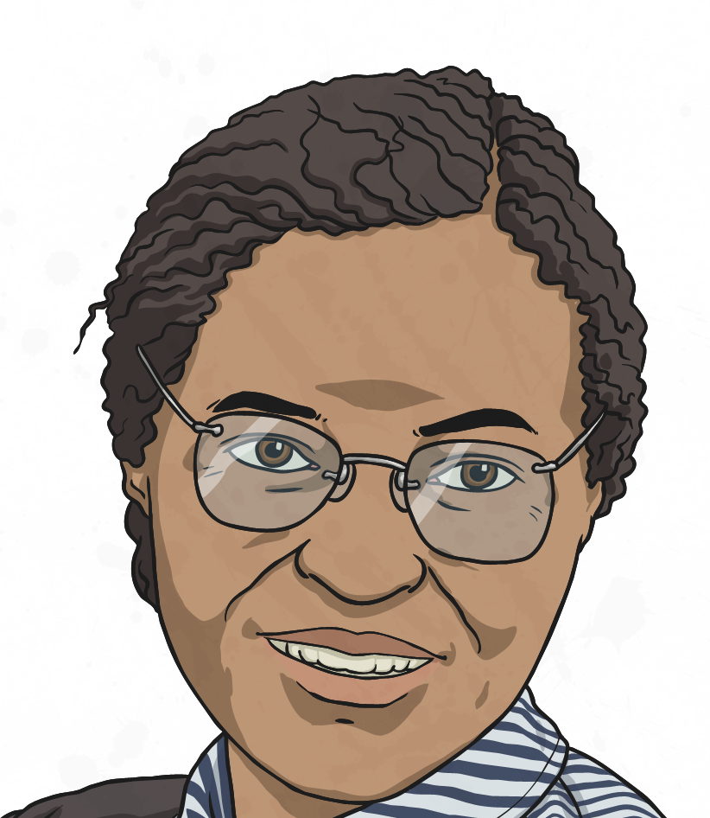
Let’s Recap
Yesterday we explored a range of famous figures and you selected someone inspirational to write about!

Slide 4

Starter
A key feature of biographies is the use of possessive apostrophes.
A possessive apostrophe shows that something belongs to someone.
e.g. Miss Watton’s dog is called Buddy.
Mrs Cox’s dog is called Willow.

Slide 5
Starter
Let’s work through some apostrophe challenges together!

Slide 6

Let’s start writing our biographies!
We start with a title and a question to entice our reader!
We can then begin by describing their early life.
Remember to include your subheadings.

