Slide 2
Monday 18th October 2021
L.O: To analyse writing.
C: Biography

Slide 3

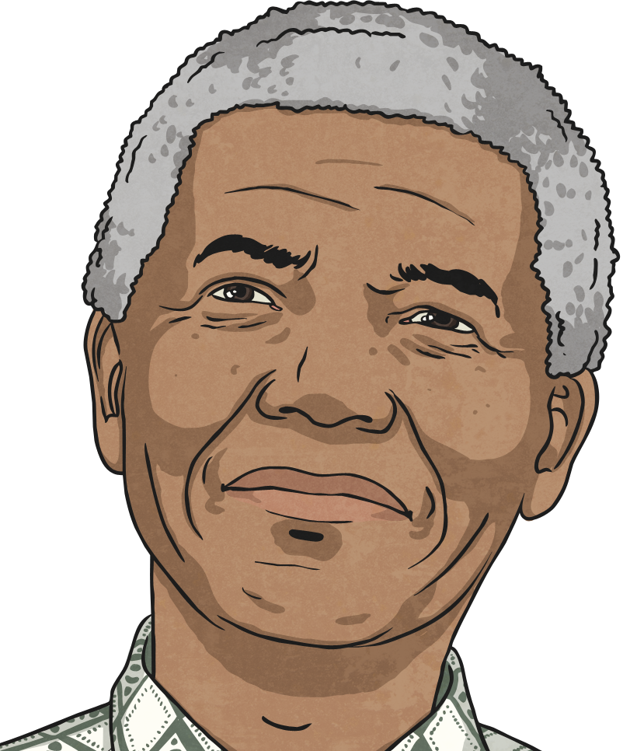
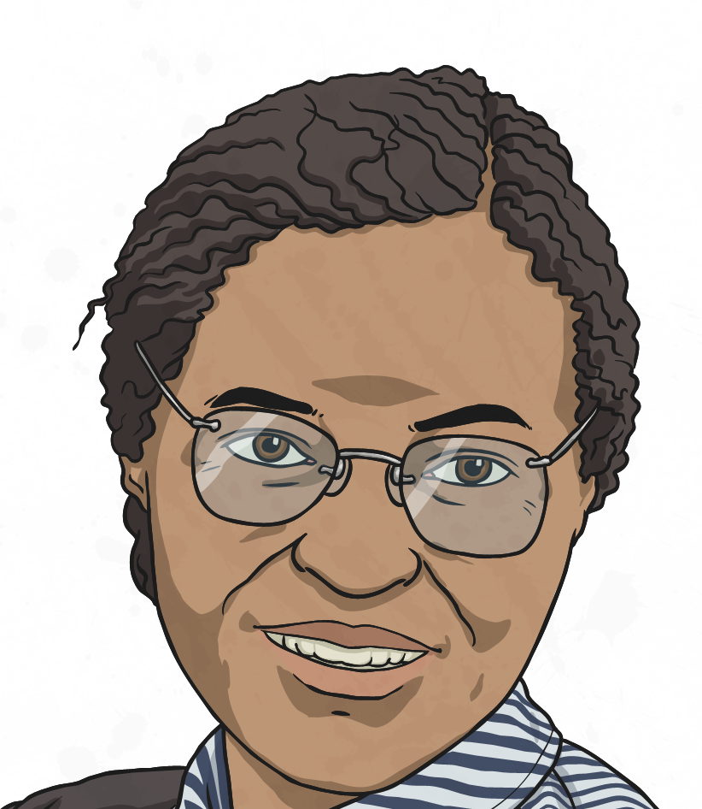
Let’s Recap
Black History Month is a time set aside each year to celebrate the achievements of Black men and women in the past and today.

Slide 4

Last week…
You made some amazing stars to describe some incredible famous figures.
Today we are going to investigate a few more famous figures.

Slide 5
Last week…
We are going to collect some information to help us write biographies!
A biography is a piece of non-fiction writing which informs us about the life and achievements of somebody!

Slide 6
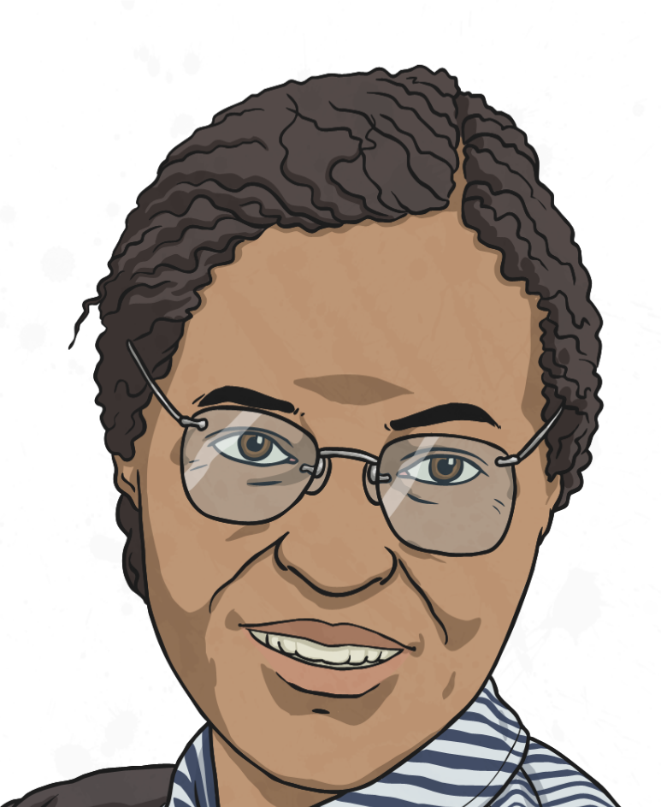
Today’s Task!
First I would like you to work through the fact files and choose a famous figure you would like to write your biographies about.

Slide 7
Today’s Task!
Next I would like you to fill in your pre-writing sheet!
The more facts and detail you record, the better your biography will be!

