Slide 2
Wednesday 20th October 2021
L.O: To write with purpose.
C: Biography

Slide 3


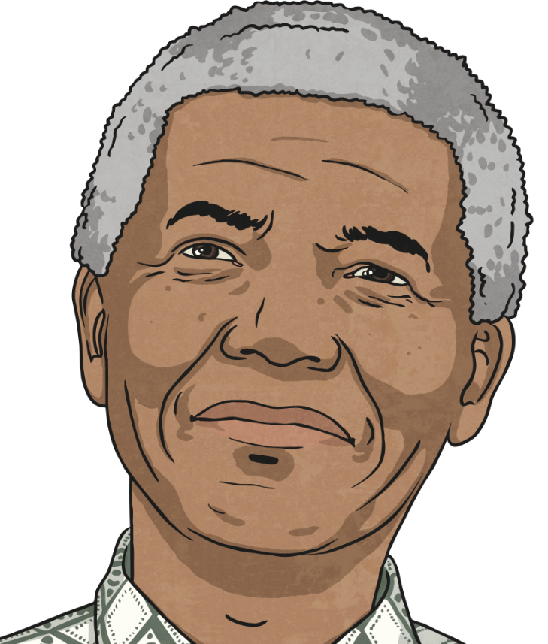
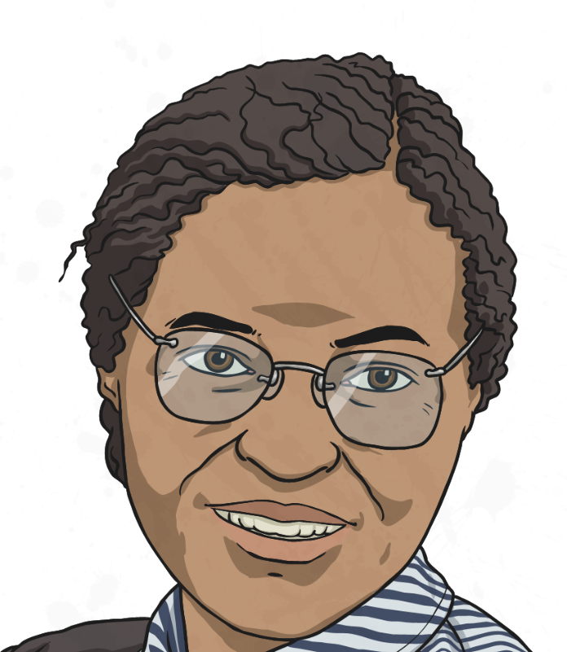
Starter
RED PEN TIME!
Can you edit and improve your work from yesterday?

Slide 4

Let’s finish writing our biographies!
We need to explain our famous figure’s legacy!
Why are they remembered?
What change did they instigate?

