Slide 1


Slide 2
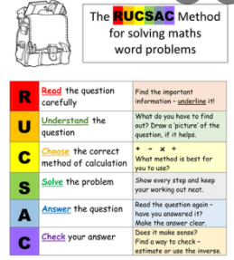

Slide 3
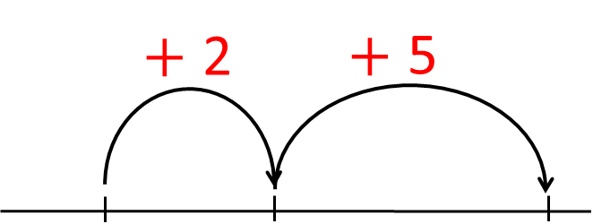



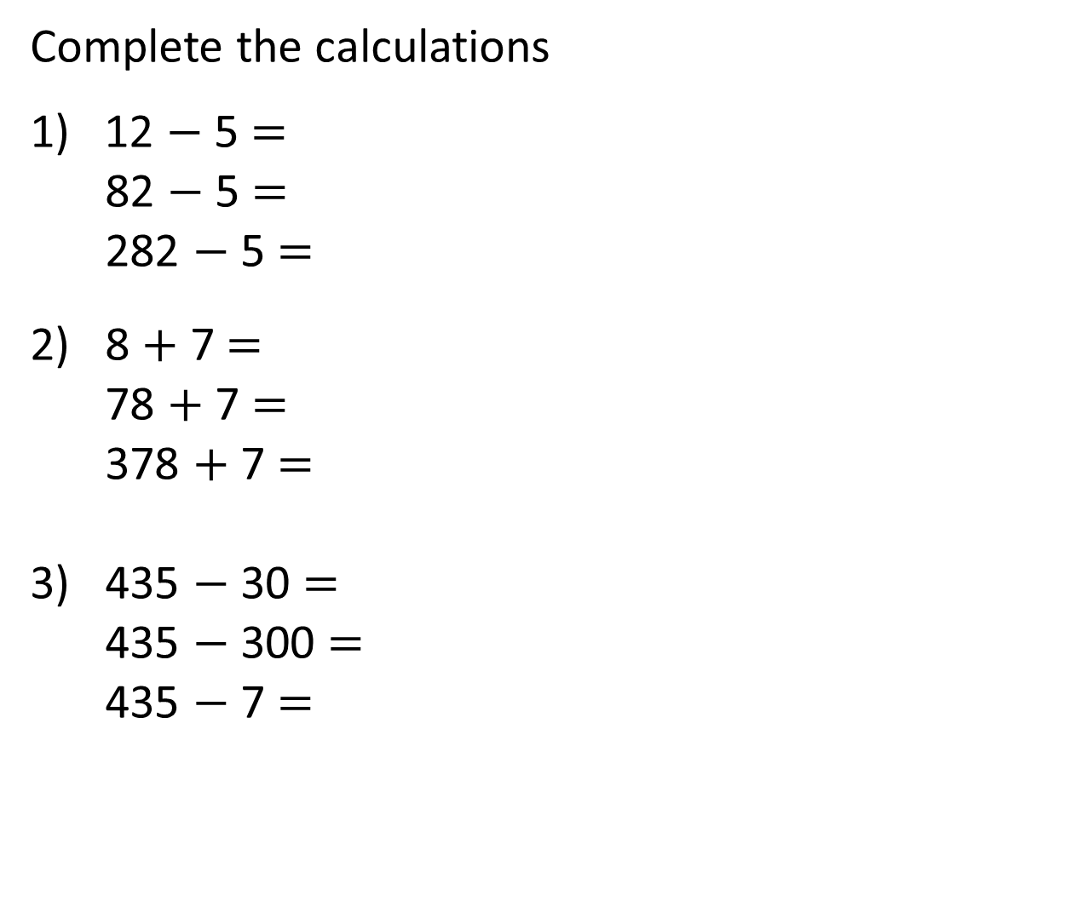

Complete the calculations
1) 12 $−$ 5 $=$
82 $−$ 5 $=$
282 $−$ 5 $=$
2) 8 $+$ 7 $=$
78 $+$ 7 $=$
378 $+$ 7 $=$
3) 435 $−$ 30 $=$
435 $−$ 300 $=$
435 $−$ 7 $=$
$−$3
$−$2
10
12
$+$2
$+$5
8
10

Slide 4
Complete the calculations
1) 12 $−$ 5 $=$
82 $−$ 5 $=$
282 $−$ 5 $=$
2) 8 $+$ 7 $=$
78 $+$ 7 $=$
378 $+$ 7 $=$
3) 435 $−$ 30 $=$
435 $−$ 300 $=$
435 $−$ 7 $=$
7
$−$3
$−$2
77
277
12
10
15
$+$2
$+$5
85
385
8
10
405
135
428

Slide 6



g
e
e
n
l
l
m
a
a
t
h
s
c
h
I will get some base 10 ready for us
I can’t wait to get
started.
Me too!

Slide 7
Have a go at questions
1 - 5 on the worksheet

Slide 8
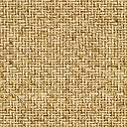
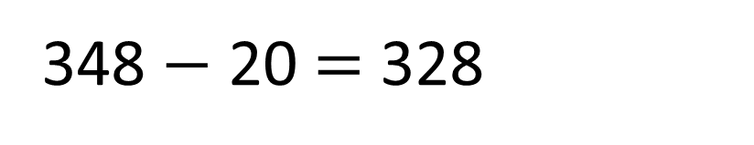
348 cm
328 cm
?
20 cm
348 $−$ 20 $=$ 328
I started by drawing the string and labelling what I knew

Slide 9
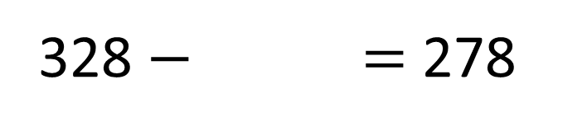
328 cm
278 cm
50 cm
?
This part was a bit trickier so we used base 10 to help us.
328 $−$ $=$ 278
50

Slide 10
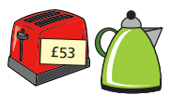
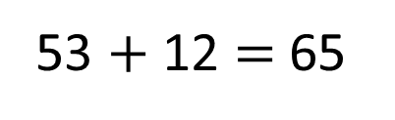

The kettle costs £12 more than the toaster.
How much do the kettle and toaster cost altogether?
Toaster
53
12
£118
?
Kettle
65
53 $+$ 12 $=$ 65
H | T | O
 | 5 | 3
 | 6 | 5
I think the kettle and the toaster cost £65
$$+$$
1
1
8
I think the kettle and the toaster cost £118
1

Slide 11
Have a go at the rest of the questions on the worksheet

Slide 12
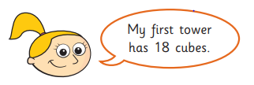

Ava started with 100 cubes.
She built 2 towers.
She had 55 cubes left.
100
55
27
18
I used a part-whole model

Slide 13
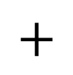

Ava started with 100 cubes.
She built 2 towers.
She had 55 cubes left.
100
T | O
5 | 5
1 | 8
18
27
55
?
$$+$$
7
3
I used a bar model
1
100 $−$ 73 $=$ 27

