Slide 1
Thursday 18th November 2021
LO: To write with purpose
C: Explanation Text

Slide 2
What section did we write yesterday?
What grammar terminology did we look at?

Slide 3

MC Grammar - Prepositions
https://www.youtube.com/watch?v=QZVK0VFvRVY

Slide 4
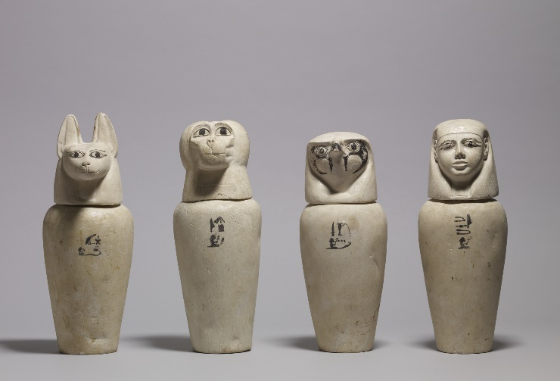
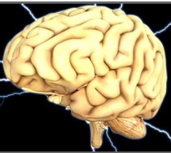
What is the next section we are going
to write?

Slide 5
In order to write this section, what
information are we going to need?

Slide 6
Why did they remove some of the
organs?
Where did they put them after?
Why did they leave some of the organs?

Slide 7
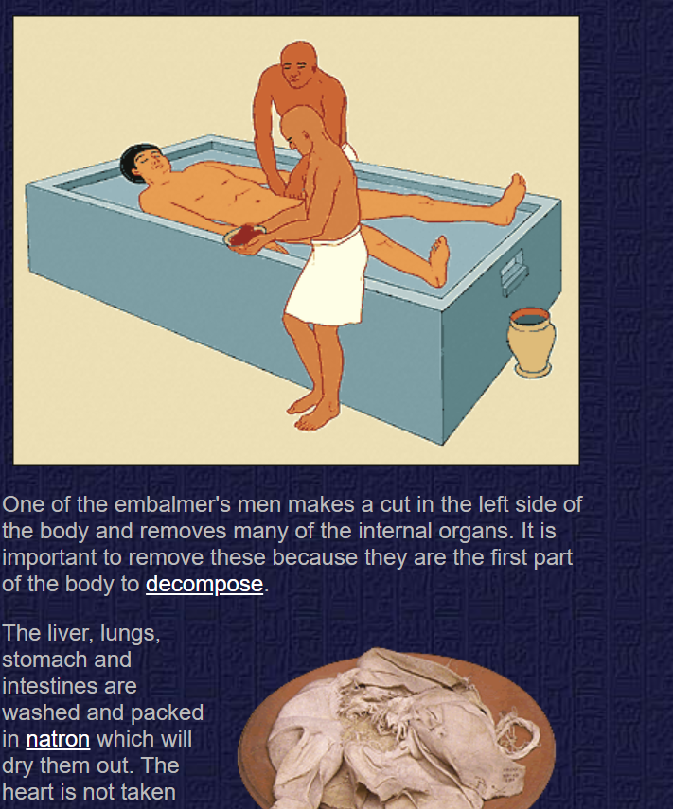
http://www.ancientegypt.co.uk/mummies/story/page3.html

Slide 8
How do we need to set out our work?
What features do we need to remember?

Slide 9
Have a go at writing your next section
Can you include any prepositions?

