Slide 1
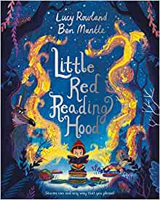
Thursday 10th June 2021
LO: To use sentences appropriately
C: Opening
MY
STORY

Slide 2
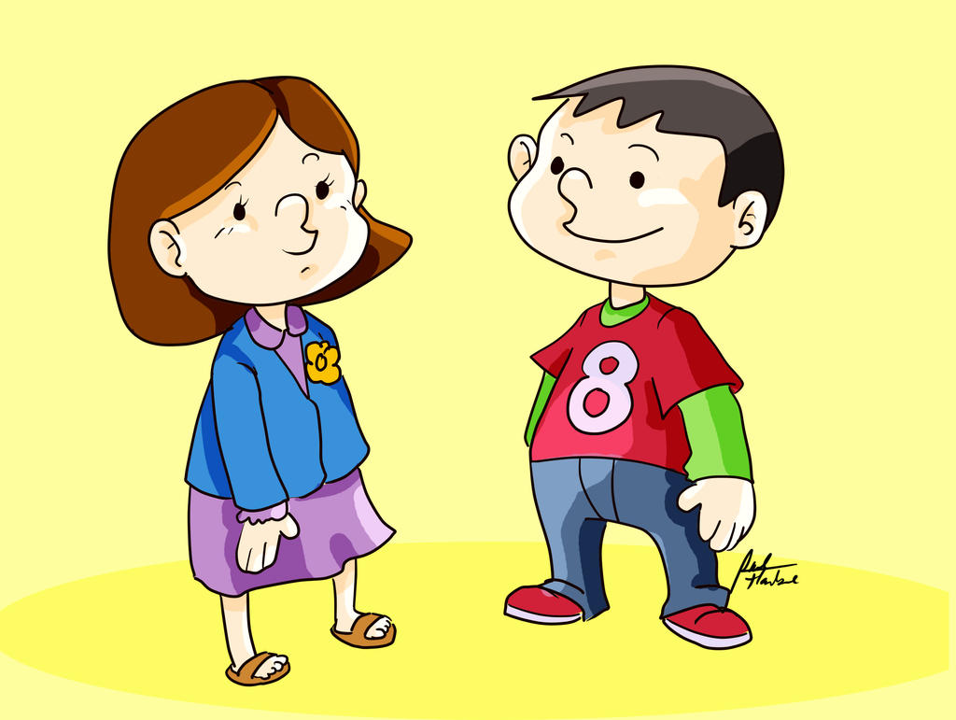
Starter
Talk your partner through your story idea.

Slide 3
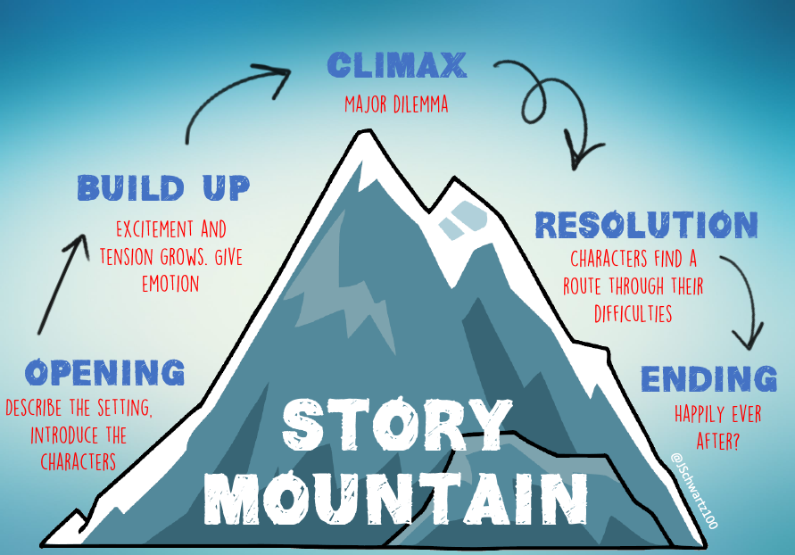
Today we are focusing on…

Slide 4
Warning Tale Structure
The opening section should start with your character wanting to go to your chosen location and being warned about a possible danger. This section will need to contain a conversation between you (main character) and you parents/adult.
What is that conversation going to be?

Slide 5
Have I correctly used speech punctuation in my opening?
I had always been adventurous and loved to explore. One sunny afternoon, after finishing my homework and chores, I asked my Mum if I could go and explore the woods at the end of the road alone.
“Now Sophie, don’t go too far into the wood, it is getting late,” my mum had warned me.
“Yeah, yeah…” I shouted back not really listening. “I promise I won’t be out for too long.”
“You’ll get lost in the dark!”
Did I listen? Of course I didn’t. I had explored so many places on my own and it never worried me. Mum worries too much! I threw on my trainers and ran out of the door, down the road and into the woods.

Slide 6
Try and have a go at writing your opening which includes speech!

