Slide 1
Wednesday 23rd February 2022
L.O. To investigate places
C: Historical Binfield

Slide 2
Look at the map
https://digimapforschools.edina.ac.uk/?error=session&context=/roam/map/schools
Or Google Maps
We are going to look at how Binfield changed throughout the years!

Slide 3
Look at the map
https://digimapforschools.edina.ac.uk/?error=session&context=/roam/map/schools
Or Google Maps
We are going to look at how Binfield changed throughout the years!

Slide 4
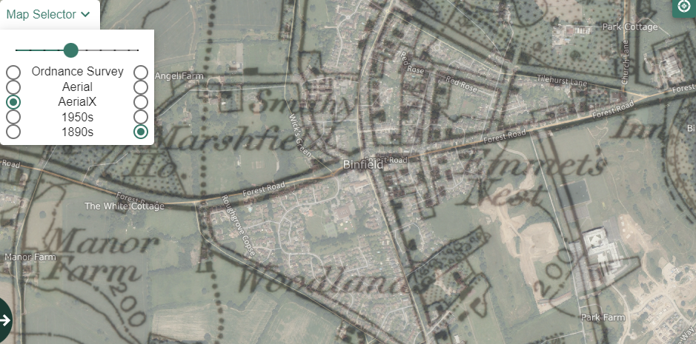
How has the land use changed over time?

Slide 5
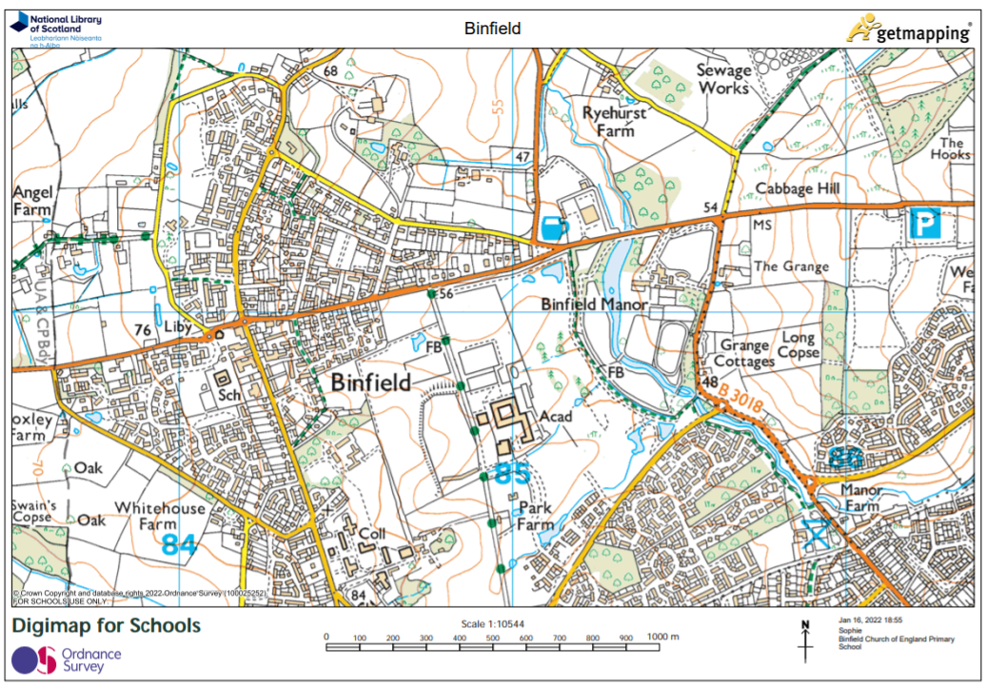
Task
Use tracing paper to draw on some of the human features we have today in Binfield (e.g. shops).
Copy and complete:
I think the human features in Binfield have changed because..

