Slide 1
Friday 25th February 2022
L.O: Identify that humans and some other animals have skeletons and muscles for support, protection and movement.
C: Animals and Humans

Slide 2
https://www.bbc.co.uk/bitesize/clips/ztfnvcw

Slide 3

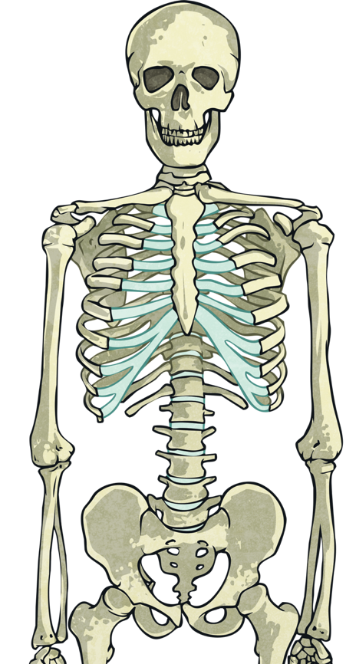
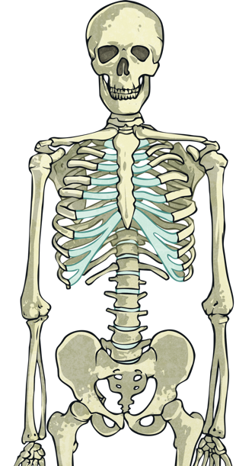
What is a skeleton?
Every human and animal is born with a skeleton. A skeleton is made up of bones, tissues, cartilage and joints.
Our skeleton grows as we get older.

Slide 4
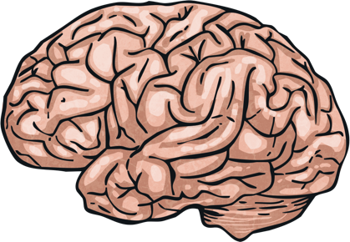
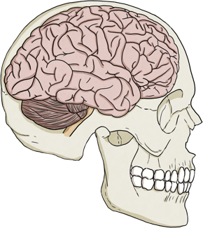
Why do we need a skeleton?
Our skeleton helps us to do many things.
It helps us move
It gives the body structure and shape
It holds us upright
It protects our organs
Can you think of the structure that protects our brain?
That’s right, it’s the skull!

Slide 5
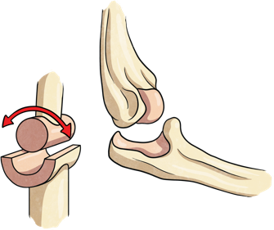
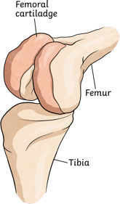

Parts of the skeleton
The skeleton is made up of different parts. Click on the images to find out more information on the parts mentioned below.
Bones
Joints
Cartilage

Slide 6

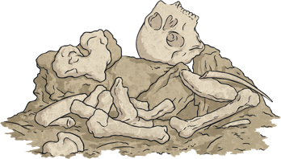
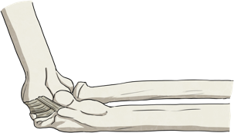
Bones
Bones make up a lot of the skeleton. They are alive and always growing and changing at different rates. We have many different bones in our bodies. Can you name any bones?
Bones are made up of living tissues. The outer tissue is hard and the inner tissue of a bone is soft. Bones can store different nutrients like calcium and fat which can be used by the body when needed.
A baby is born with around 300 bones and as the baby grows into an adult the bones fuse together and the number of bones an adult then has is 206.
Back

Slide 7
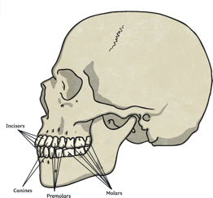
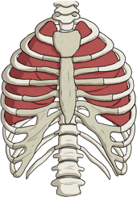

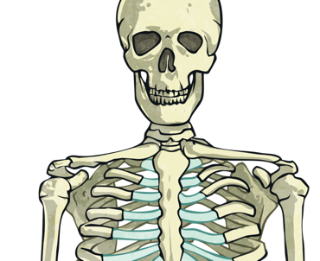
Some bones in the skeleton include:
Back
Skull
Femur
Ribs
Collarbone
Humerus

Slide 8
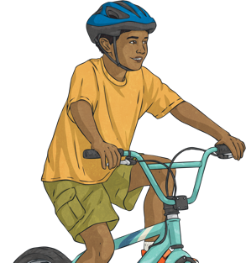
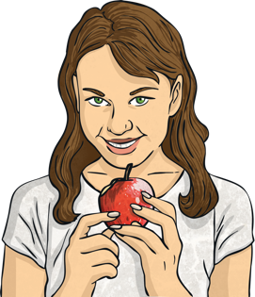
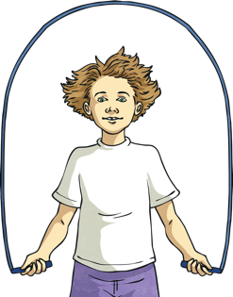
Taking care of our skeleton
It is very important that we keep our bones, joints, muscles and tissues strong and healthy as we grow up. Here are different ways to care for our skeleton.
Wearing a helmet when cycling will protect
your skull.
Eating a healthy diet helps your bones
grow strong.
Being active - exercise helps to strengthen your bones and joints.

Slide 9
https://www.youtube.com/watch?v=Jpvuqj5nv6U

Slide 10
Red pen- what is the difference between vertebrates and invertebrates? Why do some animals not have a backbone?

