Slide 1
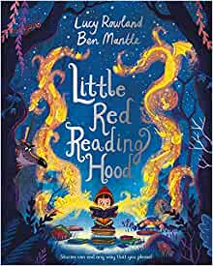
Monday 14th June 2021
LO: To write with purpose
C: Resolution
MY
STORY

Slide 2
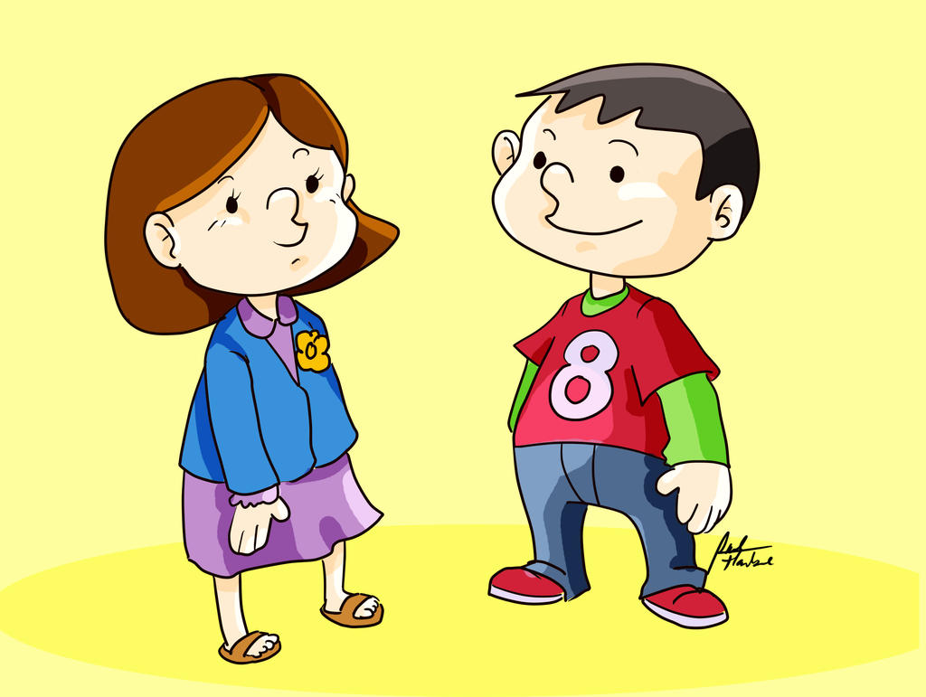
Starter
Read through story and make any edits

Slide 3
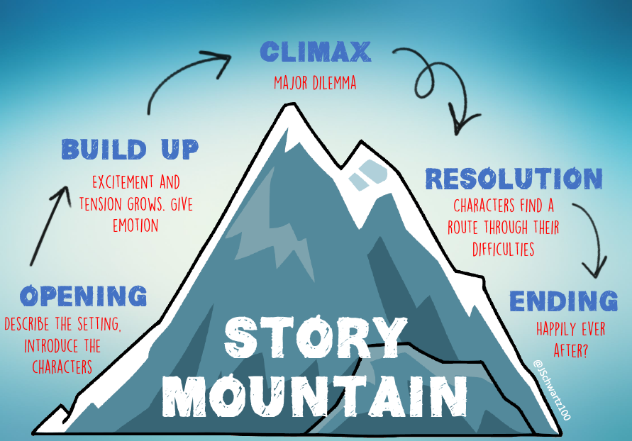
Today we are focusing on…

Slide 4
Resolution
Think about the books you have read recently. How do the characters in that story resolve their problem?
Is the resolution rushed?

Slide 5
Resolution
Your resolution should do three things:
Refer back to the problem at the beginning
Solve all the problems
Main character should learn a lesson

Slide 6


