Slide 1
23.2.2022
L.O: To use measures.
C: Recap Counting Money- Pounds

Slide 3


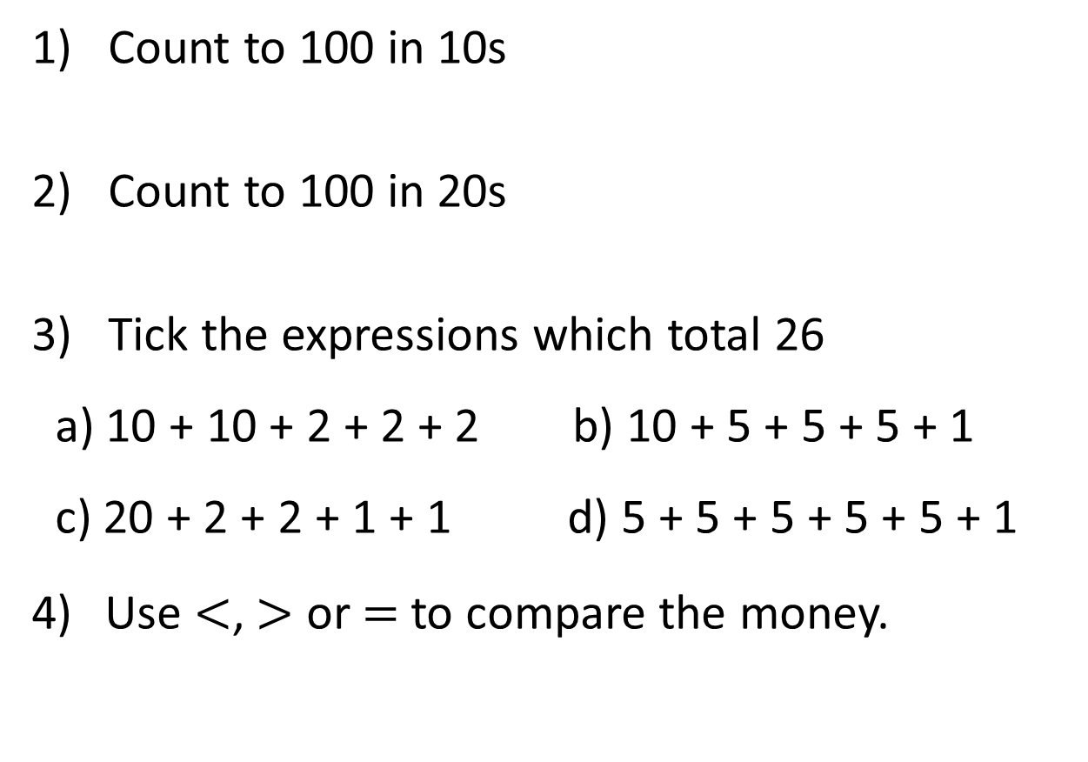
1) Count to 100 in 10s
2) Count to 100 in 20s
3) Tick the expressions which total 26
a) 10 + 10 + 2 + 2 + 2 b) 10 + 5 + 5 + 5 + 1
c) 20 + 2 + 2 + 1 + 1 d) 5 + 5 + 5 + 5 + 5 + 1
Use $<$, $>$ or $=$ to compare the money.

Slide 4


1) Count to 100 in 10s
2) Count to 100 in 20s
3) Tick the expressions which total 26
a) 10 + 10 + 2 + 2 + 2 b) 10 + 5 + 5 + 5 + 1
c) 20 + 2 + 2 + 1 + 1 d) 5 + 5 + 5 + 5 + 5 + 1
Use $<$, $>$ or $=$ to compare the money.
10, 20, 30, 40, 50, 60, 70, 80, 90, 100
20, 40, 60, 80, 100
$$>$$

Slide 5
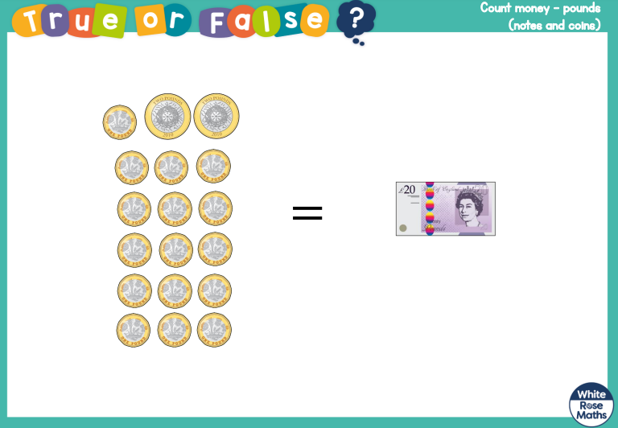

Slide 6
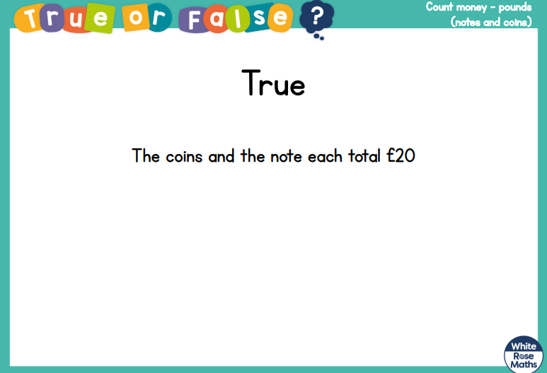

Slide 8










1p
2p
5p
10p
20p
50p
£1
£2
£5
£10
£20
£50

Slide 9

Dora is using pound coins to represent the value of different notes.
Which note has she represented?

Slide 10
Which notes has she represented?

Slide 11
Which note has she represented?

Slide 12

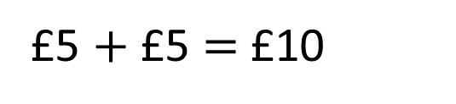
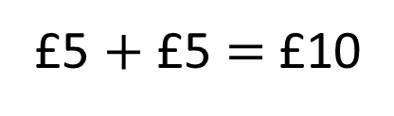
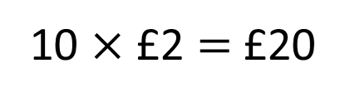
Which sets total £10?
a)
b)
c)
Have a think
10 $×$ £2 $=$ £20
£5 $+$ £5 $=$ £10
£5 $+$ £5 $=$ £10

Slide 13

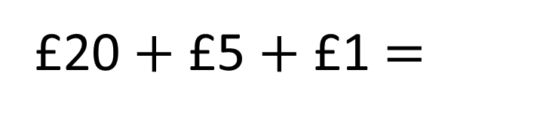
How much money is there?
£20 $+$ £5 $+$ £1 $=$
£26
It’s easier to add them if I place the greatest value notes first.

Slide 14

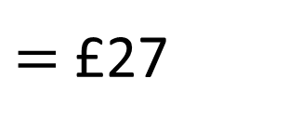
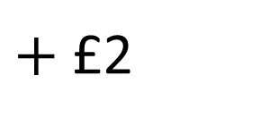
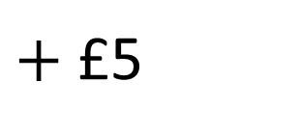
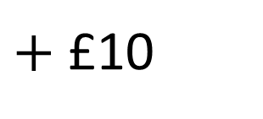
How much money is there?
$=$ £27
£10
$+$ £10
$+$ £5
$+$ £2
If you have pictures of notes and coins, you can cross them out as you count them.

Slide 15
Have a go at questions
1 – 4 on the worksheet

Slide 16

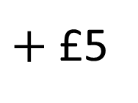
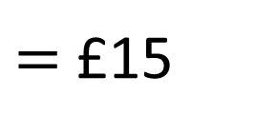
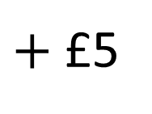
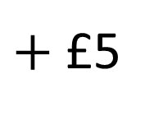
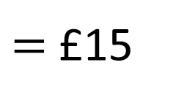
I have more money.
No you don’t, I have more money.
£10
$+$ £5
$=$ £15
£5
$+$ £5
$+$ £5
$=$ £15
Who is correct?
Have a think

Slide 17


Ron is thinking of an amount.
What amount could Ron be thinking of?
My amount can be made using 3 different notes.
£20 + £10 + £5 = £35
£50 + £10 + £5 = £65
£50 + £20 + £5 = £75
£50 + £20 + £10 = £80
Have a think

Slide 18

Annie is making amounts using pounds.
She uses one note and one coin.
How many different possible amounts are there?
Have a think

Slide 19
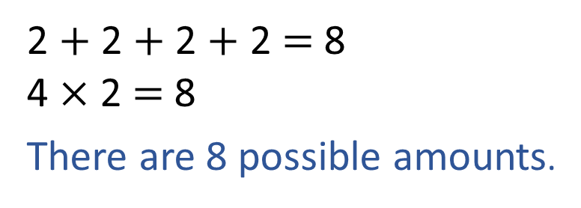
Annie is making amounts using pounds.
She uses one note and one coin.
How many different possible amounts are there?
£5
£1
£5
£2
£10
£1
£10
£2
£20
£1
£20
£2
2 $+$ 2 $+$ 2 $+$ 2 $=$ 8
4 $×$ 2 $=$ 8
There are 8 possible amounts.
£50
£1
£50
£2

Slide 20
Have a go at the rest of the questions on the worksheet

