Slide 1
21.2.2022
L.O: To use measures.
C: Recap counting in pense.

Slide 3




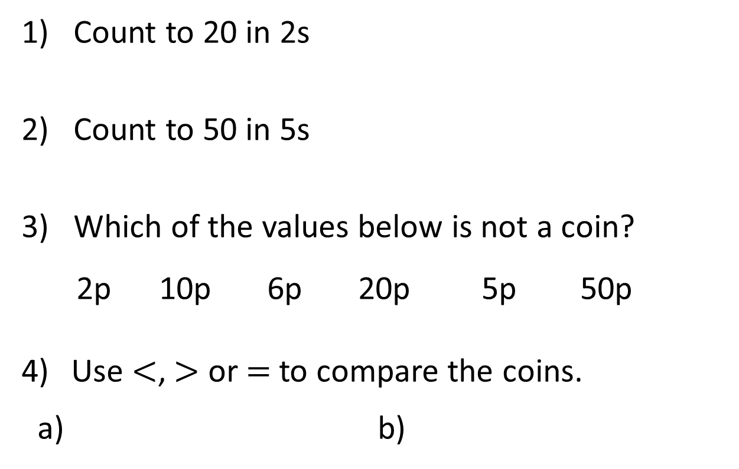
1) Count to 20 in 2s
2) Count to 50 in 5s
3) Which of the values below is not a coin?
2p 10p 6p 20p 5p 50p
Use $<$, $>$ or $=$ to compare the coins.
a) b)

Slide 4


1) Count to 20 in 2s
2) Count to 50 in 5s
3) Which of the values below is not a coin?
2p 10p 6p 20p 5p 50p
Use $<$, $>$ or $=$ to compare the coins.
a) b)
2, 4, 6, 8, 10, 12, 14, 16, 18, 20
5, 10, 15, 20, 25, 30, 35, 40, 45, 50
$$<$$
$$>$$

Slide 5
What coins and notes do we use in the England?

Slide 6








1p
2p
5p
10p
20p
50p
£1
£2
£5
£10
£20
£50

Slide 7
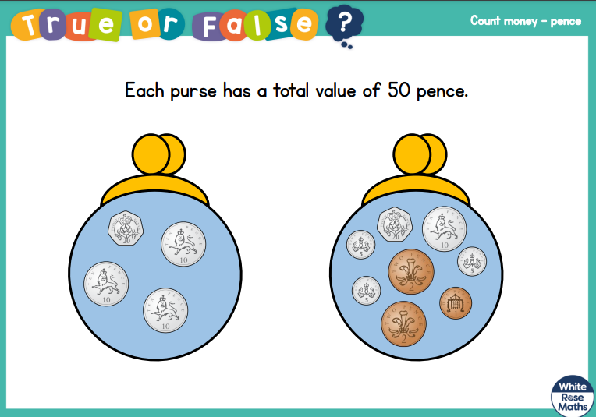

Slide 8
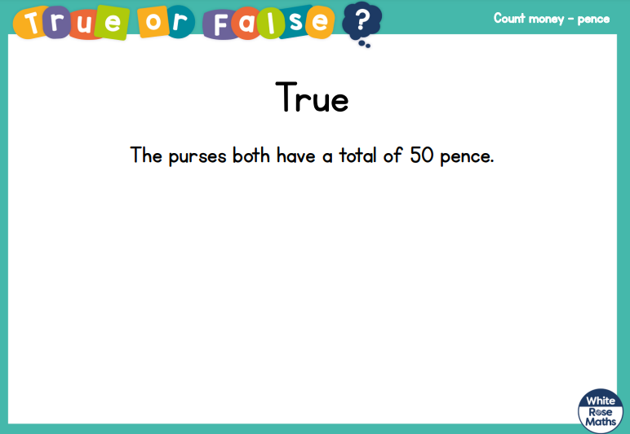

Slide 9
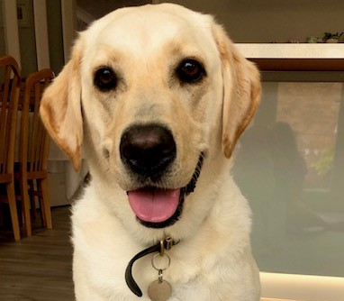
I think that the biggest coins have the highest value.
Do you agree with Buddy?

Slide 10
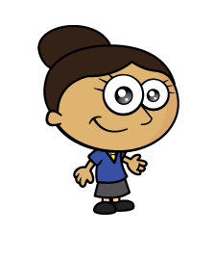

Dora has used pennies to represent the value of different coins.
Which coins has she represented?
Have a think

Slide 11

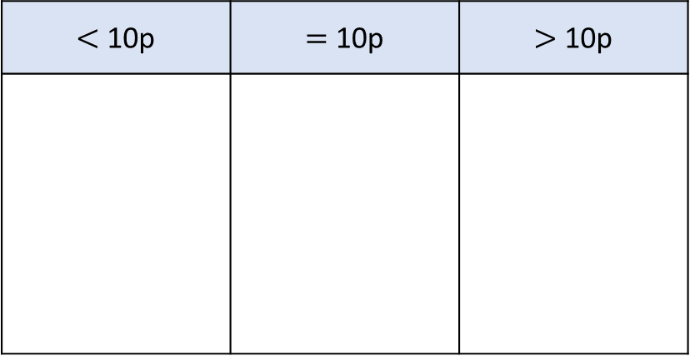
Jack is sorting the coins.
Can you explain how he has sorted them?
How else could you sort the coins?
Have a think
$<$ 10p | $=$ 10p | $>$ 10p

Slide 12

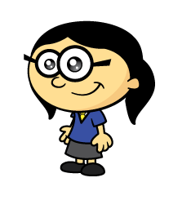
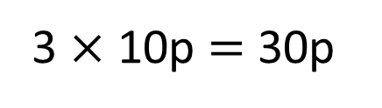
How much money is there?
30p
5
10
15
20
25
30
10p
10p
10p
3 $×$ 10p $=$ 30p
I will count in 5s
I will make 10s

Slide 13

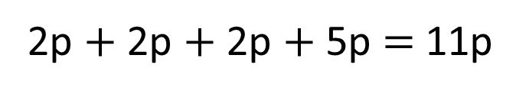
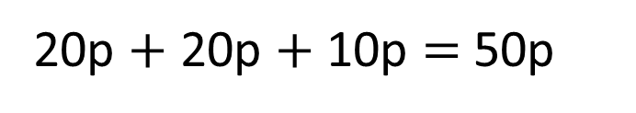
How much money is there?
61p
2p $+$ 2p $+$ 2p $+$ 5p $=$ 11p
20p $+$ 20p $+$ 10p $=$ 50p
50p $+$ 11p $=$ 61p
Have a think

Slide 14
Have a go at questions
1 - 4 on the worksheet

Slide 15
I have more money
I have more money
Have a think
Who is correct?

Slide 16
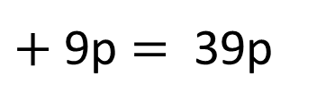
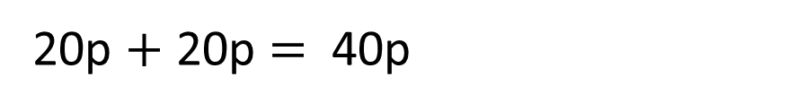
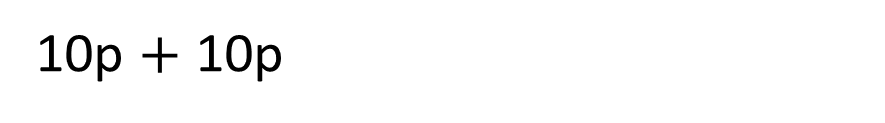
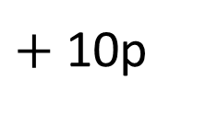
$+$ 10p
$+$ 9p $=$ 39p
10p $+$ 10p
20p $+$ 20p $=$ 40p
Annie has more coins
Eva’s coins have a greater value.
Eva has more money than Annie.

Slide 17


15p 12p 20p 60p
Have a think
I can make each amount using exactly 3 coins
I can make each amount using exactly 2 coins

Slide 18
Have a go at the rest of the questions on the worksheet

