Slide 1
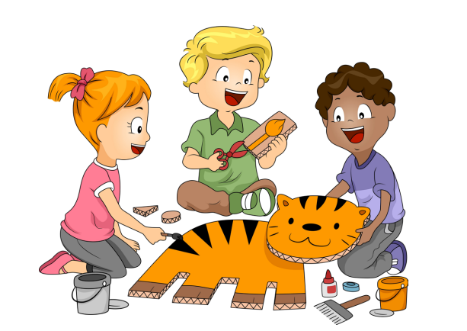
FINE MOTOR FRIDAY
Fine motor skills involve small muscles working with the brain and nervous system to control movements in areas such as the hands, fingers, lips, tongue and eyes.

Slide 2
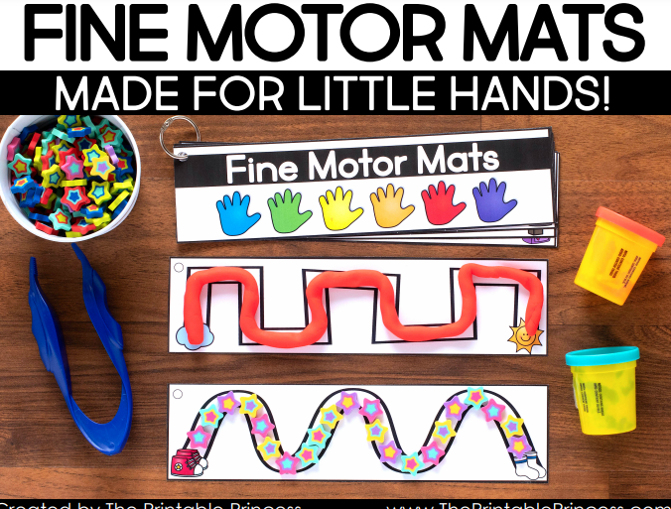
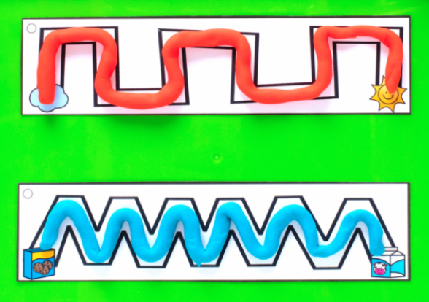
FOLLOW THE PATTERNS WITH PLAY-DOH
https://www.theprintableprincess.com/free-fine-motor-activities/

Slide 3
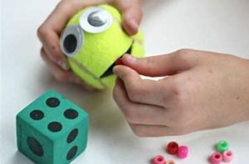
FEED THE TENNIS BALL
You need to feed the hungry tennis ball monster with coins or beads.

Slide 4
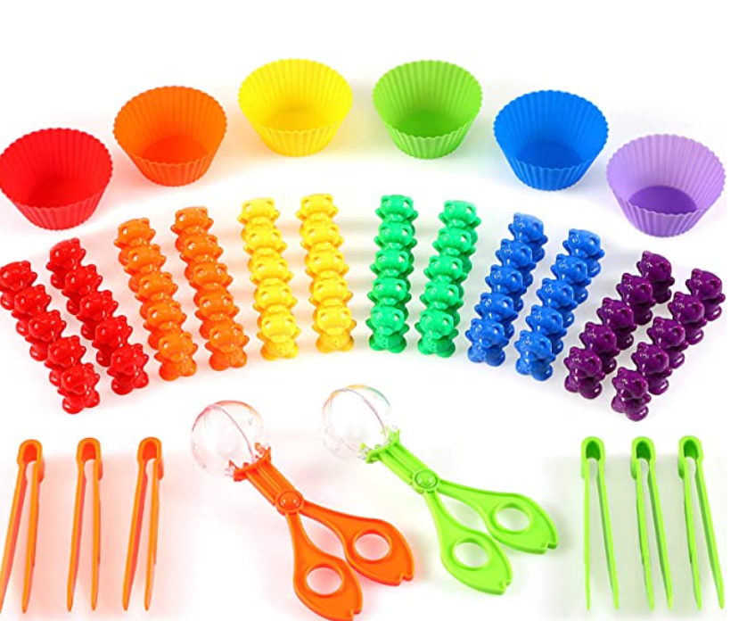
USING ONLY TWEEZERS SORT OBJECTS INTO COLOURS

Slide 5
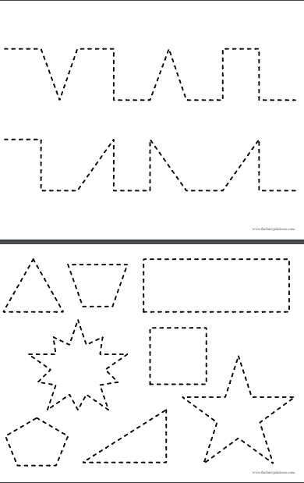
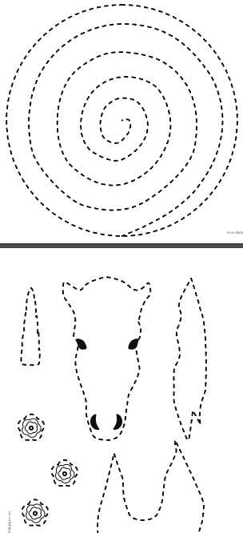
CUTTING TEMPLATES
file://binfieldschool.local/HOME-DRIVES/STAFF/sophie.george/Downloads/New-Cutting-Practice-Set-The-Fairy-Printsess.pdf

Slide 6
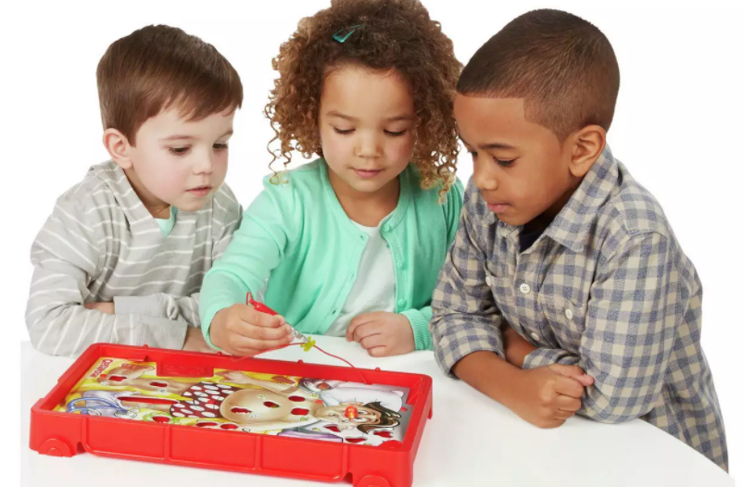
PLAY OPERATION

