Slide 1

FINAL SPELLING BEE PRACTISE
Use any method you like to learn your spellings.
How are you going to remember the different homophones?

Slide 2

Let’s Warm Up

Slide 3
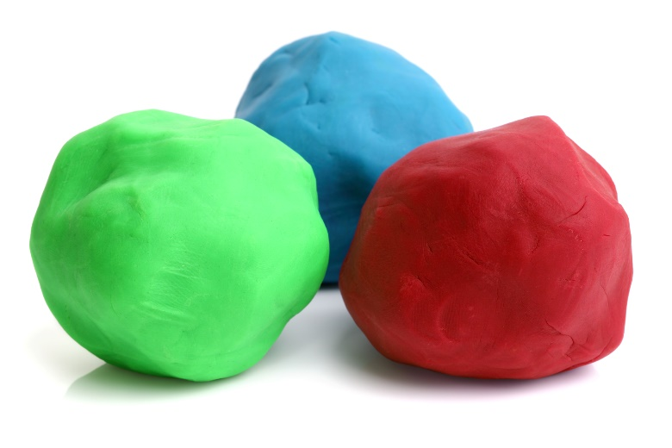
Dough Disco
https://youtu.be/i-IfzeG1aC4
Grand Old Duke of York | Nursery Rhymes | Dough Disco - Bing video
Dough dance/finger gym routine | Down in the Jungle | Nursery rhyme with playdough - Bing video

Slide 4
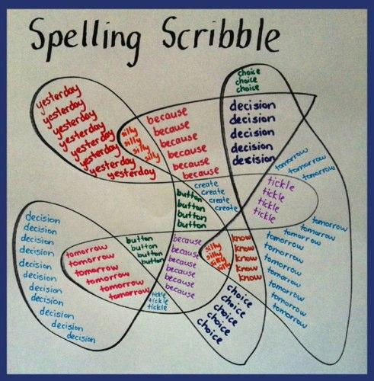
Spelling Ideas

Slide 5
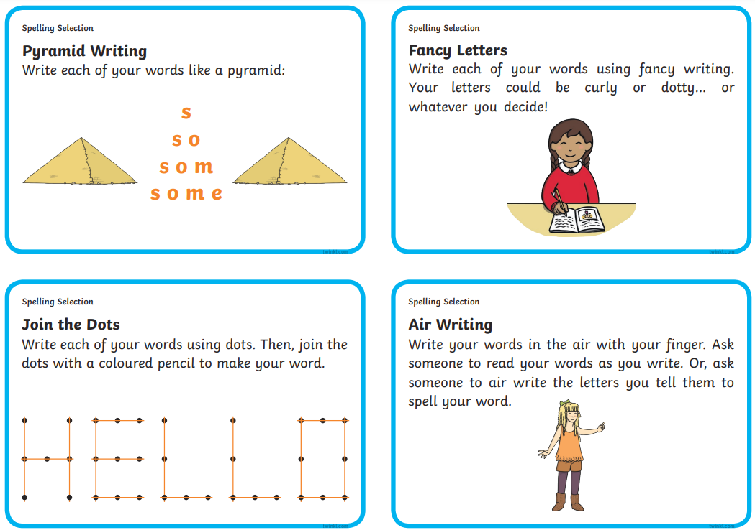

Slide 6
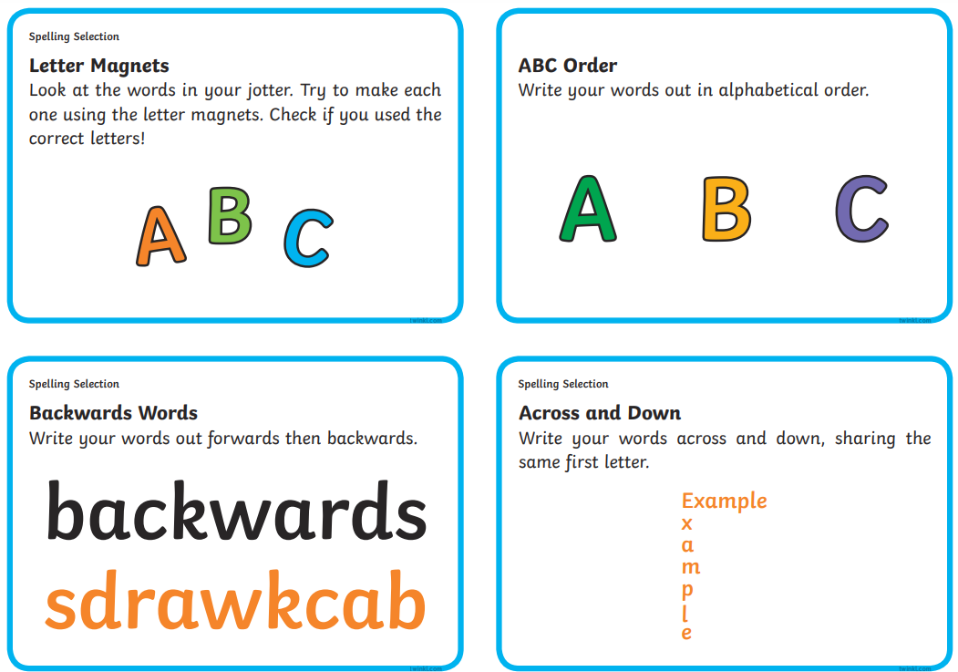

Slide 7
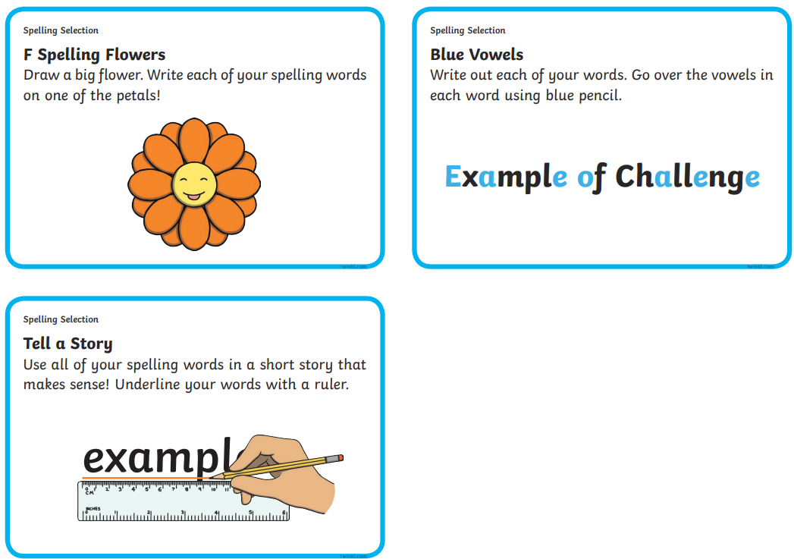

Slide 8
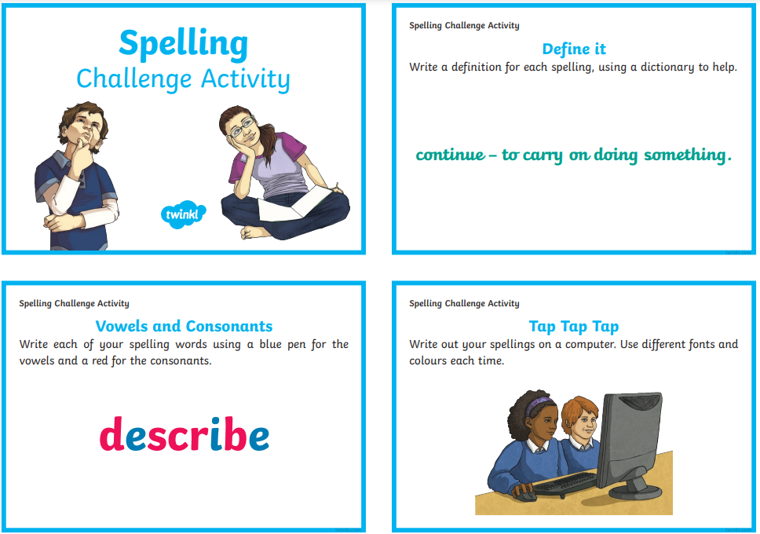

Slide 9


