Slide 1

Let’s Get Ready for Writing!

Slide 2
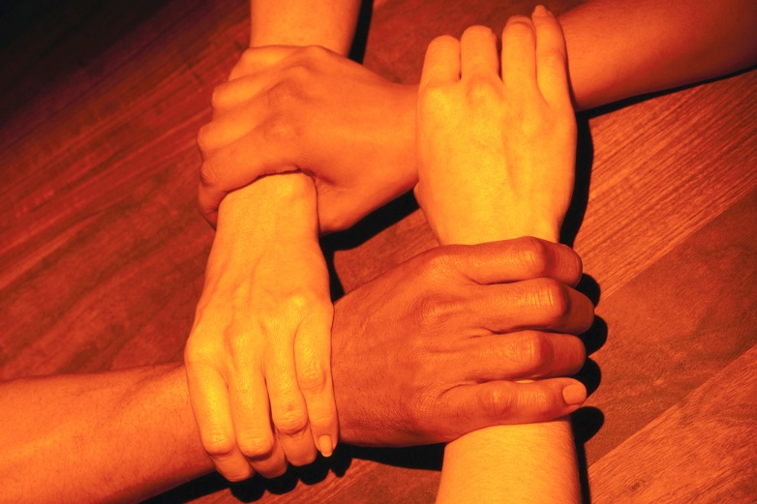
Hand Wake Ups

Slide 3
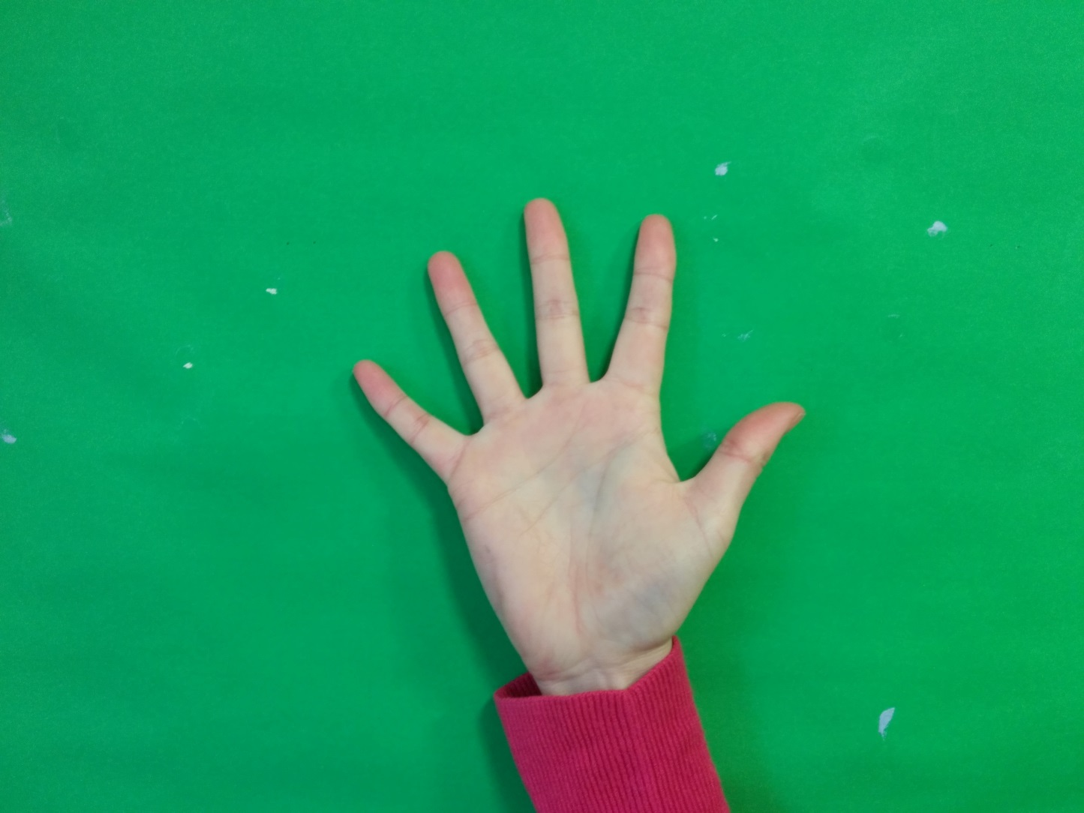
1. Make stars with both hands

Slide 4
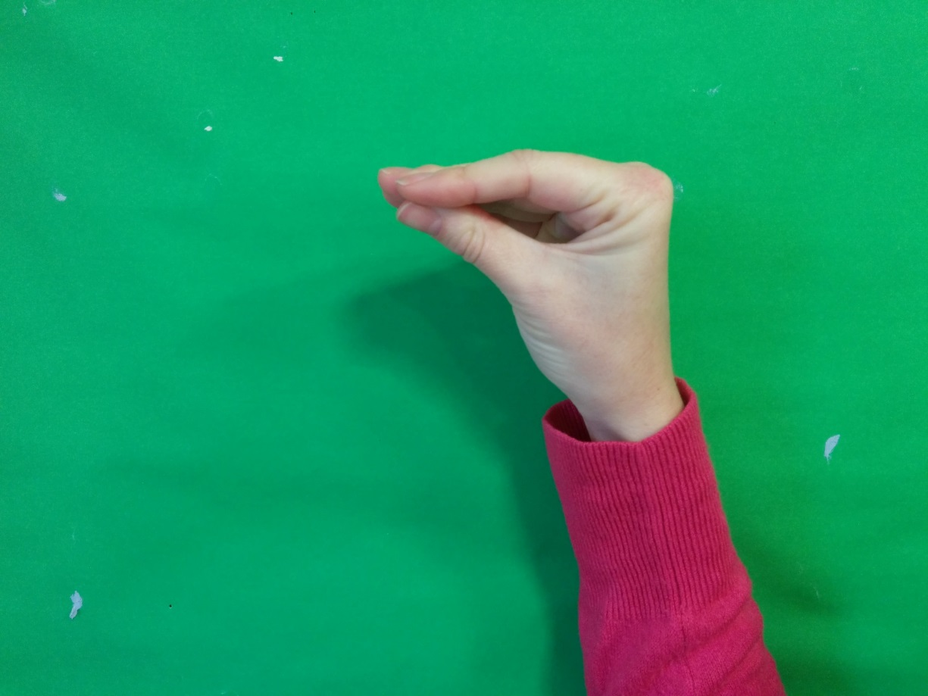
2. Make ‘duck beaks’ with both hands

Slide 5
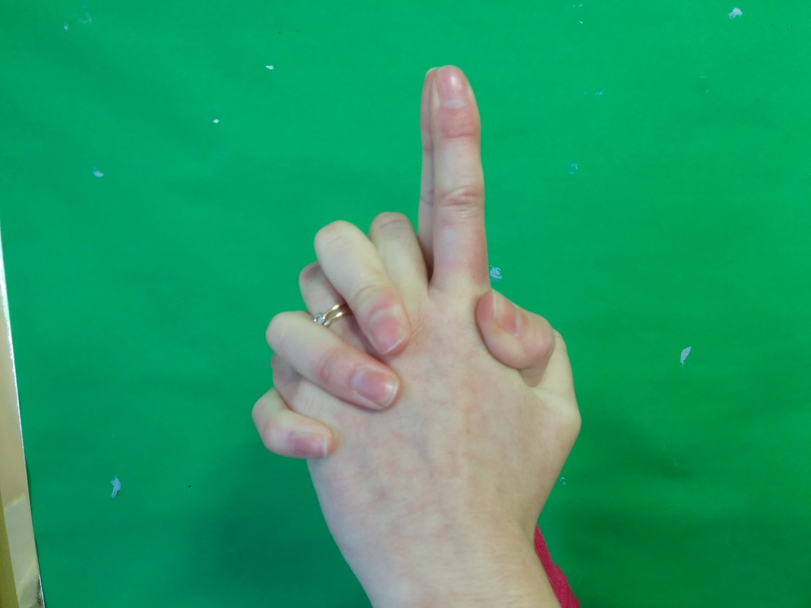
3. Weave fingers together and extend index fingers, pushing them together.

Slide 6
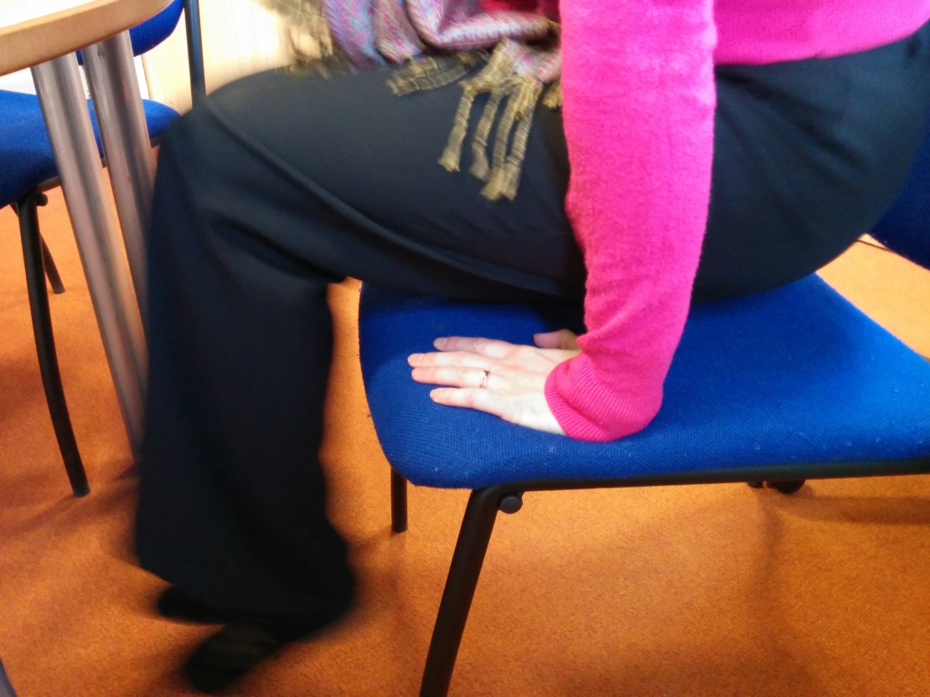
4. Sit on your hands, palms down and lift yourself off of the chair/floor. Repeat 10 times.

Slide 7
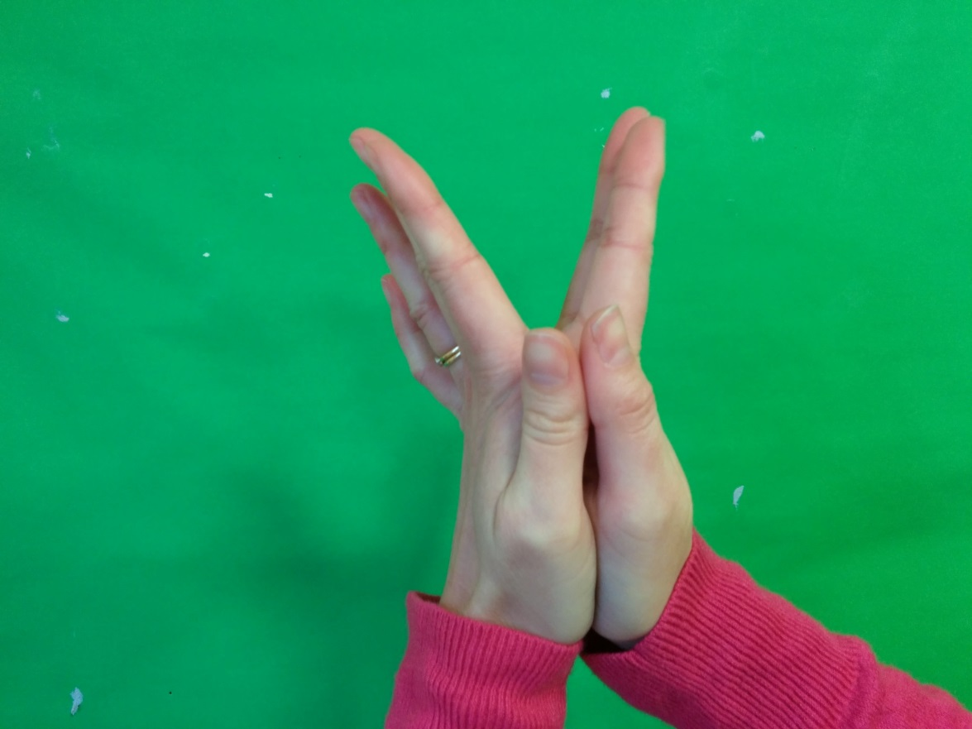
5. Put your palms together and open and close your fingers

Slide 8
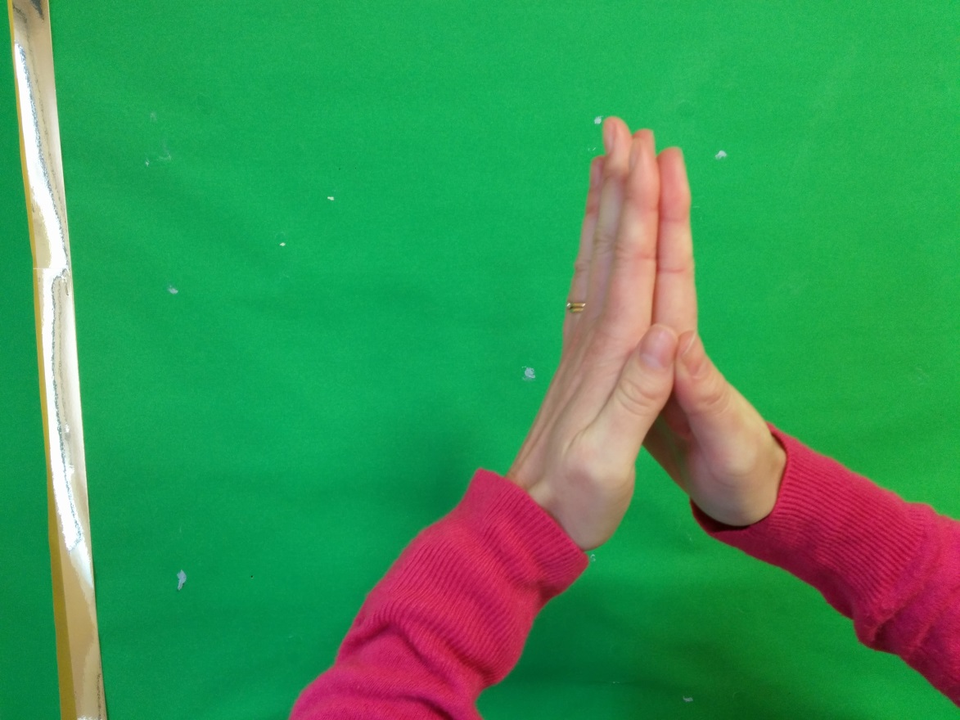
6. Put your palms together, push your fingers together and move your wrists apart.

Slide 9
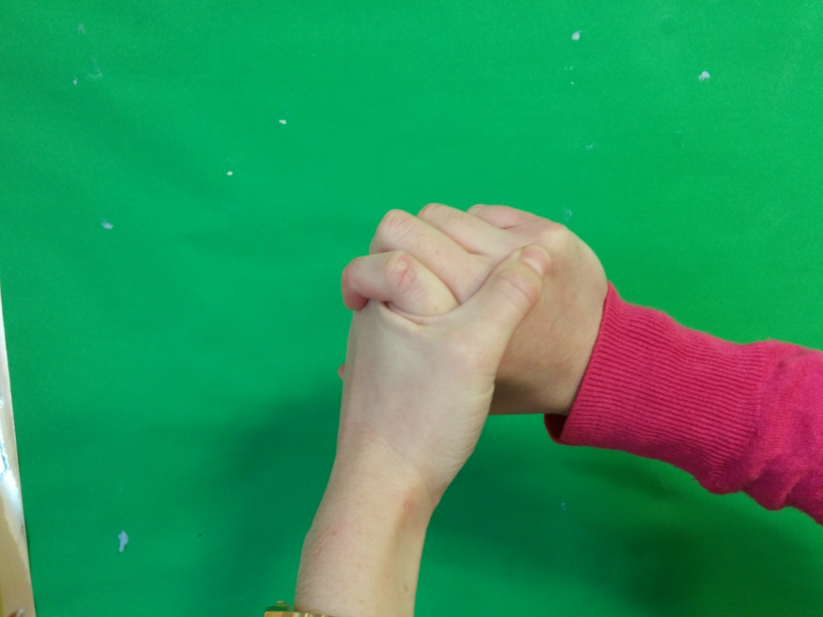
7. Wring your hands

Slide 10
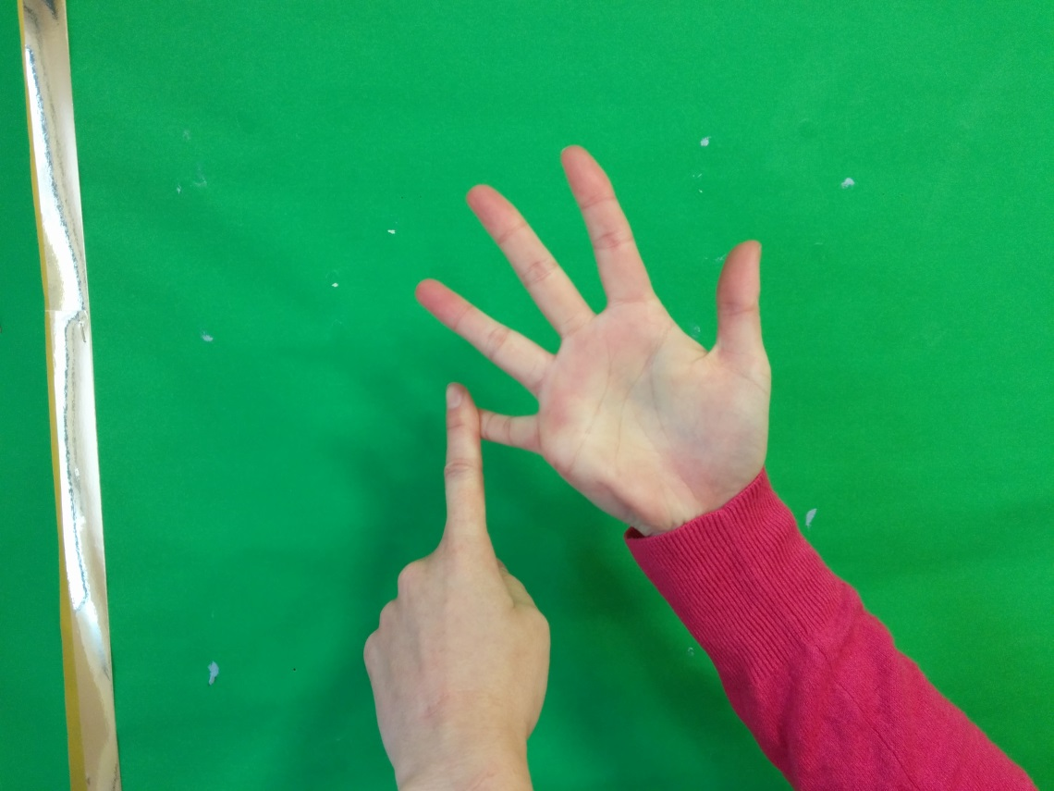
8. Count from 1-5 and point at your fingers using your index finger on the other hand.

Slide 11
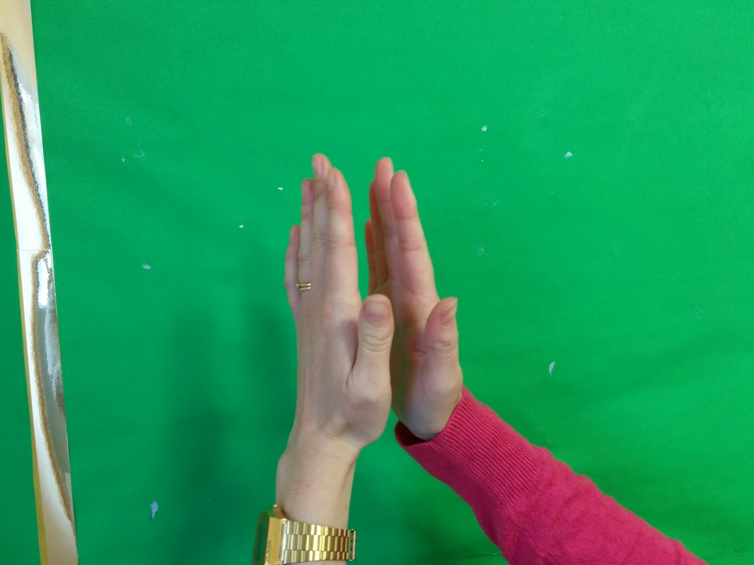
9. Clap quietly, getting louder and louder.

Slide 12

Play-Doh Disco

Slide 13
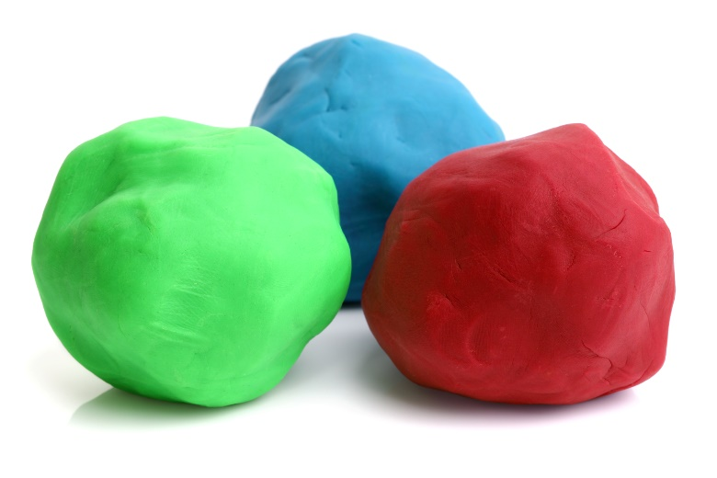
Dough Disco
https://youtu.be/i-IfzeG1aC4
Grand Old Duke of York | Nursery Rhymes | Dough Disco - Bing video
Dough dance/finger gym routine | Down in the Jungle | Nursery rhyme with playdough - Bing video

Slide 14
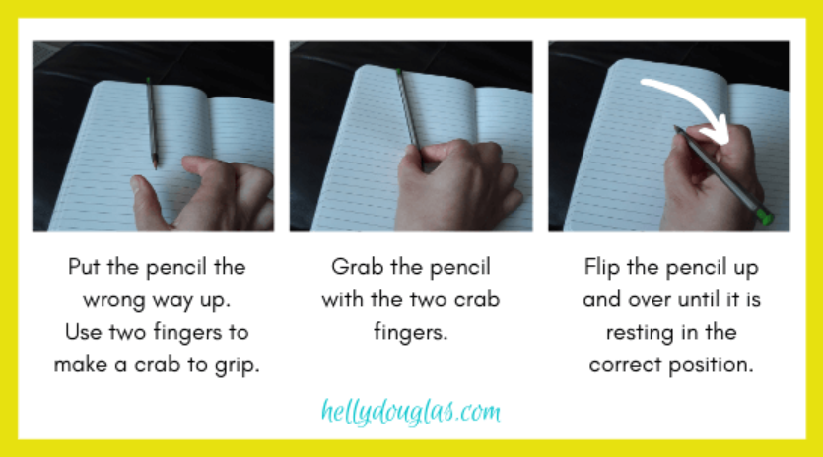
How should we hold our pencil?

Slide 15
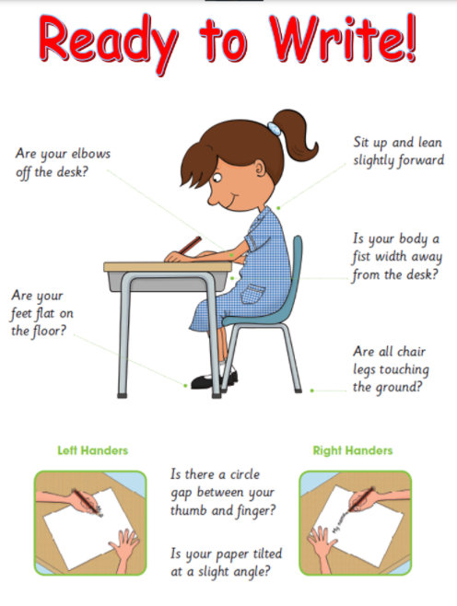
How should we sit
when writing?

Slide 16
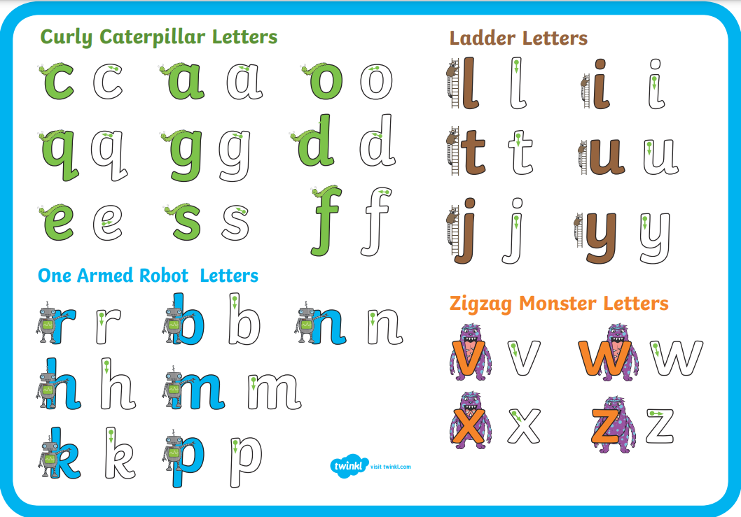
Which letter group are we learning today?

Slide 17
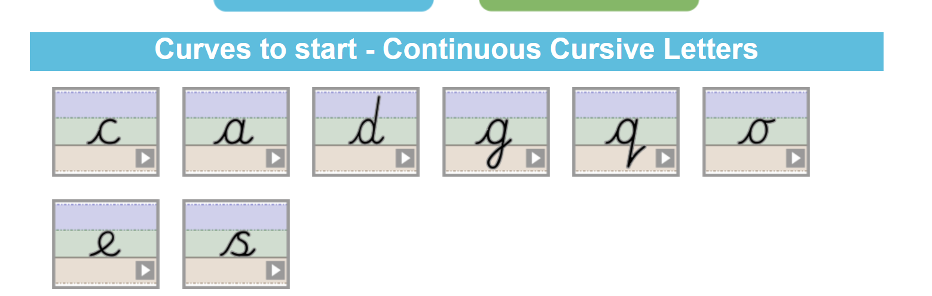
https://teachhandwriting.co.uk/continuous-cursive-refiners-choice-3.html

Slide 18
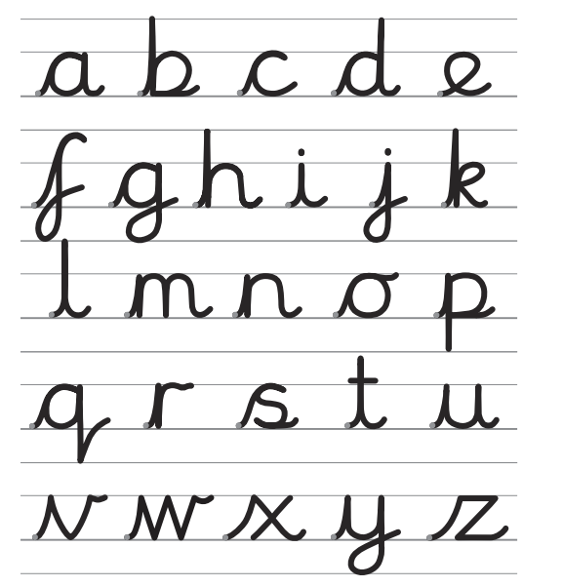
Can you write your Spelling Bee words in your best cursive handwriting?

