Slide 1
Tuesday 22nd February 2022
LO: To spell correctly
C: Words, Words, Words!

Slide 2

Starter
Can you remember what this word means?

Slide 3

On Friday, we have a Spelling Bee competition with the other class.

Slide 4
The 10 spellings we are going to be tested on are. . .
our
there
were
wear
their
we’re
are
they’re
immediately
where

Slide 5
Here are two of our spellings.
Can you write them in shaving foam or in mud with a stick?
people
immediately
Can you find a way to remember the spellings?

Slide 6

THERE
THEIR
THEY’RE
What’s the difference?

Slide 7
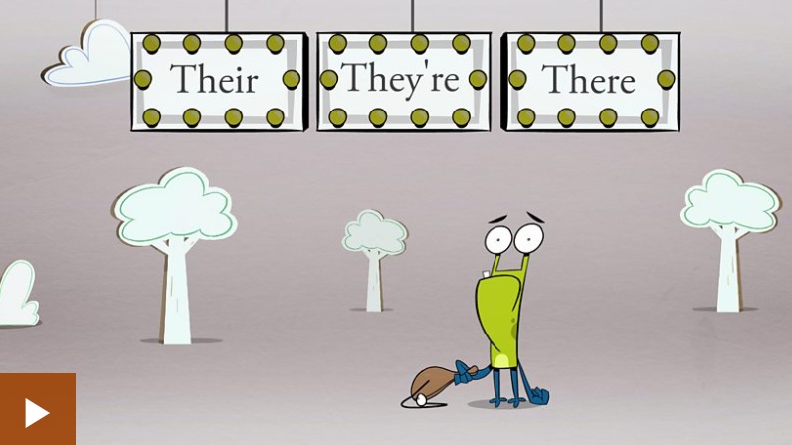
https://www.bbc.co.uk/bitesize/topics/zqhpk2p/articles/z3cxrwx

Slide 8
Write the correct word in the shaving foam
The teacher told them to leave . .. books on the desk.
their
We will go to McDonalds if. .. is time.
there
They’re
. .. baking a cake for Grandma.
.... is a nice restaurant near to where . . . standing.
There
they’re

Slide 9
OUR
ARE
What’s the difference?

Slide 10
Are or Our?
Be careful not to confuse these two high-frequency words...
‘are’
is a present tense form of the irregular verb ‘to be’.
‘our’
is a possessive determiner (which are sometimes called possessive adjectives).

Slide 11
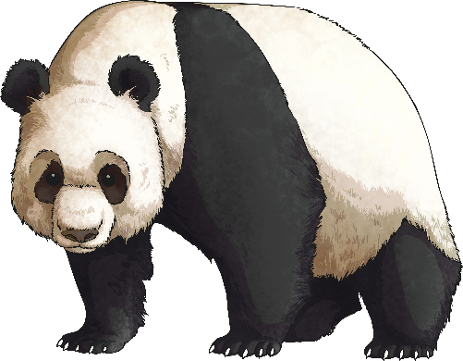
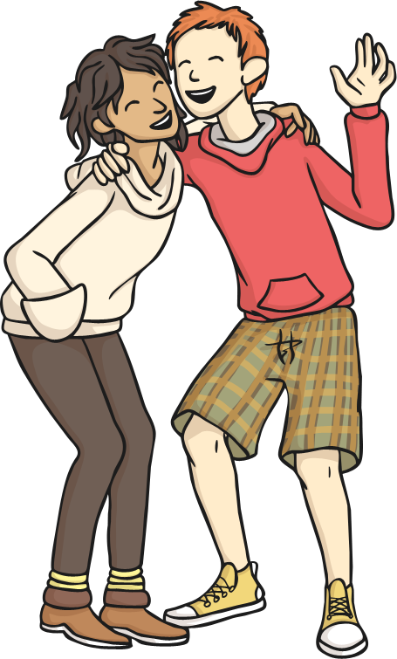
Using ‘are’
can be used as the main verb in a sentence where it would be placed before a noun or noun phrase.
‘are’
Giant Pandas are endangered animals.
We are best friends.

Slide 12
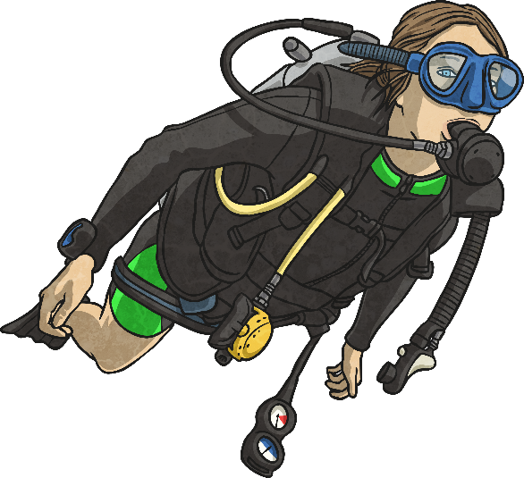
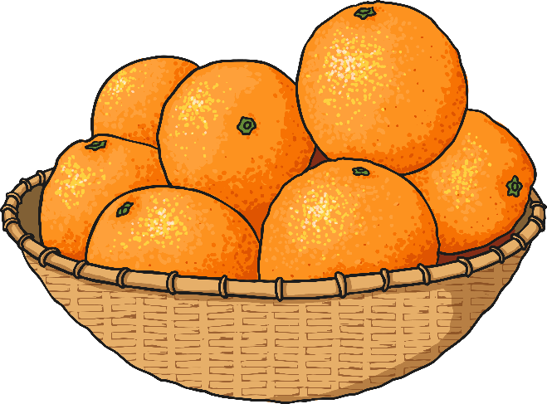
Using ‘are’
can also be used as an auxiliary (helper) verb in a sentence where it would be placed before another verb.
‘are’
The divers are swimming underwater.
Oranges are growing on the tree.

Slide 13
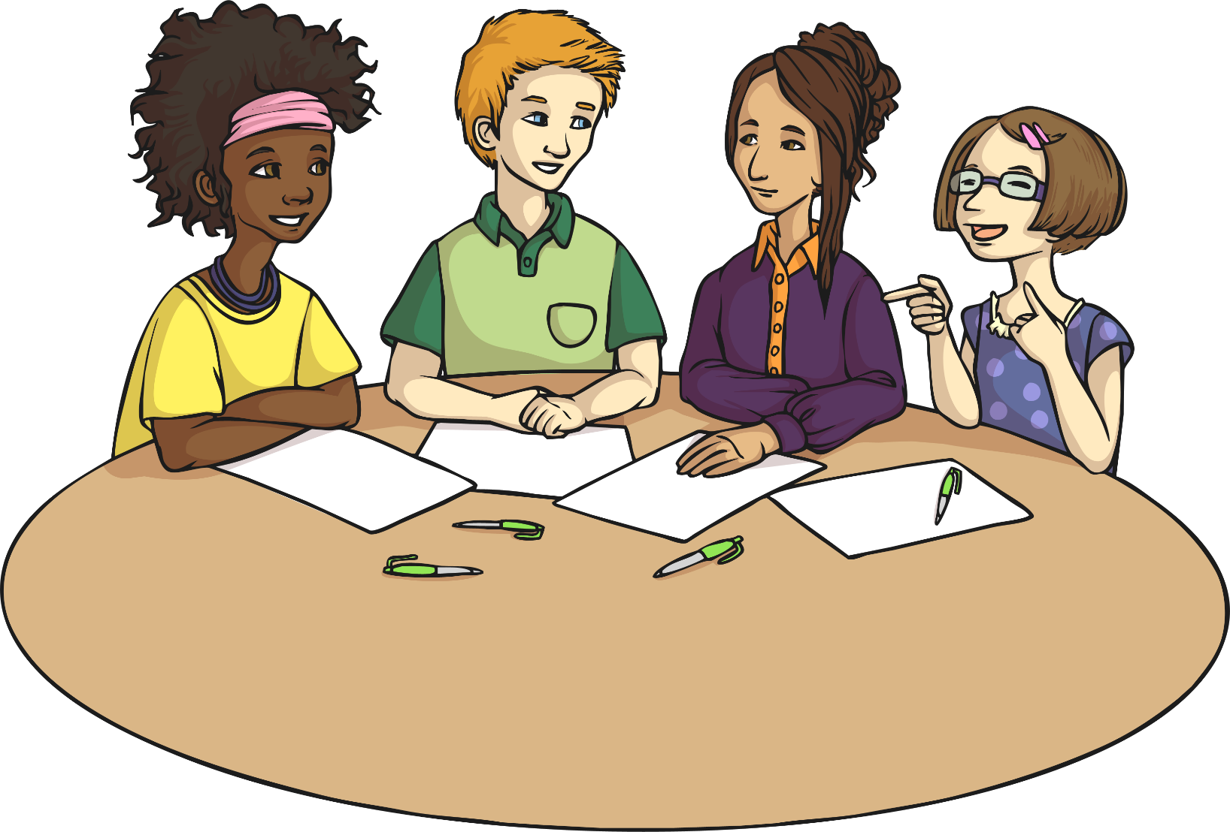
Using ‘are’
‘are’
can also be used to form a question.
Are you coming out to play?
Are we nearly there yet?
Are aliens real?
Are there any biscuits left?

Slide 14
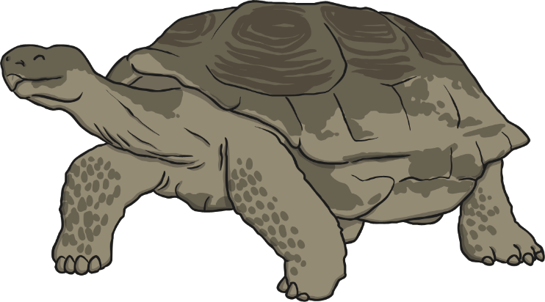
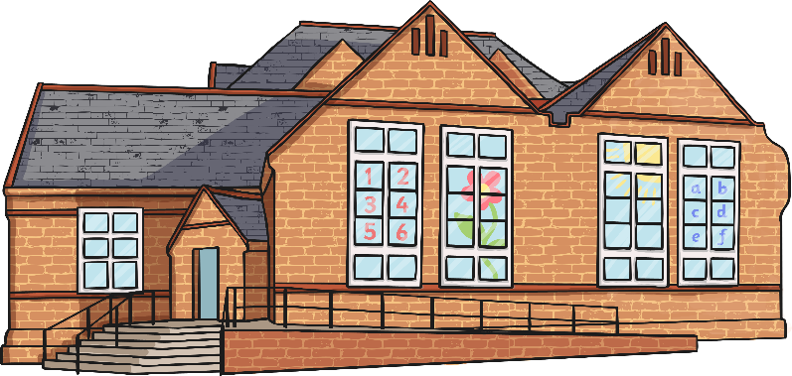
Using ‘our’
is a possessive determiner that goes before a noun or noun phrase to show the ownership of something.
‘our’
Our pet tortoise is called Speedy.
This is our school –
Greenfield Primary.

Slide 15
Write the correct word in the shaving foam

Slide 16
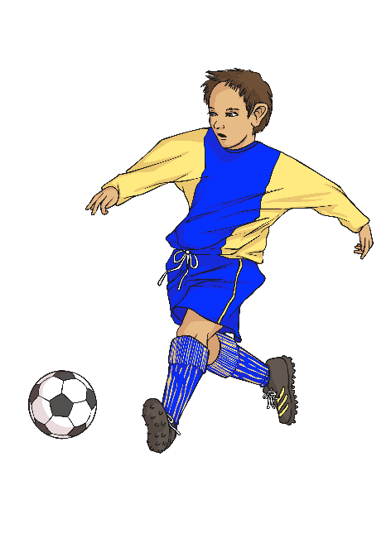
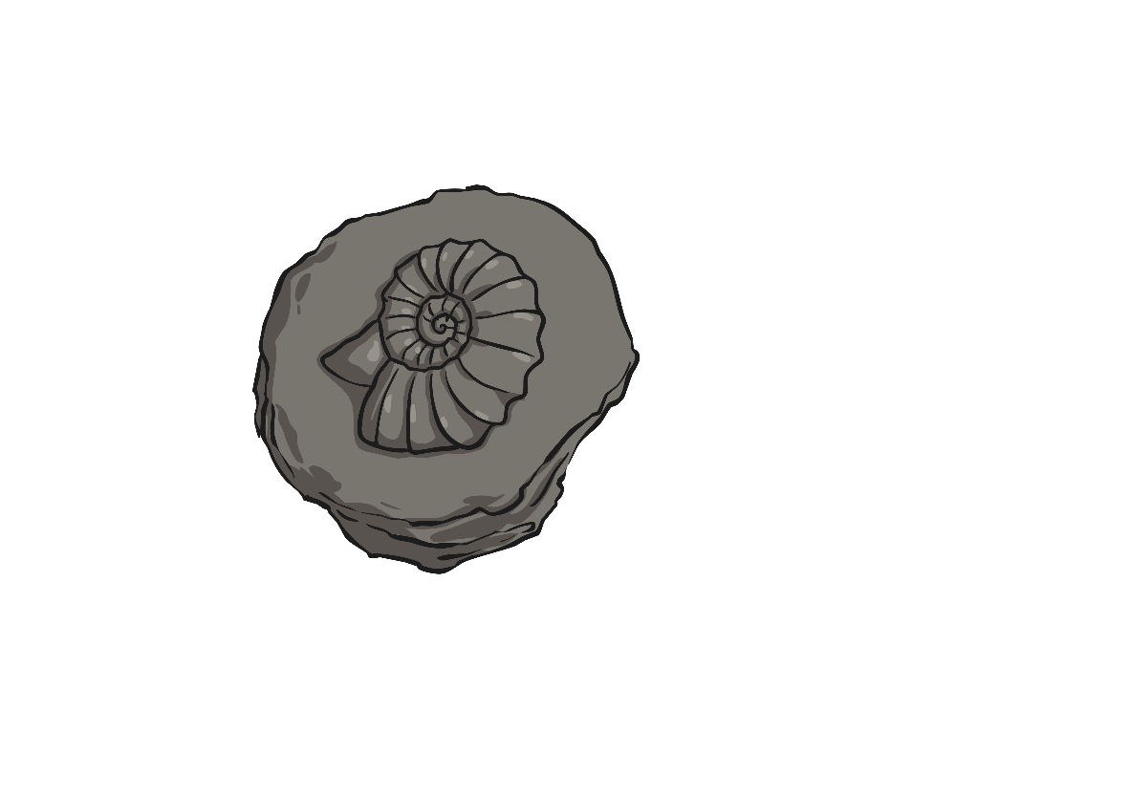
Now it’s your turn… ‘are’ or ‘our’
____ new football kit has yellow and blue stripes.
Our
Fossils ____ often found under rocks.
are
Rebecca and Thomas ____ cleaning their table.
are

Slide 17
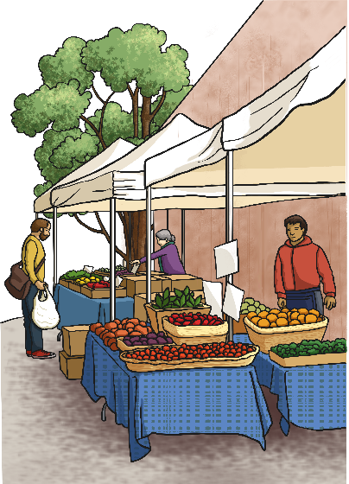
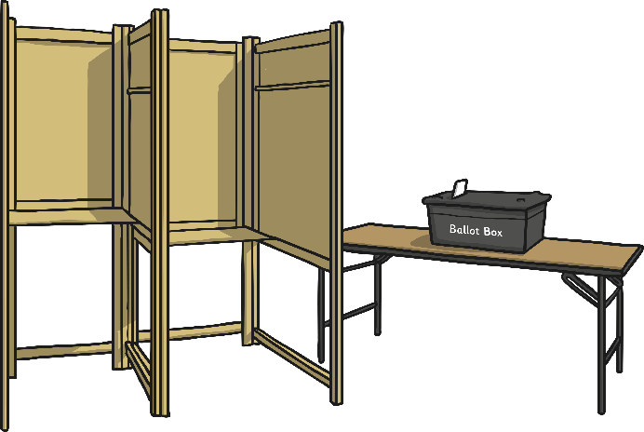
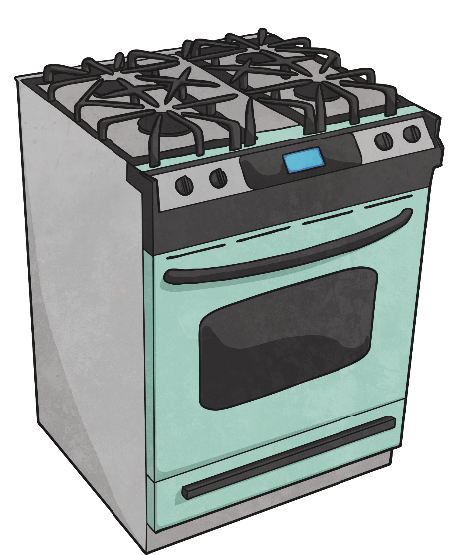
This is ____ local market, which sells fruit and vegetables.
our
____ you going to vote in the election?
Are
____ buns ____ baking in the oven.
Our
are

Slide 18
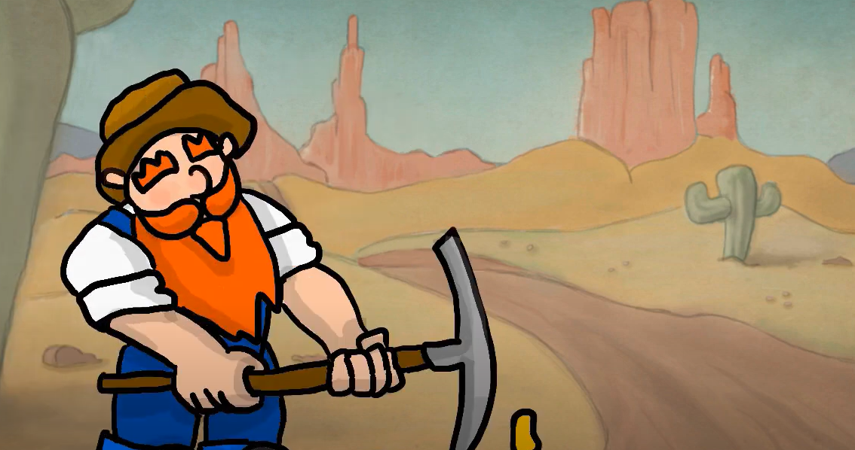
WERE
WE’RE
WEAR
WHERE
https://www.youtube.com/watch?v=EFs7agY--Ps

Slide 19
Write the correct word in the shaving foam

Slide 20
Simon: Are you ready to go?
Josie: . . . . . . . . . are we going? I need to know so that I can choose what to . . . . . . .
Simon: . . . . . . going out, that’s all you need to know. Just . . . . . something comfortable.
Josie: Like what?
Simon: I don’t know, like what you . . . . . .wearing last weekend. What did you . . . . . then?
Josie: Just jeans and a t-shirt.
Where
wear
We’re
wear
were
wear

