Slide 1

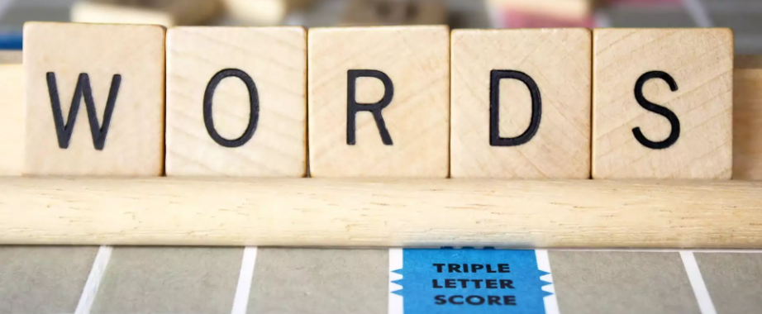

Slide 2
Monday 21st February 2022
LO: To spell correctly
C: Words, Words, Words!

Slide 3


Our WOW word of the week is...

Slide 4
INCREDULOUS
What could this word mean?
Have you heard it before?
What can we do if we are unsure of a word?

Slide 5


Slide 6
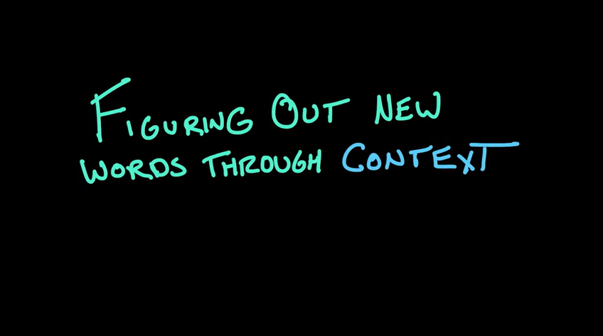
nference
efinition
xample
ntonym
https://www.youtube.com/watch?v=CiNggzdWkIo
ynonym

Slide 7
Using IDEAS, can you work out what incredulous means?
Lisa gave me an incredulous smile when I began telling her about my journey to space last night. However, the more I described, the more she began to believe that I was telling the truth.

Slide 8

Did you work out what is means?
feeling or showing an inability to believe something

Slide 9
Task
Task 1 - learn the spelling
Task 2 - write the word in a sentence
Task 3 - write your own definition for the word
Task 4 - write some synonyms for the word
Task 5 - write some antonyms for the word

