Slide 1

Friday 11th June 2021
LO: To use sentences appropriately
C: Opening
MY
STORY

Slide 2
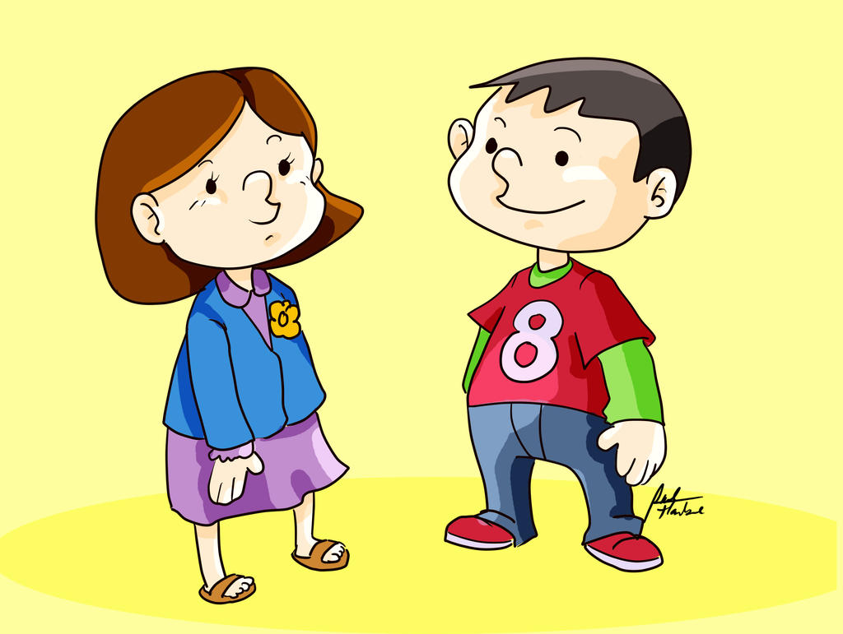
Starter
Let’s edit yesterday’s work

Slide 3
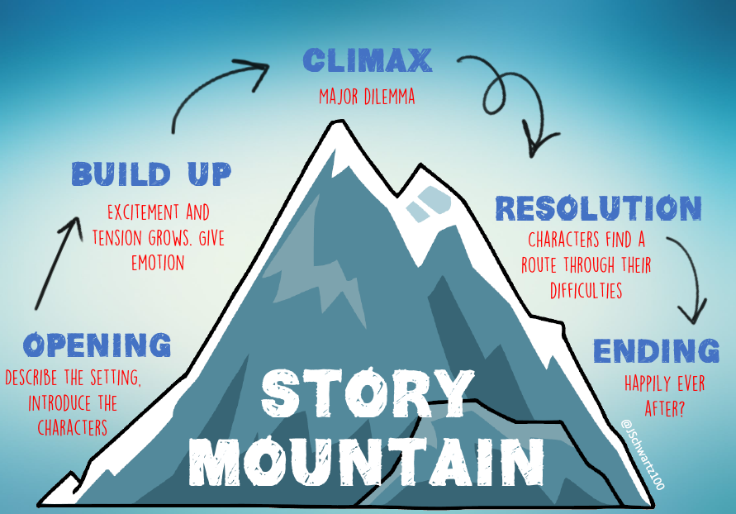
Today we are focusing on…

Slide 4
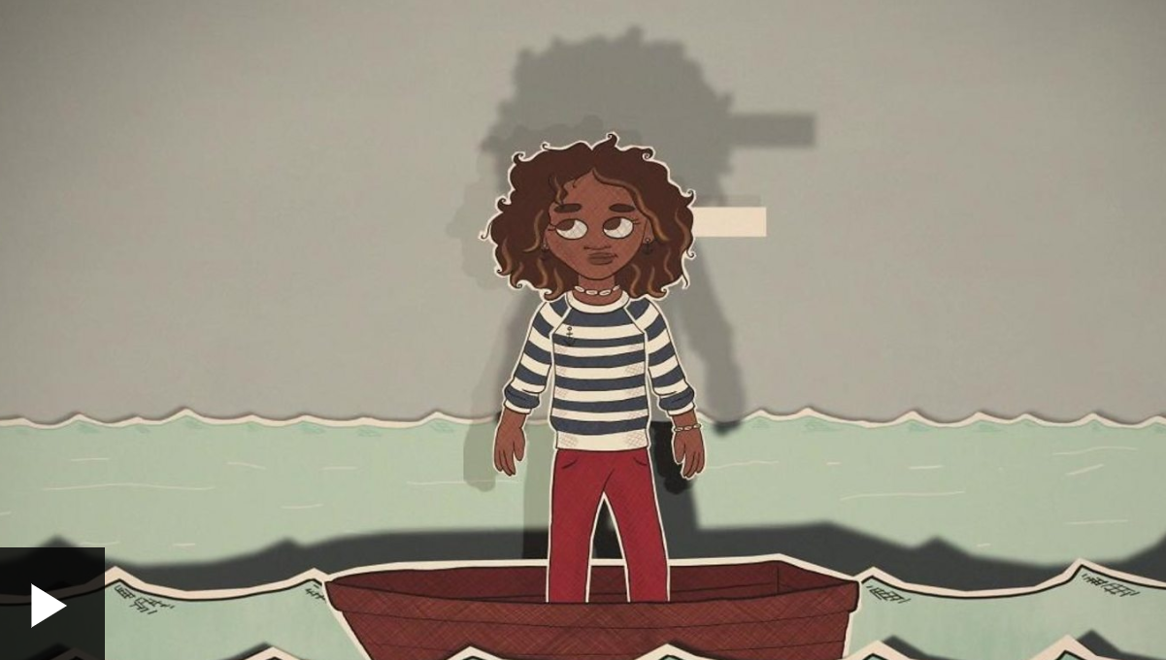
Let’s write the description of our setting.
https://www.bbc.co.uk/bitesize/topics/zkgcwmn/articles/zfh6vk7

Slide 5
Guided Write - Setting
I had been in this woods a few times with my Mum and Dad, but never on my own. Exploring on my own made me feel really grown up and it meant I would not have my parents telling me off climbing trees, jumping streams or building dens!
After what felt like a short time, but was actually several hours of exploring, I decided to head home. I was tired and hungry. As I looked around to get my bearing, a shiver ran down my spine, the glorious sunshine was gone and had been replaced by dark, heavy clouds.
Help me finish this…

Slide 6
Time to write your own!

